Slide 1

Grain Belt Express Clean Line
Clean Energy. Delivered.

Slide 2
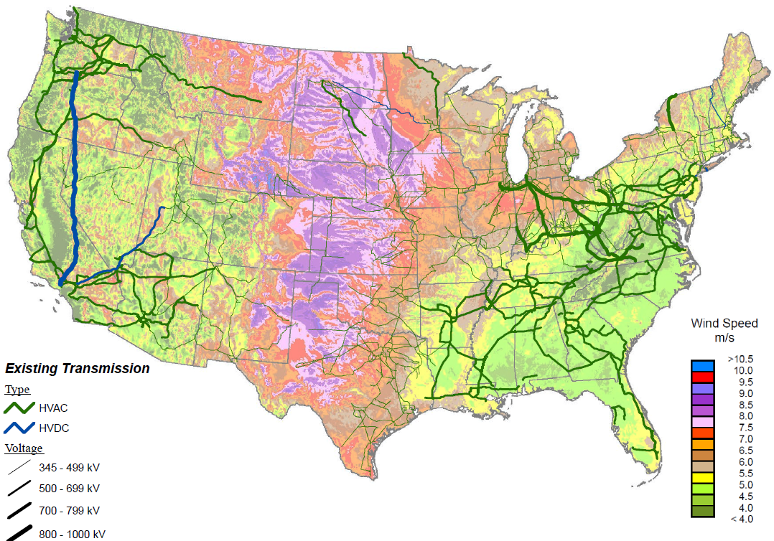










Clean Line’s projects connect the lowest-cost wind resources to major demand centers
Clean Line projects

Slide 3
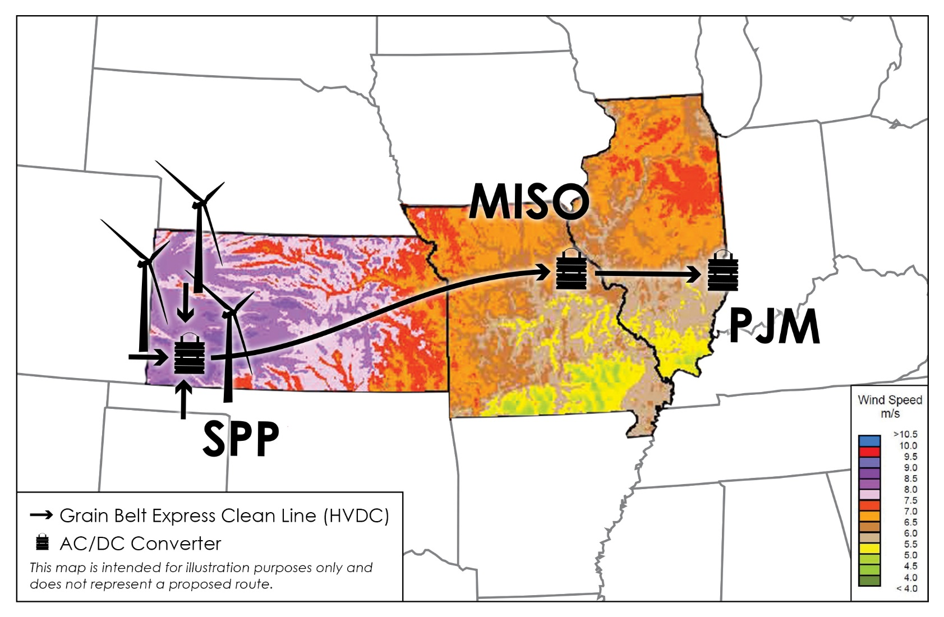
Every year Grain Belt Express will deliver to Missouri enough low-cost, wind power for 200,000 homes
Clean Line is studying an interconnection to Ameren’s transmission line system on the Maywood-Montgomery 345 kV transmission line in Ralls County

Slide 4
Wind energy delivered by Grain Belt could account for up to 12% of Missouri’s 2030 carbon reduction target ¹
Mass-based annual CO₂ emissions reductions for Missouri ²
million tons
CO₂ emissions reductions contemplated in proposed Clean Power Plan
Imported renewables can be counted towards Clean Power Plan compliance
The final Clean Power Plan rule clarifies that the state that drives investment in a renewable resource can take credit for that resource, regardless of the location of the renewable facilities
Additionally, a renewable resource does not need to be located in a state for the state to receive credit under the Clean Energy Incentive Program
CO₂ emissions reductions from Grain Belt
1.2 mm tons = gas
2.7 mm tons = coal
1 Assumes energy delivered by Grain Belt Express displaces coal
2 EPA Clean Power Plan. Note: Mass-based CO₂ emission reductions based on EPA emissions rates and generation assumptions for 2012 and 2030 targets for existing affected sources for each state. Grain Belt Express displacements are calculated using the average coal and gas emission rates for PJM states as defined in the EPA Clean Power Plan and assume a 60% utilization rate of the Grain Belt Express line

Slide 5
Missouri’s renewable energy standard is driving demand for wind energy prior to CPP interim goals
Missouri’s Renewable Energy Standard rises to 15% of energy consumption in 2021¹
Missouri’s investor-owned utilities will need to procure approximately 5-6 million MWh per year of additional renewable electricity to meet the RES in 2021.
Wind delivered by the Grain Belt Express could account for more than ¼ of the renewable energy required by Missouri's RES.
1 EIA Detailed State Data. “Retail Sales of Electricity by State by Sector by Provider.” Available online at http://www.eia.gov/electricity/data/state/. and Missouri Public Service Commission. “Renewable Energy Standard Compliance Reports.” Available online at http://psc.mo.gov/electric/Renewable_Energy_Standard_Compliance_Reports.

Slide 6
The cost of wind will rise each year between 2016 and 2020 as the PTC is phased out
Kansas Wind Cost, based on year of utility commitment¹
$/MWh
2016 is the last year that wind development will be able to qualify for 100% of the Production Tax Credit²
Wind costs will increase between $4/MWh and $9/MWh each year as the Production Tax Credit is phased out
Kansas wind cost assumes 55% capacity factor resource, $1515/kW wind capex, and a 10-year Kansas property tax abatement
PTC value is reduced to 80% in 2017, 60% in 2018, 40% in 2019, and 0% in 2020

Slide 7
Grain Belt offers advantages over Missouri’s other options to fulfill demand for wind energy
1
Low-cost energy
No risk of congestion
2
3
Economic development

Slide 8
1
High capacity wind delivered to Missouri by Grain Belt is state’s lowest-cost renewable energy option
Cost of Energy
$/MWh
Source: Supply Side Resource Options from Ameren’s 2014 IRP
Western Kansas wind can be generated for 2-2.5 cents/kWh and transmitted via the Grain Belt Express to Missouri for approximately 1.5-2.0 cents per kWh.

Slide 9
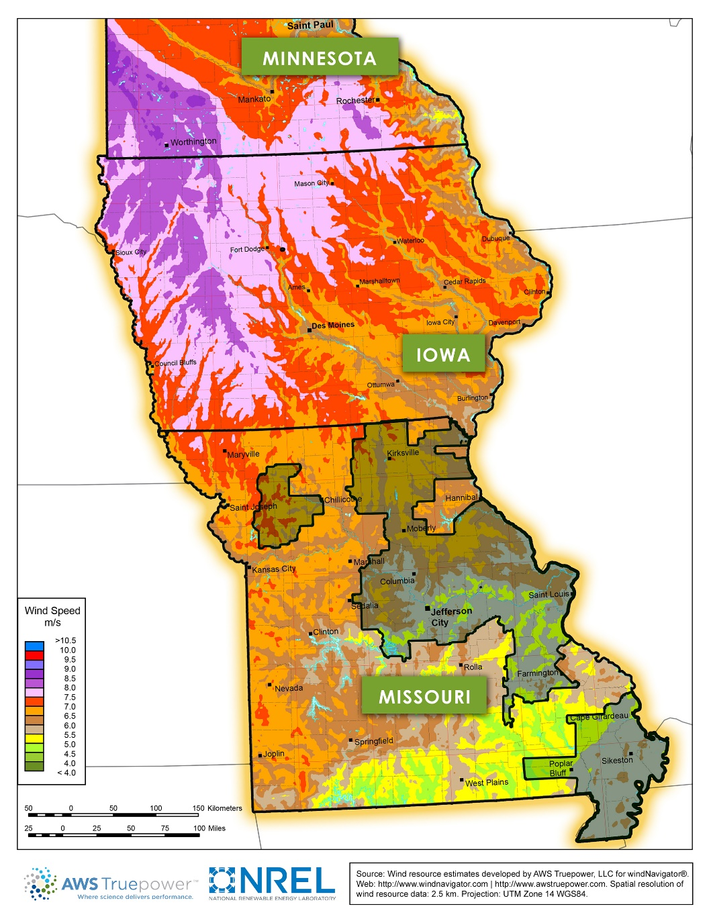
Grain Belt Express avoids congestion associated with MISO transmission
2
The best MISO wind resources are generally located in western Iowa and southern Minnesota. Wind farms situated in these windy regions see significant congestion that Missouri LSEs would ultimately bear if purchasing power from these wind farms
Building windfarms with large nameplate and in these high wind speed areas may be difficult as land and transmission constraints develop – Grain Belt can connect large amounts of high capacity factor wind to MISO Missouri with little to no congestion risk
MISO wind farms
Grain Belt converter station
Average LMP difference between Ameren Missouri and MISO wind farms¹
$/MWh
Ameren Missouri Service Territory
Average historical LMPs from 35 MISO windfarms and Ameren Missouri hub from the past 3 years (2013-2015), weighted by aggregate MISO wind

Slide 10

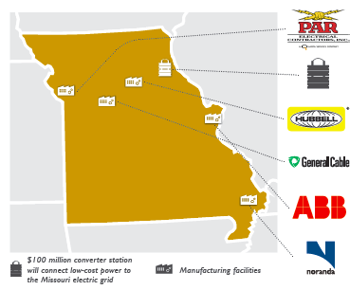
Clean Line’s $500 million infrastructure investment in Missouri will stimulate the state’s economy
3
In the first year of operation alone, Clean Line estimates that it will pay a combined $5 million to the taxing districts hosting the project.
Clean Line has preferred supplier agreements with Missouri companies
Kansas City
Will manage the construction of the project. Employs 3,000 Missourians.
Ralls County
$100MM Converter station will deliver enough energy every year for 200,000 Missouri Homes
Centralia
Manufactures insulators and hardware. Employs 600 Missourians.
Sedalia
Manufactures conductor. Employs 185 Missourians.
St. Louis
Manufactures power transformers. Employs 175 Missourians.
New Madrid
Manufactures aluminum rod and supplies to General Cable’s Sedalia facility.

Slide 11

www.grainbeltexpresscleanline.com
www.cleanlineenergy.com

