Slide 1
Empowering
Ameren Missouri Customers to Act On Energy
MEEIA Communications Plan Overview:
Integrated Campaign Launch

Slide 2
Our Strategic Approach
OBJECTIVE
Increase appetite for Ameren Missouri’s ActOnEnergy® programs
to positively influence customer behavior toward participation
STRATEGIES
EDUCATE
DEMONSTRATE
MOTIVATE
Leverage third party experts to attract interest and drive understanding of program benefits
Showcase real benefits to the customer (both business and residential)
Spur customers to action

Slide 3
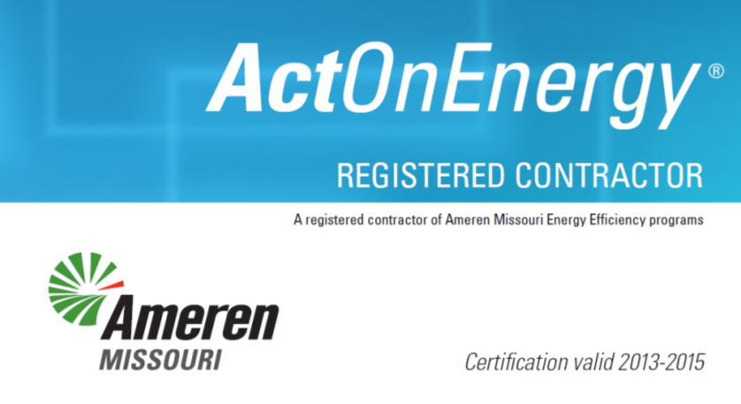
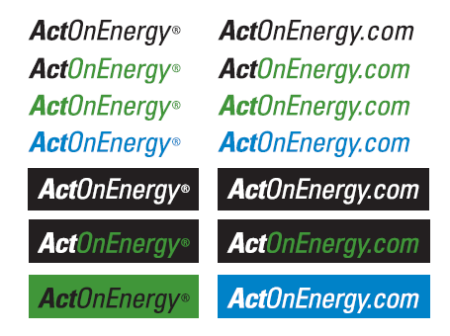

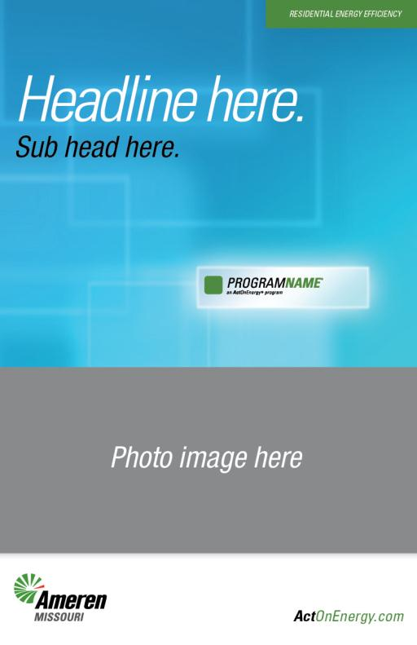









Ramping Up: Pre-Launch Activities
Developed new naming architecture for residential and business programs
Created style guide and templates for implementer marketing efforts
Conducted training sessions with implementers to provide tools for consistent use of our brand

Slide 4
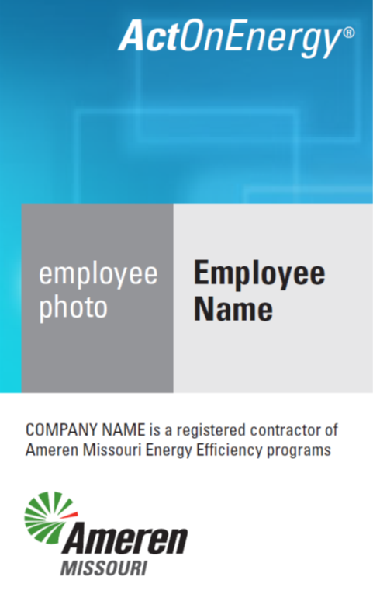

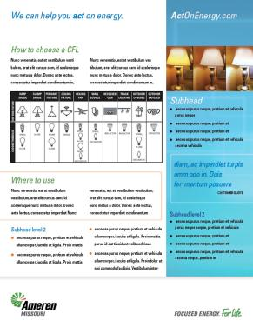
Implementer Tools and Templates
Contractor badge and vehicle magnet
Advertisement
Sample retail tearsheet

Slide 5

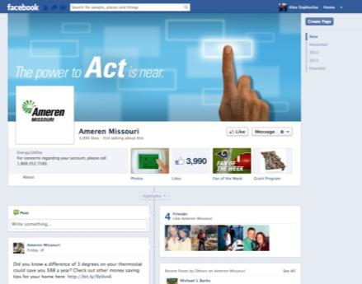
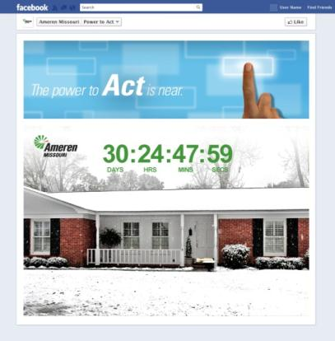
Teaser Campaign – December
BILLBOARD
Advertising – outdoor and select print in-market 12/17
Social – Facebook countdown “clock”

Slide 6
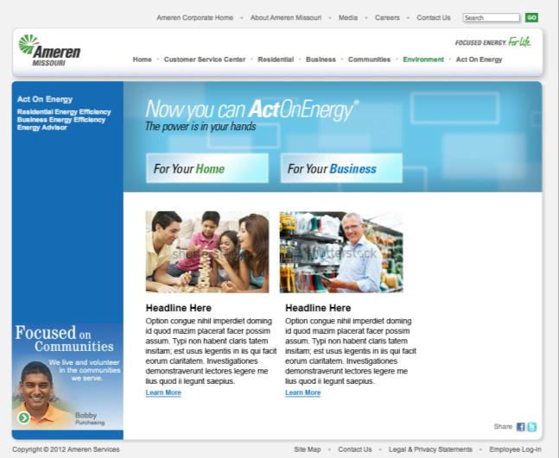
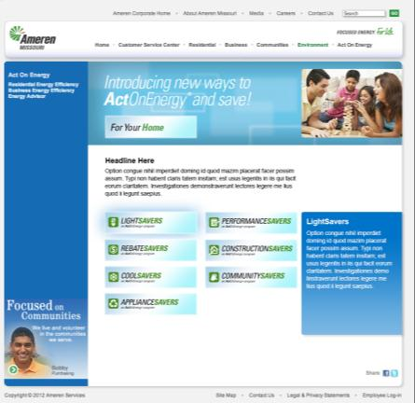
New Website – Launches Jan. 2

Slide 7

Paid Media Campaign Introduces New Program Names and Details
Fully-integrated media campaign includes:
Network and cable TV spots
Radio
Digital/mobile
Transit/outdoor
Facebook ads/sponsored stories
Select print

Slide 8


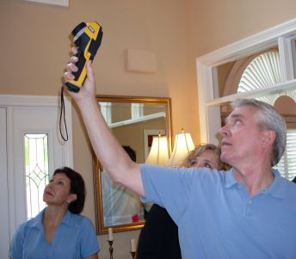



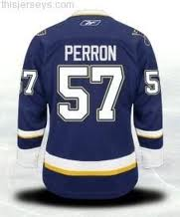




Program Launch Activations
Johnson home
Sponsored by:
St. Louis Rams and Ameren Missouri employees make “Energy House Calls” in January
Distribute CFL bulbs and ActOnEnergy information
St. Louis Blues players host Ameren Missouri “Tweet-up” to engage customers and draw media attention in February (pending NHL discussions) with ActOnEnergy giveaways
Ameren Missouri teams of “Energy House Hunters” award free home energy audits to residential customers when they spot our branded yard signs throughout the area

Slide 9

Power to Act TV Spot
30 sec. Click on image to view in YouTube

