Slide 1

Solar Solutions
Affordability. Reliability. Sustainability.

Slide 2
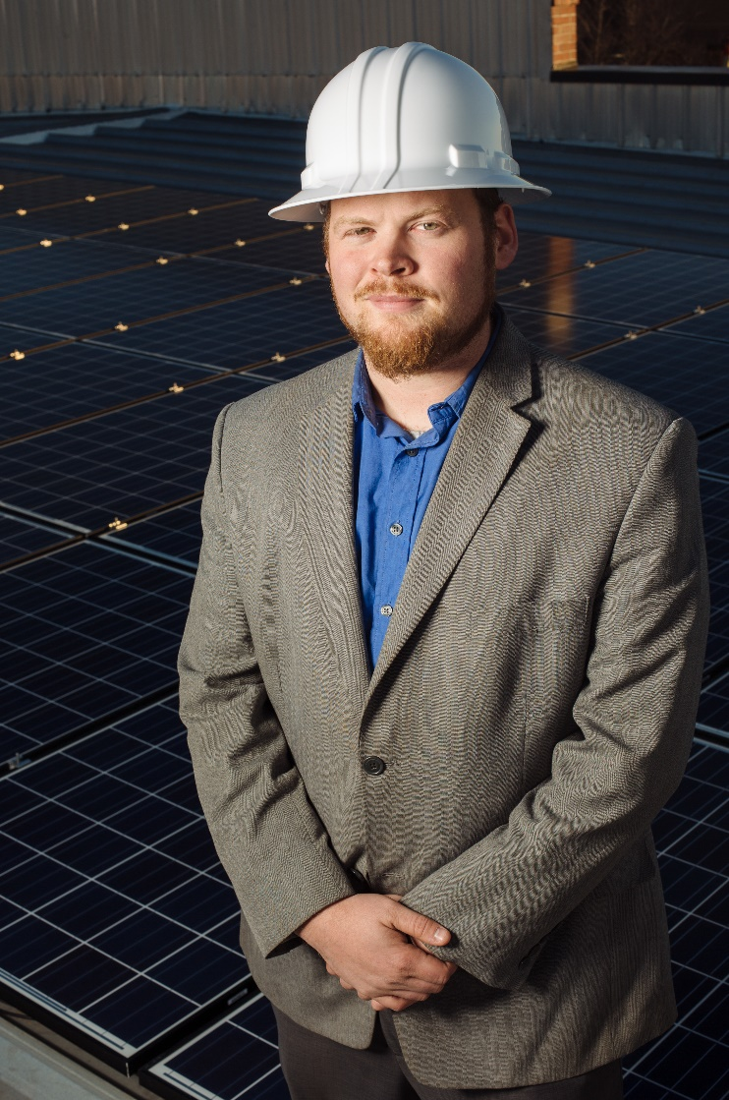
Missouri Solar Energy Industries Association (MOSEIA)
Industry trade group representing the interests of Missouri’s solar installers, distributors and manufacturers.
Our Mission: To strengthen and expand the solar industry and establish a sustainable energy future for all Missourians.
Caleb Arthur, President

Slide 3
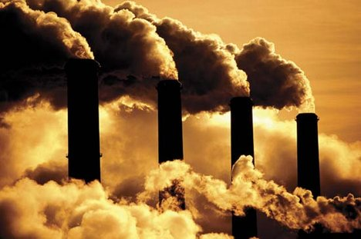
Where We Are
Missouri still mostly coal dependent
Hidden costs of coal—health and environmental issues
Renewable energy prices, especially solar, have fallen dramatically
Natural gas prices are uncertain
Fracking is banned in some states and could become more heavily regulated affecting the price of natural gas

Slide 4
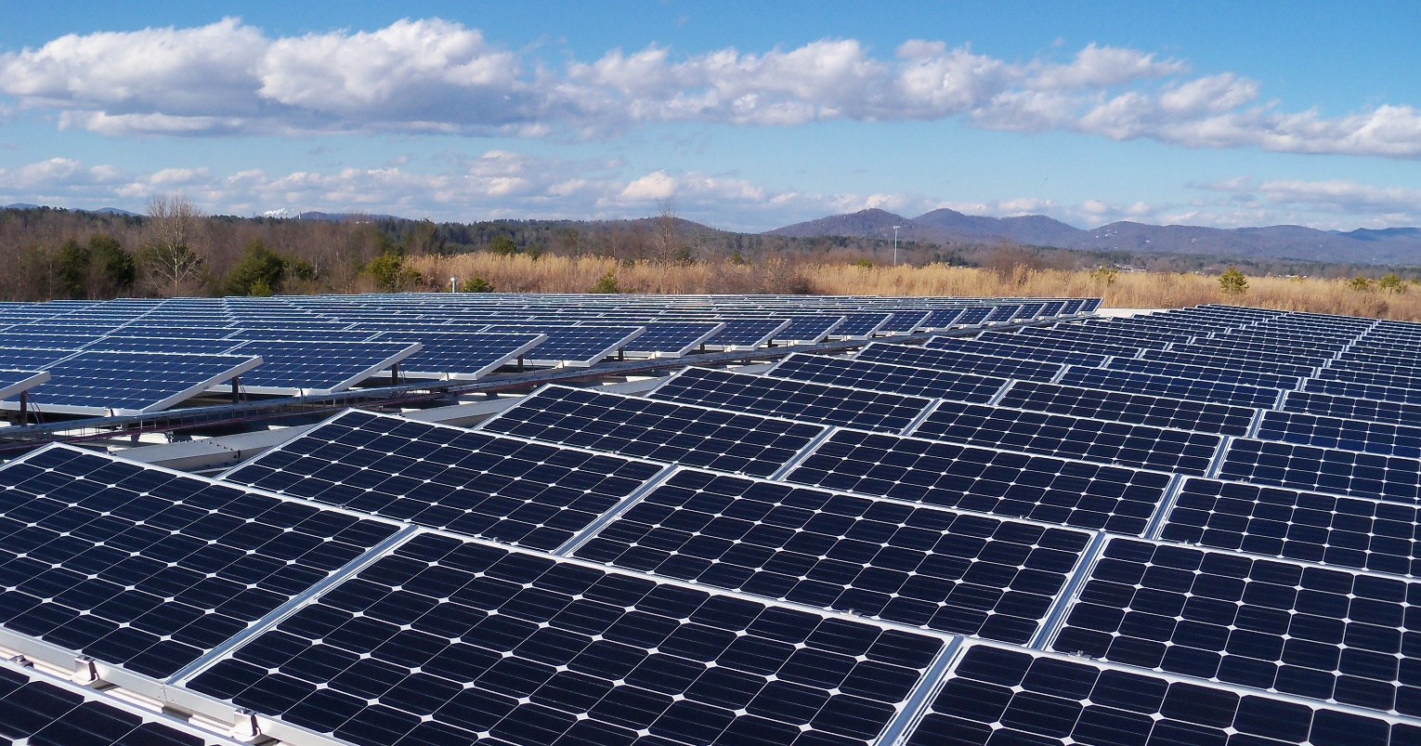
Utility Scale Solar
Has a proven track record
Saves money by avoiding ongoing fuel costs
Is reliable and clean
Has achieved or is very near grid parity with fossil fuels (levelized-cost analysis)
Is very bankable; investors like it

Slide 5


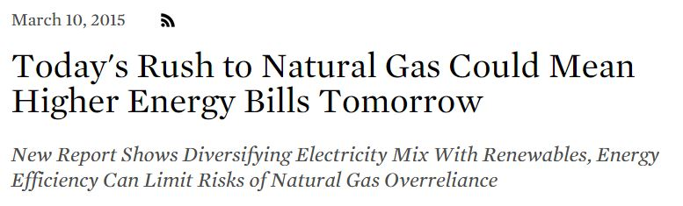
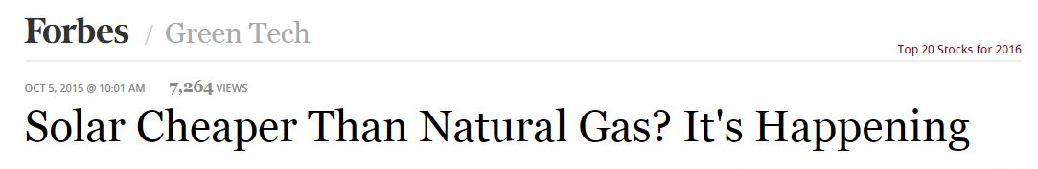
Solar vs Natural Gas: Pricing Forecast

Slide 6
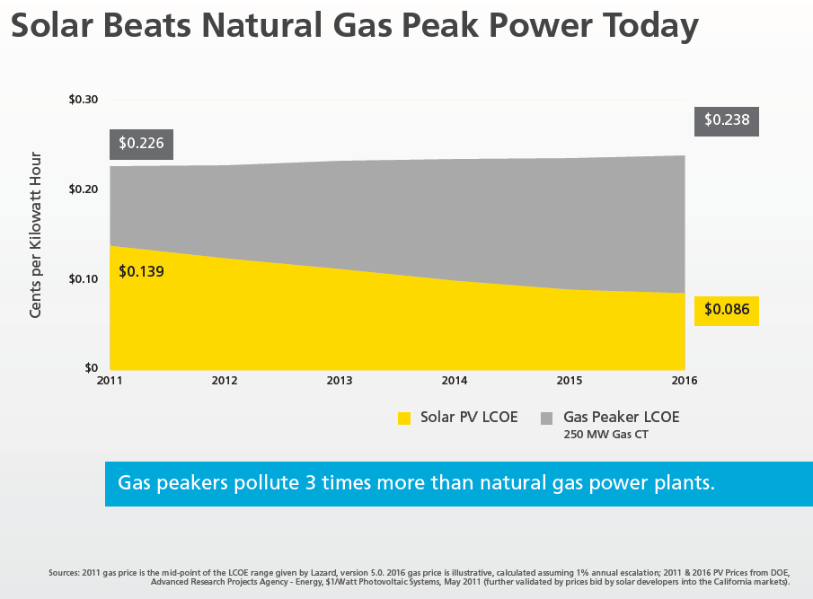
Solar Beats Natural Gas Peak Power Today

Slide 7
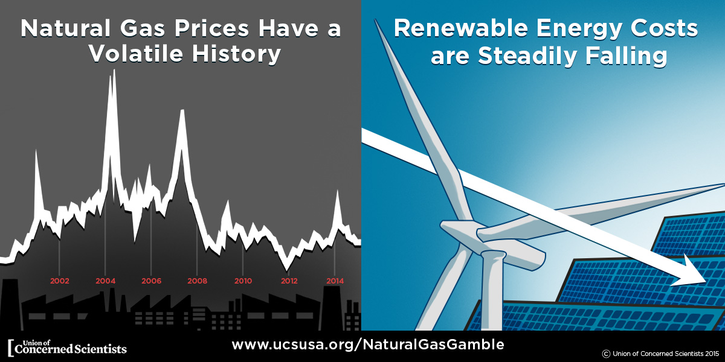

Slide 8
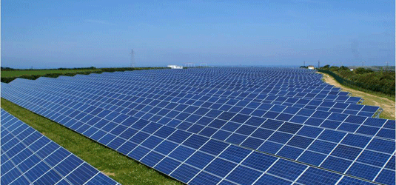
Outlook For Utility Scale Solar
Changes in state and federal environmental policy favor solar
Solar prices continue to fall
Solar technology is improving
Large-scale storage under development

Slide 9
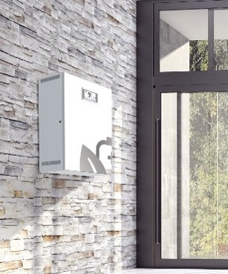
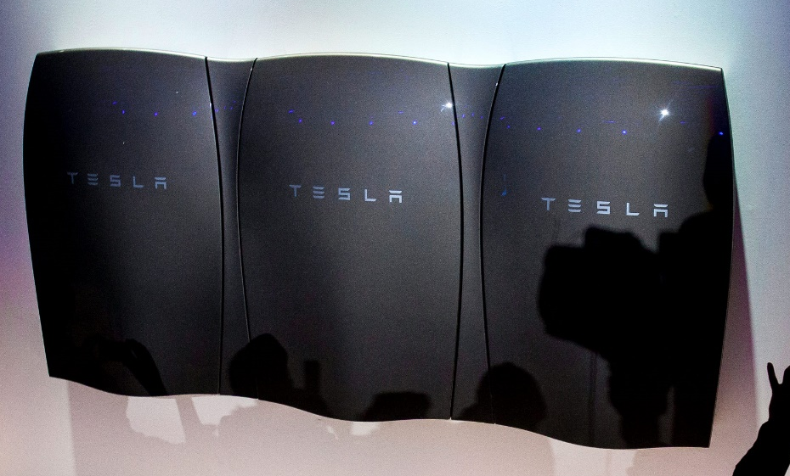
The Latest Battery Technology
Battery technology has made great progress
New Tesla Power Wall and Sonnen batteries set to replace current battery backup systems
Smaller, more affordable, longer lasting
Very reliable when coupled with solar

Slide 10
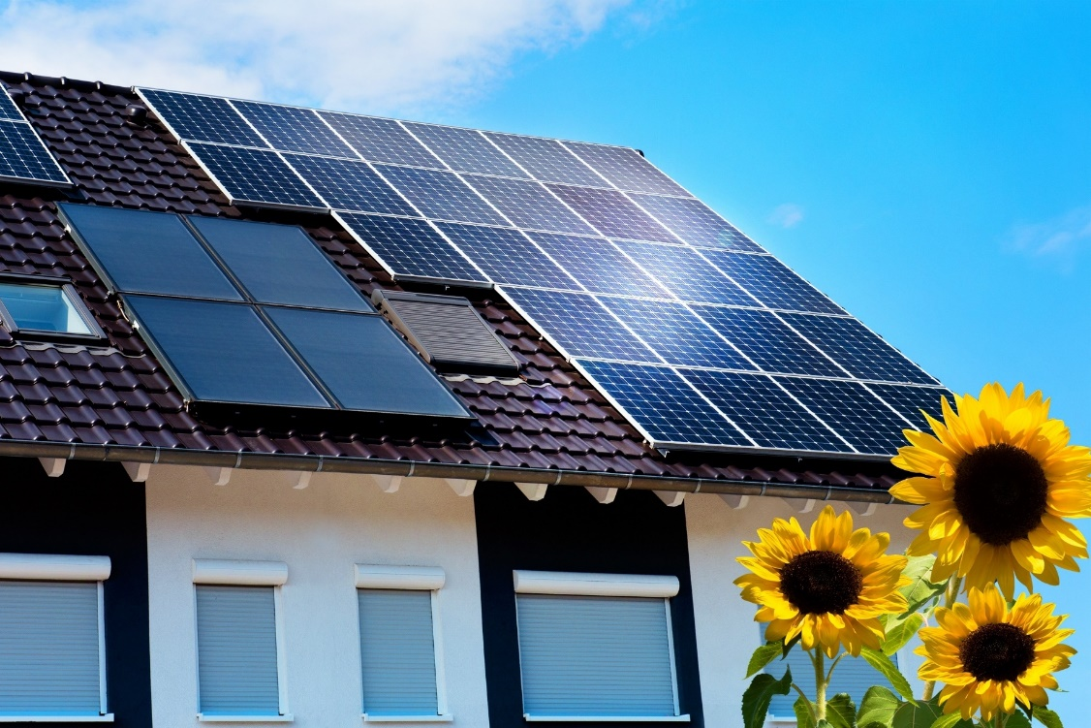
Going Off Grid
More affordable and reliable than ever
Uses new battery backups and a standby generator
New inverter technology integrates all system components seamlessly
Ensures near perfect reliability in any circumstance

