Slide 1
Workshop Presentation by The Empire District Gas Company and Liberty Utilities (Midstates Natural Gas) Corp.
PGA-2020-0222
Docket No. AO-2021-0264
Mike Beatty,
Vice President of Operations

Slide 2
Agenda
The Event
February Supply Costs
Operations
Purchased Gas Adjustment (PGA)
Communications
Questions

Slide 3
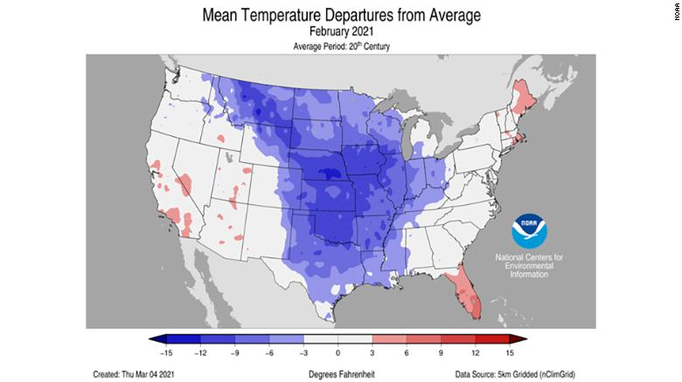
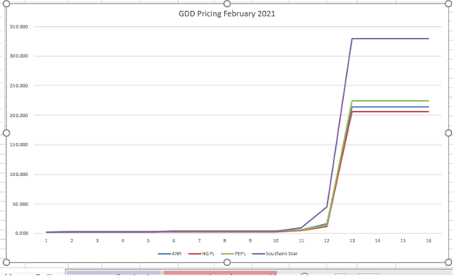
The Event
Extreme Cold
  Daily temps between -10 to -20 F
  Anomalies of -10 to -30 degrees
Prices
  Period from Feb 6 to Feb 18
    Minimum Price $2.68
    Max Price $622.78

Slide 4
February Supply Costs
LU - Midstates
$9.7 vs $2.2 in a typical Feb
$9.7 vs $21.8 typical annual costs
LU - Empire District Gas (EDG)
$35.5 vs $1.7M typical Feb
$35.5 vs $15.4 typical annual costs
We followed our purchasing procedures and ensured supply met demand on all days during the cold snap (as required by pipelines due to OFOs)
Daily purchases were necessary to supplement base supply and (maximized) storage withdrawals
Some areas also necessitated additional purchases due to marketer shortfalls
Daily gas prices reached historical highs, resulting in extremely high costs

Slide 5
Operations
Liberty is served by 7 Transmission Companies
11 operations areas serving 146 communities in 42 counties
84,880 Residential, 11,728 Commercial, 60 Industrial, 966 Transportation customers
Service and supply were maintained throughout the winter weather event.
There were some impacts to a number of transport customers due to supply issues.

Slide 6
Purchased Gas Adjustment (PGA)
Firm PGA rates under normal process would increase by approximately $0.07 per ccf for MNG and $0.90 for EDG
Recovery over multiple years

Slide 7
Communications
Customers were not required to curtail usage, but many voluntarily reduced usage and worked collaboratively with the company to monitor consumption allowing the utility to meet the needs of all customers.
Key customers and community leaders were contacted before and during the event through direct calls and email.

Slide 8
Operational Flow Orders (OFOs)
Did the gas utility issue operational flow orders (OFOs) lead to penalties to customers?
Pipeline | Notice | Start Date | End Date | Liberty Area OFO | Empire Area OFO
ANR | Phase 2 Extreme Condition | Feb 5 | Feb 6 | No | No
 | Phase 3 Extreme Condition | Feb 7 | Feb 21 | No | No
MRT | OFO | Feb 12 | Feb 19 | Yes | NA
NGPL | OFO | Feb 17 | Feb 22 | Yes | NA
Ozark | Operational Alert | Feb 17 | Feb 20 | Imbalance Warning | NA
PEPL | OFO | Feb 15 | Feb 18 | Yes | Yes
Tetco | OFO | Jan 28 | Feb 21 | NA | NA
Trunkline | None |  |  | NA | NA
Southern Star | OFO | Feb 11 | Feb 19 | NA | Yes
Did you assess Operational Flow Orders penalties to any customers for their actions during the weather event? We are not expecting any material OFO penalties.

Slide 9
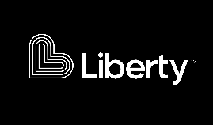
Thank you
Questions?

