Slide 1

Environmental Impacts of Electric Vehicle Charging
Noah Garcia
Natural Resources Defense Council
May 25th

Slide 2
Power Sector Snapshot
Source data: EIA

Slide 3
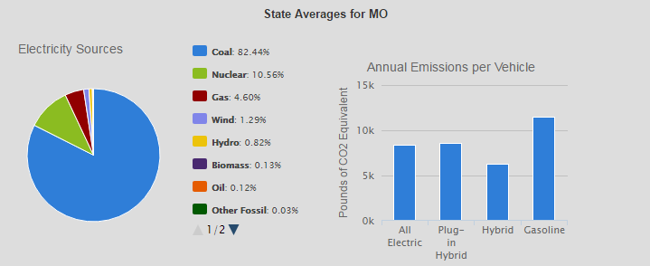
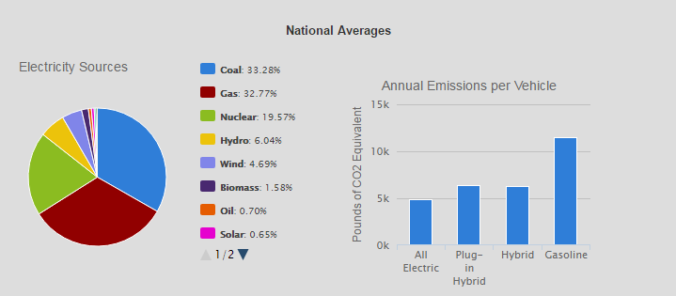
EV vs. Gasoline Vehicle Emissions Comparison
Vehicle Type | Annual Emissions per Vehicle (lbs CO₂e)
Gasoline | 11,435
All Electric (BEV) | 8,328
Plug-in Hybrid (PHEV) | 8,552
Hybrid | 6,258
BEVs in Missouri still emit 27.2% less pollutants than gasoline counterparts (on average)
Source: Alternative Fuels Data Center (DOE)

Slide 4
Criteria Pollutants
CAIR/CSAPR reductions since 2005
Tangible public health gains to be made
  Estimated 50,000 premature deaths nationally attributed to traffic pollution each year*
Source data: EIA

Slide 5
Looking Long-Term
Electric vehicles get cleaner over time
  KCP&L wind contracts
  CPP estimated to reduce MO CO₂ emissions 28% from 2012 levels
  NRDC-EPRI analysis*
    Transportation electrification to reduce GHG emissions 430 million metric tons annually by 2050 (Base Scenario)
    Total transportation and electric sector emissions halved by 2050 relative to 2015 (Base Scenario)
*See Environmental Assessment of a Full Electric Transportation Portfolio (NRDC, EPRI)

Slide 6
Looking Long-Term
Charging Infrastructure
  Essential to overcoming barriers to EV adoption
  Potential to provide more than just environmental benefits (through proper siting, load management, etc.)
    Fuel cost savings
    Widespread utility customer benefits
    Grid reliability benefits
    Renewables Integration
  Key to long-term strategy

Slide 7

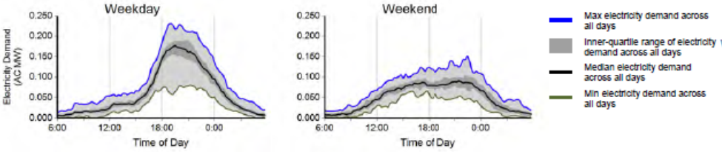

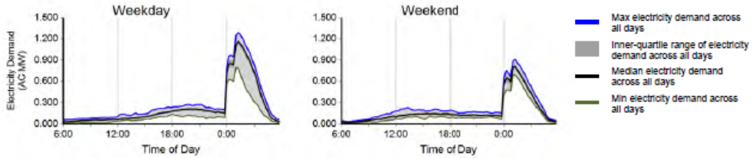
Load Management/Grid Reliability/Renewables Integration
Residential EV Charging in Dallas/Fort Worth by Time of Day
The EV Project, Quarterly Report, Q2, 2013.
Residential EV Charging in San Diego by Time of Day
The EV Project, Quarterly Report, Q2, 2013.

Slide 8
Takeaways
EVs provide clean air benefits in Missouri today
Benefits magnified as power sector CO₂ and criteria pollutant emissions decline
Charging infrastructure critical to widespread transportation electrification

