Slide 1





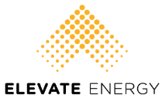
Making Multifamily Homes Healthy and Affordable Through Energy Efficiency: An Update on Missouri Stakeholder Activities
Annika Brink National Housing Trust | Presented at the 2015 Missouri Public Service Commission Stakeholder Collaborative on 12/1/2015
Notes:
Title Slide

Slide 2
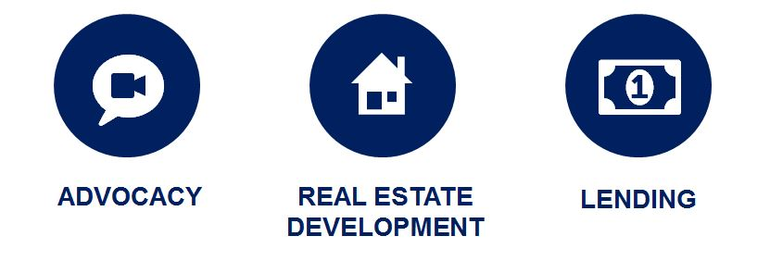
National Housing Trust
NHT protects and improves existing affordable rental homes so that low income individuals and families can live in quality neighborhoods with access to opportunities.
Notes:
National Housing Trust

Slide 3
Overview of Affordable Multifamily Conversations
St. Louis Stakeholder Convenings
Apr, May, Jul, Aug, Oct 2014 and Mar 2015 (White Paper)
Kansas City Stakeholder Convenings
2015: February, April, July…
Participation in PSC, DE, and DNR Conversations
PSC Statewide Collaborative (Oct 2014)
State Energy Plan work group (Nov 2014-Mar 2015)
MEEIA Rules working docket (Jan 2015-Aug 2015)
Ameren MEEIA (Dec 2014 - ?)
KCPL MEEIA (Aug 2015- ?)
Clean Power Plan/Clean Energy Incentive Program (emerging)
Notes:
Why is NHT involved with energy efficiency?
- Resident Stories

Slide 4

Resident Stories
“I’m a single father with a son named Jayden. My building was improved and now my son can focus on learning his ABCs instead of worrying about being cold.”
Dewitt Hood, affordable housing resident, speaking to D.C. Public Service Commissioners
Notes:
Why is NHT involved with energy efficiency?
- Resident Stories

Slide 5
Home energy is a significant and growing component of low-income household budgets
Households that earn less than the national median income spend 17 percent of their budget on energy costs.
Nominal spending by renters on home energy increased by 53 percent from 2000 to 2010, compared to a 22-percent increase in spending on all other types of goods and services.
Gary Pivo, Unequal access to energy efficiency in US multifamily rental housing: opportunities to improve, 2014.
Notes:
Why is NHT involved with energy efficiency?
- Resident Stories

Slide 6
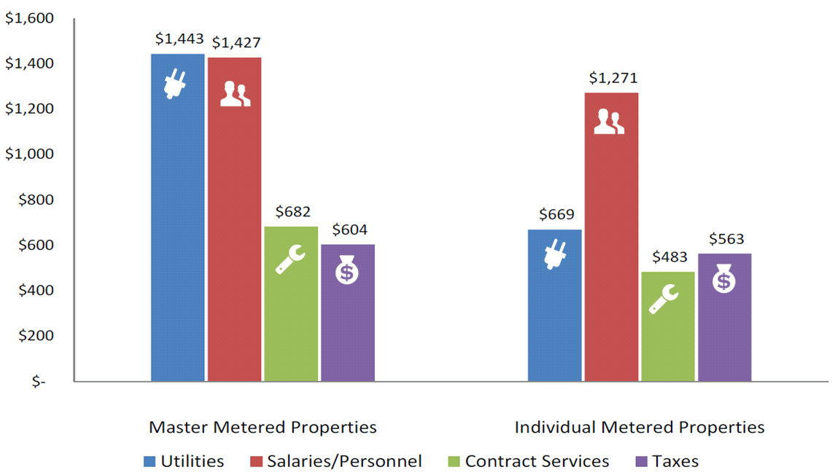
Energy costs present the best opportunity to reduce operating expenses and help sustain affordable housing
Credit: NAA
Notes:
Energy costs present the best opportunity to reduce operating expenses and help sustain affordable housing

Slide 7
Multifamily is often overlooked
Multifamily Share of Utility Spending on Residential Energy Efficiency
Multifamily Share of Housing Market
San Diego
Phoenix
Dallas
Honolulu
Salt Lake City
Houston
New York
Los Angeles
Chicago
Detroit
Seattle
Austin
Credit: ACEEE
Notes:
Multifamily is often overlooked

Slide 8

Affordable Multifamily Barriers
Unfamiliar building type
Complicated meter arrangements
Owner bandwidth
Lack of information
Financing barriers
Regulatory barriers
Split incentive
Notes:
Owner bandwidth
Uncoordinated program offerings (gas/electric, common/in-unit)
Small incentives
Lots of paperwork
Lack of information
Limited reserves and other financing barriers (many investors, may be imposed by HFA)
Regulatory barriers to larger, tailored, and more streamlined programs
- Michigan 2% of revenues example
- Missouri barrier to serving LIHTC properties (over 24,000 units in Ameren’s service territory—about half of the subsidized affordable multifamily units–or about 20% of the affordable multifamily units)
This is why an integrated stakeholder approach is so important—and we’re already seeing great progress in several states.

Slide 9
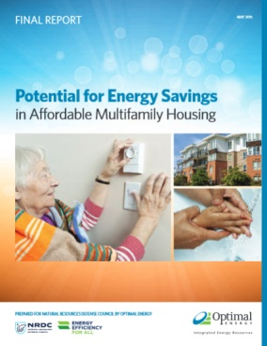
The Opportunity
Notes:
So far, we have created two key resources to support this work:
Program Design Guide
Potential Study
On the Potential Study front, we found that we were advocating for increased energy efficiency in affordable multifamily housing without the hard numbers that utilities and state policymakers wanted to see. So, we worked with potential study experts to create the study we needed.

Slide 10
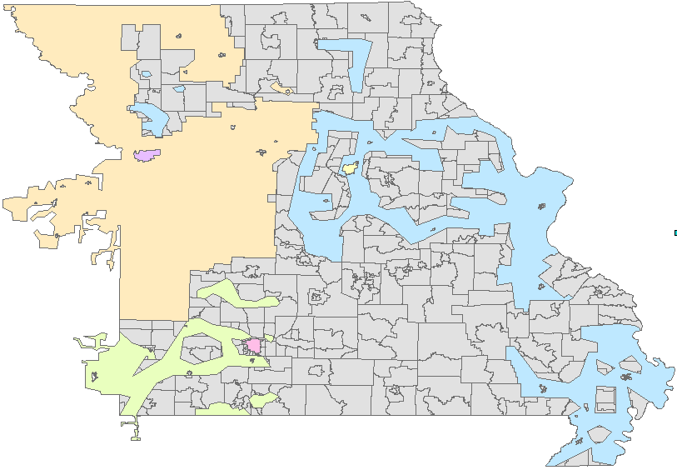
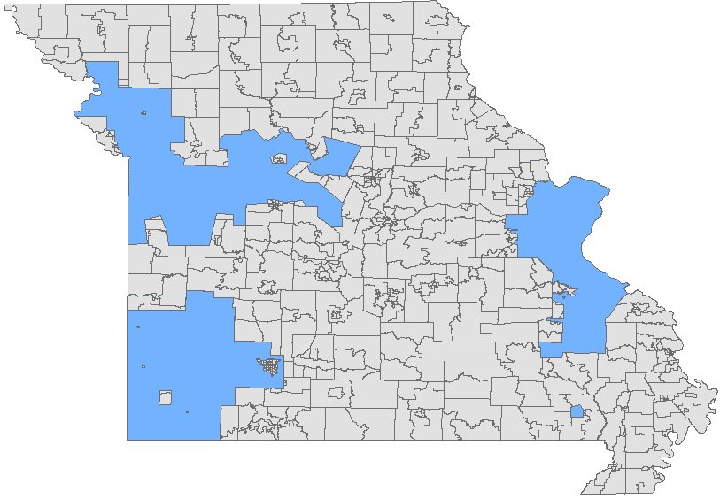
Size of the opportunity
 | MF | Aff MF
State | 380,000 | 221,000
Ameren | 186,000 | 92,000
KCP&L | 104,000 | 69,000
Springfield | 18,000 | 14,000
Empire | 17,000 | 9,000
Independ. | 10,000 | 7,000
Columbia | 10,000 | 6,000
Elsewhere | 37,000 | 24,000
221,000
157,000
Laclede/MGE

Slide 11
Results – Costs and Benefits, Maximum Achievable Scenario (2015-2034)
Total
Electric only
Gas only
Note: All dollars are present value 2015 Million $
Notes:
But, the statewide benefit-to-cost ratios (BCR) range from 1.8 to 2.8 for the base case depending on the state and fuel. In North Carolina, for example, total benefits (from all fuels) amount to $626 million from an investment of $293 million, resulting in net benefits of approximately $333 million. This means that the energy efficiency spending would return $2.14 to the North Carolina economy for every dollar invested.

Slide 12
Affordable Multifamily Electric Consumption Distribution by State and End Use
Notes:
2. Measures to reduce energy usage for heating and cooling contribute to nearly half of projected electric energy savings.

Slide 13
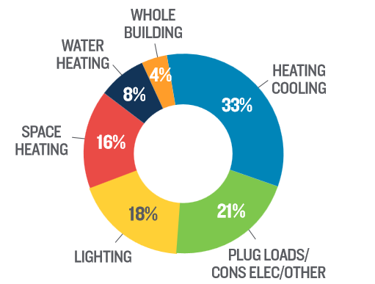
Results – Cumulative Electric Energy Savings by End Use, 2034
Notes:
2. Measures to reduce energy usage for heating and cooling contribute to nearly half of projected electric energy savings.
The heating and cooling end uses (i.e., heating/cooling, space heating, and cooling) contribute a combined 49% of total electric energy savings by 2034. The savings potential is achieved primarily through the introduction of smart thermostats, efficient windows, and air sealing.
Equipment plugged directly into an outlet (plug load), of which consumer electronics are a major part, contributes a significant 21% of the total potential.
Energy efficiency measures for lighting contribute 18% of the electric potential.
After lighting, the next largest end use savings contributions come from improvements in water heating (8%) and whole-building measures (4%), such as behavioral initiatives and making improvements in existing equipment (retro-commissioning).

Slide 14
Affordable Multifamily Natural Gas Consumption Distribution by State and End Use
Notes:
3. The vast majority of natural gas usage is from space heating and water heating.

Slide 15
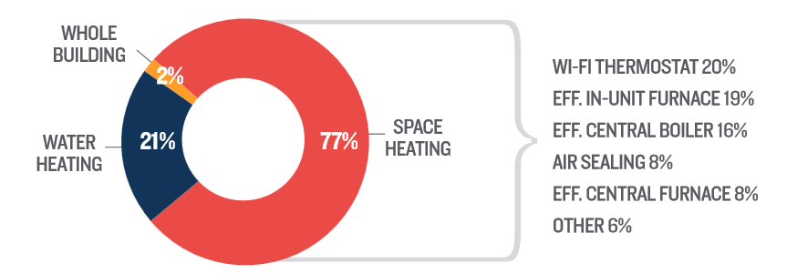
Results – Cumulative Natural Gas Energy Savings by End Use, 2034
Notes:
3. The vast majority of natural gas usage is from space heating and water heating.
Space heating accounts for 77% of the gas savings, with an additional 21% from water heating measures. The remaining 2% are from retro-commissioning activities.
Smart thermostats, efficient in-unit and central furnaces, central boilers, and air sealing contribute the vast majority of space heating savings.
Commercial clothes washers, water heater pipe wrap, and low-flow showerheads and faucet aerators are the principal measures contributing to gas water heating savings.

Slide 16

Most of the Benefits from Low-Income EE are NOT energy-related.
Notes:
5. The inclusion of non-energy benefits (NEBs) can have a significant impact on maximum achievable potential.
Only ¼ of the benefits from weatherization are energy-related!
Unexpected: 6.2 million low-income Americans live with asthma
Utility benefits, e.g.
reduced arrearage carrying costs
reduced customer collection calls/notices
reduced termination/reconnection costs
reduced bad debt write-offs
Societal benefits, e.g.
economic development
job creation
energy security
reduced emissions and environmental impacts
reduced health care spending
maintenance of affordable housing
Participant benefits, e.g.
water/wastewater bill savings
reduced maintenance costs
lower turnover rates
increased comfort
increased durability
improved safety
improved health (e.g. less asthma resulting in fewer sick days)

Slide 17






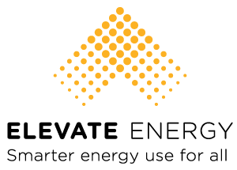







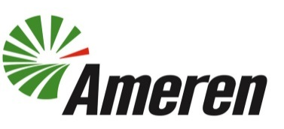
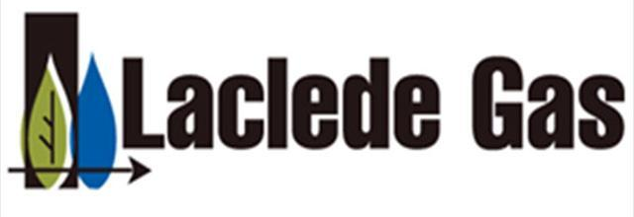










St. Louis Network

Slide 18
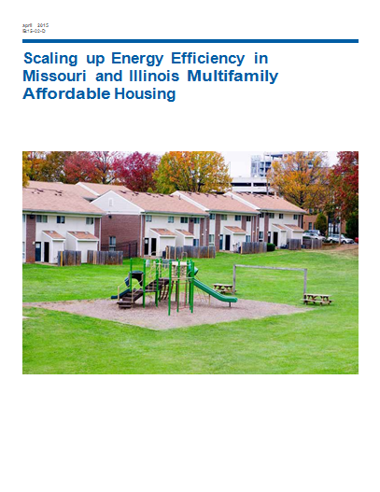
St. Louis Area White Paper
Develop comprehensive, easy-to-use programs to
capture all cost-effective savings
  1.1 Improve cost-effectiveness tests
  1.2 Capture multifamily in potential studies & TRMs
  1.3 Provide “one-stop shop” across fuels and meters
  1.4 Eliminate unnecessary barriers
Eliminate funding barriers & financing gaps
Help owners measure & manage energy use
3.1 Provide aggregate energy use data
3.2 Promote benchmarking
Improve collaboration among efficiency and housing stakeholders
4.1 Align flexible low-income definitions across programs
4.2 Match programs to owner timelines and motivations

Slide 19




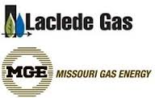







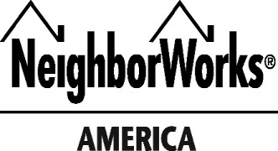




Kansas City Network

Slide 20
Kansas City Issues Inventory
Building Owner Opportunities
  To maximize the efficiency potential in multifamily affordable properties, building owners and operators need to feel confident that the benefits from energy efficiency improvements will outweigh the time and costs required to make such improvements.
Financing
  Financing for energy efficiency improvements can supplement utility incentives, such as grants or rebates and allow owners to undertake more comprehensive retrofits and achieve greater energy savings.
Program Design
  Developing and implementing well-designed programs targeted to the affordable multifamily housing sector can help utilities meet their energy efficiency goals, maintain affordable housing, and create healthier living environments for residents.
Notes:
3. The vast majority of natural gas usage is from space heating and water heating.
Space heating accounts for 77% of the gas savings, with an additional 21% from water heating measures. The remaining 2% are from retro-commissioning activities.
Smart thermostats, efficient in-unit and central furnaces, central boilers, and air sealing contribute the vast majority of space heating savings.
Commercial clothes washers, water heater pipe wrap, and low-flow showerheads and faucet aerators are the principal measures contributing to gas water heating savings.

Slide 21
Successes
Regulatory barrier eliminated
  PSC approves Ameren-proposed tariff to deliver low-income MEEIA programs in mixed-income buildings
Building owner demand encouraged
  Missouri Housing Development Commission funding applicants will now conduct energy audits on rehab projects of 12+ units
  St. Louis Affordable Housing Commission funding applicants must now apply for utility incentives
  Kansas City now requires the benchmarking of certain multifamily buildings
…program design improved?

Slide 22
Emerging Conversations
Decoupling to spur greater EE investment
Improvements to MEEIA process
Low-income multifamily opportunities in Clean Power Plan / CEIP
  Low-income role in both CPP and CEIP
  Opportunity to 2x/3x low-income multifamily EE
  Maximize benefits by filing plan ASAP
  Need outreach to low-income multifamily voices

Slide 23
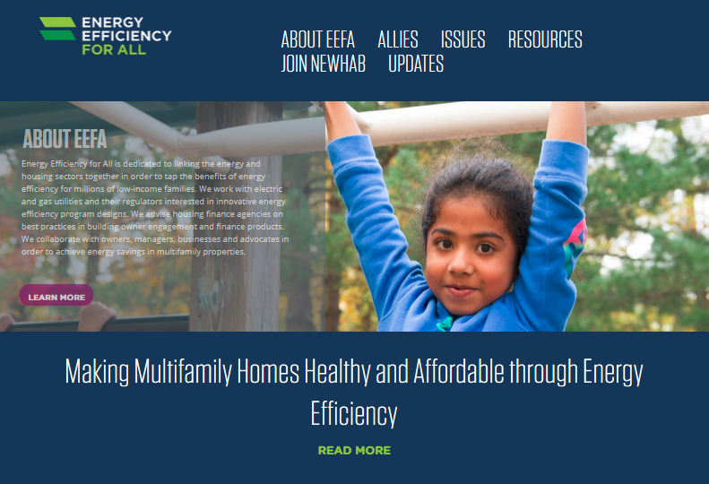
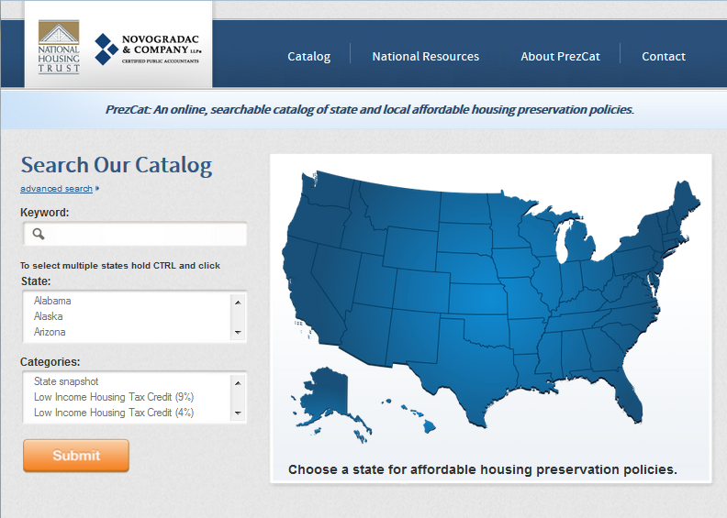
For more information
www.EE4A.org
www.prezcat.org
Notes:
For more information

Slide 24
Thank you
Annika Brink
National Housing Trust
abrink@nhtinc.org
202.333.8931, ext. 141
www.EE4A.org
www.prezcat.org
www.nhtinc.org
  @NatlHsingTrust
Notes:
Thank you

Slide 25
Appendix
Notes:
Appendix

Slide 26



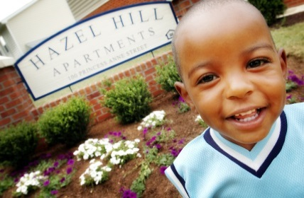
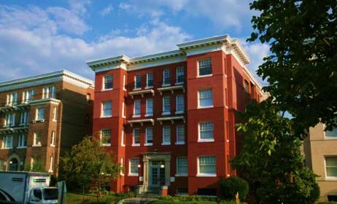
Affordable Multifamily Housing?

Slide 27
Affordable Multifamily Housing?
“Affordable” generally =
Household pays no more than 30% of income for rent + utilities
Low-income household makes 80% of Area Median Income
“Multifamily” = buildings of 5+ units
      Within affordable…
      1. Public Housing
      2. Subsidized Housing
      HUD
      USDA
      LIHTC
      3. Unsubsidized Housing
…but also % of Federal Poverty Level and more…
Often close interaction with state Housing Finance Agency
Notes:
Minnesota DOC example

Slide 28




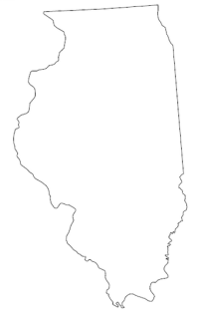

Non-Energy Benefits
5
20 years
300 studies
18+ states
Credit: Lisa Skumatz/SERA
Notes:
In 2011, Massachusetts issued a 262-page report on this topic:
"In some cases, the evaluation team does not recommend quantifying an NEI. NEIs were not recommended for quantification for one of several reasons:
- The NEI is too hard to quantify meaningfully
- Quantifying the NEI would amount to double counting as the NEI is already accounted for
- There is insufficient evidence in the literature for its existence
- The NEI is too intangible"
Despite these reasons for rejecting the quantification of certain NEIs, the report nevertheless recommended quantifying 31 NEIs, including the following:
arrearages, bad debt write-offs, terminations and reconnections, rate discounts, customer calls, collections notices, safety-related emergency calls, insurance savings, higher comfort levels, quieter interior environment, lighting quality & lifetime, increased housing property value, reduced water usage and sewer costs, more durable home and less maintenance, equipment and appliance maintenance requirements, health related NEIs, improved safety (heating system, ventilation, carbon monoxide, fires), window AC NEIs, national security, marketability/ease of finding renters, reduced tenant turnover, property value, equipment maintenance (heating and cooling systems), reduced maintenance (lighting), durability of property, tenant complaints, appliance recycling (avoided landfill space), appliance recycling (reduced emissions due to recycling plastic and glass, reduced emissions), and appliance recycling (reduced emissions due to incineration of insulating foam)

