Slide 1
MISO’s analysis of the Clean Power Plan
Environmental Compliance Workshop
February 4, 2016
Marc Keyser
Program Manager
Program Strategy/Clean Power Plan
Notes:
Slide notes, talking points and background information

Slide 2
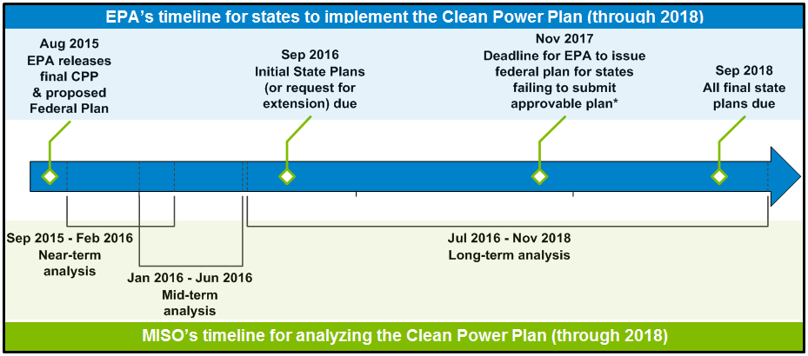
MISO’s analysis of EPA’s Clean Power Plan will report key findings ahead of the coming deadlines that states must meet
EPA Action
EPA Action
Goals:
  Inform policymakers as they formulate compliance strategies
  Enable the reliable, efficient implementation of CPP-related policy decisions made by our member-states and asset-owners
Today
*While this date is the initial deadline for the EPA, they have indicated they will issue a federal plan for states failing to submit one as soon as possible.
Near-Term Modeling Understanding compliance pathways
Mid-Term Modeling
Preparing for transmission overlay development
Long-Term Modeling
Developing transmission overlay
Notes:
As the three boxes at the bottom of this slide illustrate, MISO is analyzing EPA’s final Clean Power Plan in the context of three timeframes: (1) near-term modeling; (2) mid-term modeling; and (3) long-term modeling.
We based this timeline on the impending deadlines and other requirements in the final CPP rule itself.
We took this approach so that our member-states and asset owners could consider our findings in advance of developing their CPP implementation plans.
More details on our modeling:
MISO’s NEAR-TERM modeling (September 2015—February 2016) will estimate the costs and other impacts of complying with the CPP under a host of different implementation strategies, including both rate-based and mass-based compliance approaches with and without interstate trading of emissions allowances/credits.
In our near-term analysis, we will model the compliance costs and other impacts of the CPP by using six different hypothetical scenarios (more details below) that represent how states and utilities might choose to implement the rule.
For example, one of these scenarios will model the costs and other impacts of complying with the CPP by incrementally converting 25% of the existing coal-fired generation fleet to natural gas combined cycle units.
Other scenarios will model the costs and impacts of complying with the CPP by increasing the use of renewable energy and energy efficiency.
All six of the scenarios were developed with input from stakeholders.
MISO’s MID-TERM modeling (January 2016—June 2016) is designed to help MISO and stakeholders to better understand how the CPP could affect the development of future MISO-wide transmission expansion plans, starting with MTEP17.
We will conduct our mid-term analysis using three stakeholder-informed futures that differ in terms of how aggressively—or not—the CPP is implemented due to factors such as gas prices, technological developments and policy choices regarding renewables, and legal/political challenges to the rule.
Among other things, our mid-term modeling will include a “profitability analysis” that is designed to estimate how many existing resources would likely retire under each of the three futures in this portion of our study. The results of this analysis will be presented in aggregate, with no information that could identify specific units or companies.
MISO’s LONG-TERM modeling (July 2016—beyond) is designed to develop transmission overlays to aid in cost-effective and reliable implementation of the CPP. The long-term portion of our analysis is outside the scope of our current stand-alone CPP study.
MISO’s studies of the draft Clean Power Plan have positioned us well to analyze the final rule.
Our study tool allows us to model both state- and regional-level compliance; CO₂ mass or rate constraints; and integrated gas-electric system dispatch.
The scenarios and futures that we plug into that tool allow us to study of a range of options in a structured fashion.
Stakeholder input is essential to producing relevant scenarios and futures.
Our phased study approach produces valuable information prior to completion of the entire analysis.
More details on our six near-term production-cost scenarios:
Business-as usual (BAU): The assumptions underlying this scenario are consistent with our MTEP15 BAU economic planning model, such as 12.6 GW of MATS-related coal retirements.
CPP Constraints (CPP): CPP constraints applied.
Coal-to-Gas Conversions (C2G): 25% of coal capacity per region is incrementally converted to run on gas.
Gas Build-Out: (GBO): Same 25% coal retirement as above, but new gas-fired units are build to compensate for retired coal capacity.
Gas, Wind, Solar Build-Out (GWS): 30% of coal capacity per region is incrementally retired; 13% of that coal capacity is replaced by new gas units, and the remaining 17% is replaced by wind and solar.
High EE, Wind, Solar Build-Out (EWS): EE at 1.5% of energy sales beginning in 2020, with 1.5% year-over-year growth; 15% footprint-wide RPS.
All six scenarios were developed with input from our stakeholders.
The scenarios are designed to measure the impact that changes to the resource mix have on compliance outcomes.
Resource scenarios are not optimized for CPP compliance, and resource capital costs were not considered when developing the scenarios.
The scenarios assume that all MISO-member states would choose either rate-based or mass-based compliance, meaning there would be no “patchwork quilt” issues in the MISO footprint.

Slide 3
Mass-based compliance would cost less on regional basis, but a few states may fare better with a rate-based approach
On a MISO region-wide basis, MISO’s analysis indicates the following regarding rate-based and mass-based compliance:
The production costs of a mass-based trading regime would be lower than the production costs of rate-based trading, with the gap increasing over time.
Mass-based compliance would also require less capital investment than rate-based compliance.
Some MISO-member states may initially fare better under rate-based compliance, but over time, most states would see greater benefits under mass-based compliance.
States that already have (1) a heavy penetration of efficient gas-fired generation and/or (2) intend to build numerous non-CO₂-emitting resources may be marginally better off using rate-based compliance in the long run. However, these states would only see advantages with rate-based compliance if the generators within their borders have access to a liquid market for emission rate credits (ERCs).
Directional comparison of mass-based & rate-based production costs for the MISO region as a whole
Production Costs
Notes:
Modeling assumptions & important caveats:
The entire Eastern Interconnection would adopt either a mass-based or a rate-based trading regime, and all MISO-member states would adopt the same type of trading approach.
In other words, all 15 MISO-member states would adopt either a rate-based or a mass-based trading regime, meaning there would be no “patchwork quilt” situation in the footprint.
A liquid market would exist for either mass-based emissions allowances or rate-based emission rate credits (ERCs).
All of the not-yet-built generating resources that have signed Generator Interconnection Agreements (GIAs) actually get built and go into service.
All of the transmission-expansion projects that are forecasted in MISO’s current footprint-wide transmission plan (MTEP15) actually get built and go into service.
Models use MTEP15 natural gas price forecast ($4.67 in 2015).
Renewables are built out to the extent that MISO-member states satisfy their renewable portfolio standards and planning reserve margins.
The system is re-dispatched to meet the CPP’s required CO2 reductions, and allowances/credits are rationally exchanged.
Transmission infrastructure and gas infrastructure implications were not examined in this phase of modeling.

Slide 4




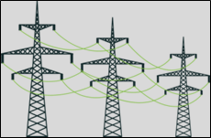
New resources will be needed to achieve CPP compliance, meaning planning and investment in new energy assets needs to begin soon
Typical conception-to-in-service timelines for various types of new energy assets*, overlaid on the CPP’s compliance deadlines:
2018: States’ final CPP plans due just 2 years from now
2022: Interim CPP
compliance period begins just 6 years from now
2030: The CPP’s final compliance period begins
Today
2025: MISO analysis shows new assets may need to be in service for CPP compliance
Mainline gas pipelines: 4-6 years
Wind farms: 4-6 years
Combined Cycle Generation:
4-6 years
*Many factors can extend the time needed to permit and build new assets, so early planning is prudent to ensure that sufficient resources will be in place to achieve CPP compliance
Transmission: 7-10 years
2016
2018
2022
2025
2030
Notes:
The CPP’s final compliance period begins in 2030, with an interim compliance period set to kick off in 2022—just six years from now.
The first deadline for states to submit their compliance plans to EPA hits this September, with all final plans due by 2018—just two years from now.
This timeline does provide slightly more breathing room compared to the deadlines in the draft CPP rule.
But given that it can take as long as 10 years or more to plan, permit and build new energy assets, states and utilities must act now in order to ensure that the necessary resources will be in service in the coming years for CPP-compliance purposes.
The CPP’s final compliance period does not begin until 2030. But as this slide illustrates, MISO’s analysis indicates that new assets may need to be in service for CPP compliance purposes as early as 2025, which underscores the need for states and utilities to act now.

Slide 5
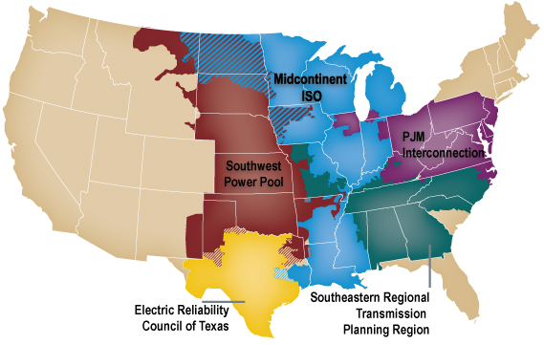
MISO is talking with neighboring system operators about our collective efforts to analyze the Clean Power Plan
Note: Areas were two system boundaries are interspersed are illustrated with a crosshatch pattern.
These talks reflect the following realities about the grid system and the CPP:
Due to the interconnected nature of the grid system, conditions that affect the MISO-controlled portion of the grid may also impact neighboring system operators.
The impacts of the CPP will be national in scope, reaching beyond MISO’s borders and the borders of any other single system operator.
Notes:
MISO is, or will be, talking with the following system operators about the Clean Power Plan:
PJM Interconnection
Southwest Power Pool (SPP)
The Electric Reliability Council of Texas (ERCOT)
Southeastern Regional Transmission Planning (SERTP)
While each system operator is conducting its own modeling and analysis of the Clean Power Plan, we are talking with each other so that we all better understand the assumptions and scenarios that we are modeling.

Slide 6

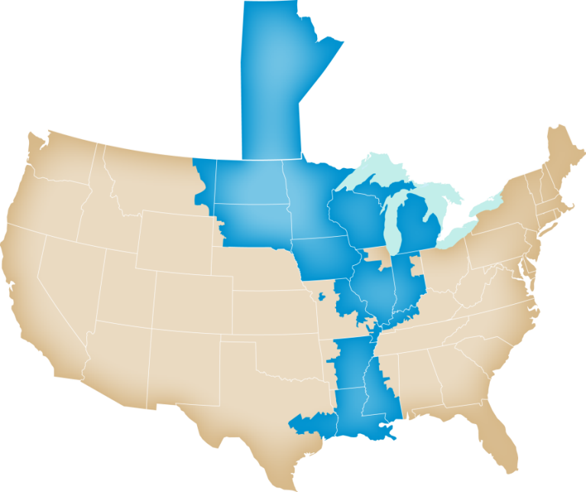

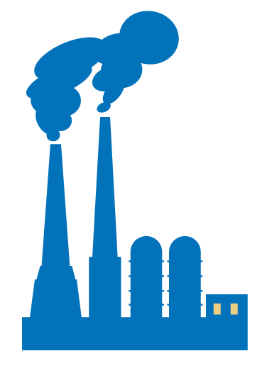

MISO plays key roles with respect to the Clean Power Plan and other forces that impact the footprint, including:
Informing Policymakers and Asset Owners
Enabling the Reliable, Efficient Implementation of Policy Decisions
How to analyze rate and mass to facilitate regional solutions
Model impacts of state/regional alternatives
Requirements of emissions-trading platforms
Evaluation of emissions-trading platforms
Assessment of MISO system operational impacts
Changes to market design
Transmission planning: second round of Multi-Value Projects?
Integration of renewables
Notes:
As I mentioned earlier, we’ve been working to analyze the Clean Power Plan since EPA issued it in proposed form last year.
The primary goal of our analysis is to provide our states and market participants with trustworthy and unbiased information they can use in preparing their CPP implementation strategies.
By working with our stakeholders and making our CPP analysis available to them, we hope to ensure that efforts by states and utilities to implement the CPP will not jeopardize the reliability of the grid or diminish the substantial efficiencies and cost savings that come from operating the system on a regional basis.
Among other things, our analysis found that taking a state-by-state approach to the CPP would seriously erode the region’s historically robust reserve margins, which are already shrinking due to coal retirements.
MISO is beginning to evaluate how a CPP-related trading platform would work and look like across our footprint.

