Slide 1

111D options and opportunities for Missouri
Missouri Public Service Commission
Federal Environmental Regulations Working Group
Docket No. EW-2012-0065
David Weiskopf
Sustainable Energy Fellow
Natural Resources Defense Council
Dweiskopf@nrdc.org
October 28th 2013

Slide 2
Regulating Greenhouse Gases from Existing Power Plants: Clean Air Act §111(d)
The Clean Air Act Requires Regulating Pollutants that Endanger Public Health
  Massachusetts v EPA (2007):
    Greenhouse gases are covered by the CAA's definition of air pollutant
    EPA must determine whether or carbon pollution from new motor vehicles endangers public health or welfare
    If carbon pollution endangers public health or welfare, EPA must set emission standards
  EPA Endangerment Finding (2009)
  American Electric Power v. Connecticut (2011):
    Court affirms that §111 of the Clean Air Act provides EPA authority to regulate carbon pollution from new and existing power plants
October 15, 2013:
  Supreme Court declines to hear further challenges to endangerment finding and authority to regulate carbon pollution under §111, reinforcing EPA’s authority to regulate carbon pollution from new and existing power plants

Slide 3
EPA 111(d) Process
October-November 2013:
  Current EPA Outreach
  EPA Listening Sessions (Region 7 Session is in Lenexa on Nov. 4)
June 2014:
  EPA Proposes Standard for Existing Power Plants under CAA Section 111(d)
  Public Notice and Comment period follows
June 2015:
  EPA Finalizes 111(d) Standard
  States develop State Plans for compliance with Public Notice and Comment
June 2016 or sooner:
  State Plans submitted to EPA for final approval

Slide 4
Key Elements of 111(d)
EPA must establish an emission guideline that reflects the “best system of emission reduction” (BSER) for existing sources.
  BSER includes consideration of cost, compliance time, and the remaining useful life if the covered sources
  A flexible system-based approach may be applied, as in current regulation of emissions from Municipal Waste Combustors
The guideline sets a standard of performance based on what can be achieved under BSER, but states may develop their own State Plans providing the pathway to reaching this standard of performance.
  If states elect not to develop a State Plan, a Federal Plan will be implemented by EPA.

Slide 5
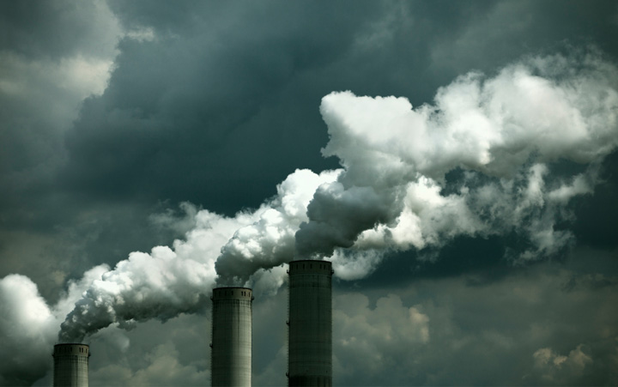




NRDC’s Proposal: Flexible Compliance through a System-Based Approach
HEAT RATE REDUCTIONS
CLEANER POWER SOURCES
FLEXIBLE COMPLIANCE
MORE RENEWABLES
INVESTMENTS IN EFFICIENCY

Slide 6
NRDC’s Proposal: Flexible Compliance through a System-Based Approach
Establish state emissions baseline
  Consider historical emissions and the current composition of the state’s power plant fleet
Set state-specific emissions targets reductions from baseline emission intensity
  E.g., state standards for 2020 range from 1,500 to 1,000 lbs/MWh depending on each state’s coal/gas generation mix in 2008-10 baseline period. Under this formula, Missouri’s target would be closer to the high end of the range due to its reliance on coal-fired units
All states must improve upon their baseline scenario, but each state’s performance targets are based on what is achievable in that state – Not a one-size fits all approach.
  Emission reductions can come through mechanisms best suited to local needs and conditions

Slide 7
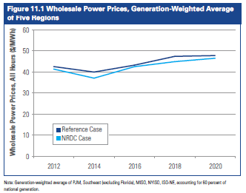
Maintaining Low Prices and Reliability
NRDC’s IPM model shows small overall reduction in wholesale prices through flexible 111d compliance plans
MISO prices projected to be 3.4% lower than reference case scenario

Slide 8
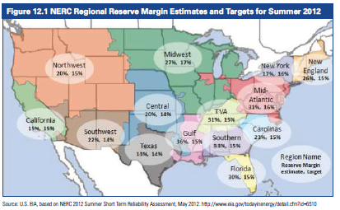
Maintaining Low Prices and Reliability
Retain our high standards for grid reliability
Missouri’s high reserve margin unaffected while modernizing state power system
Multi-year averaging available to provide sufficient compliance time while maintaining stability

Slide 9
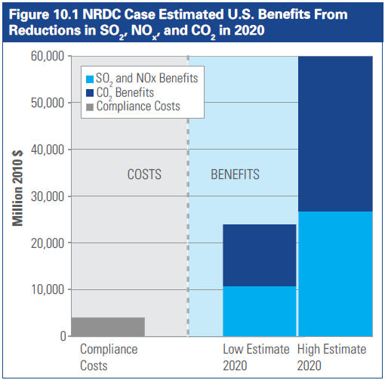
Benefits to Missouri
Health Benefits from reducing SOx and NOx alone far outweigh costs
  St. Louis consistently among ten U.S. cities with highest incidence of asthma
  Heart attacks and emergency room visits both reduced significantly in compliance scenario
Even modest estimates of the value of reducing CO₂ emissions more than double the benefits
  Reduced exposure to extreme weather-related risk, including floods, extreme storms
  Fewer heat-related deaths and hospital visits
  Increased power system reliability

Slide 10
Policy Options for Missouri
Existing State clean energy programs contribute to compliance
  MEEIA: 9.9% Cumulative Demand Reduction by 2020
  RES: 15% Renewables by 2025
  IRP: Plan future resource integration, plant modernization, and retirement of resources that have reached the end of their useful life
  Local sustainability initiatives in cities and counties
111d Compliance can build on existing efforts and/or introduce new compliance mechanisms
  Partial CCS where practicable
  Multi-state agreements

Slide 11
Process Recommendations
Cross-agency coordination with DNR on State Plan and with EPA Region 7 on CAA process requirements
Include111(d) compliance plans in state IRP process
Compile and analyze effects of existing emissions-reducing state policies, such as RES and MEEIA
Investigate ways to standardize compliance in regional utility affiliate service territories
Consider and model alternative compliance mechanisms (such as mass-based standard)
Working groups such as this one are incredibly valuable – Thank you!

