Slide 1
PIPELINE LOCATING QUALITY ASSURANCE WORK SHOP
Missouri Public Service Commission
June 17, 2021
Commission Case File GW-2021-0355
Missouri Public Service Commission | Jefferson City, MO

Slide 2
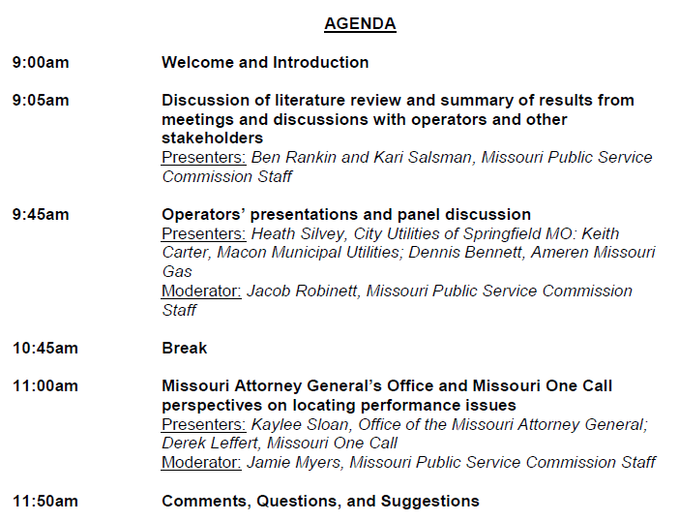
Missouri Public Service Commission

Slide 3
MUTE AND HAND RAISE
Missouri Public Service Commission
Mute & Video Button – toggle on/off
Hand Raise

Slide 4
Literature Review and Operator Discussions
Jacob Robinett, Missouri Public Service Commission
Kari Salsman, Missouri Public Service Commission
Missouri Public Service Commission | Jefferson City, MO

Slide 5
Damages
Damages to buried infrastructure are on the rise.
Locating remains a critical area for improvement
Approximately 1/3 of excavation damages in MO is the result of insufficient locating practices.

Slide 6
Critical Issues & Drivers of Damage
Facilities not marked in a timely manner
Facilities not marked accurately

Slide 7
Locating Industry Challenges Outlined in 2020 CGA locator white paper
Heavy workload, volume & variability of tickets, managing ticket volume against staffing
High employee turnover & lack of training
No mandatory white-lining
Delayed updates and inaccuracy of maps

Slide 8
Heavy Workload, Volume & Variability of Tickets, Ticket Volume and Staffing
The volume of locate requests and subsequent one call transmissions are rising.
Mis-marks due to locator error appear as a top root cause in the locating group, suggesting that locate ticket volume is often a challenge for technicians.
1/3 of locating technicians surveyed in the 2019 CGA Utility Locators Online survey point to a heavy workload as one of the biggest challenges to providing timely and accurate locates. Nearly 1 in 5 reported the daily workload is unmanageable.
Similarly, those who supervise locators say that managing ticket volume against staffing is the most significant challenge facing the industry.

Slide 9
High Employee Turnover & Lack of Training
Limited formalized training programs may contribute to the lack of awareness of important damage prevention practices.
With new excavators constantly joining the workforce, an absence of strong or consistent training and retention programs places inexperienced excavators in risky situations.

Slide 10
No Mandatory White-Lining
Lack of mandatory white-lining emerges as the top challenge facing the industry as a whole. It is identified as the top barrier to accurate and on time locates and the second most effective measure for improving locate accuracy and timeliness, only behind updated maps.

Slide 11
Delayed Updates & Inaccuracy of Maps
Company’s fail to supply the necessary information in a timely manner to update mapping records.
Inaccurate maps lead to inaccurate locates.
White – lining and updated facility maps received nearly unanimous agreement among more than 400 locate technicians as top strategies for improving locate accuracy.

Slide 12
Best Practices to Improve Locating
Establish rules for ‘project tickets’
Increase locate technician training
Making white-lining mandatory
Updated maps
Increased communication between excavator & locate technician
Reporting
Quality Assurance Audits

Slide 13
Establish Rules for Project Tickets
Find ways to control ticket volume and reduce the variability of tickets could be key to helping the industry more effectively reduce damages related to locating issues
Most states mandate short turnaround times for locates in the interest of getting projects started quickly. The current process does not consistently account for variability of locates such as job size or complexity of infrastructure. The use of design and planning tickets for large-scale projects and a more flexible ticketing process could help locating companies better manage staffing needs to accommodate influxes of tickets.

Slide 14
Increase Locate Technician Training
While 93% of technicians surveyed in the 2019 survey reported receiving training prior to going in the field, 94% said that more training would improve the accuracy and timeliness of locates.
One way to give technicians more experience and draw them more deeply into the profession is improving the frequency of ongoing technician training, which could also help improve the speed and accuracy of the in-the-field workforce.

Slide 15
Make White-Lining Mandatory
White-lining the area to be excavated is Common Ground Alliance best practice, but according to the CGA Next Practices Initiative more than half of locate technicians indicate that their biggest challenge is the area to be marked is not clearly defined – something that could easily be resolved by electronic white-lining as part of an effective notification process

Slide 16
Maintaining Accurate Maps
Continuously verify and update maps.
Visual Inspections

Slide 17
Increased Communication Between Excavator & Locate Technician
97% of technicians surveyed identified increased communication between themselves and excavators as an effective way to improve accurate, on-time locates.
Damage Prevention Council meetings, Regional Partner summits & one call ticketing software.

Slide 18
Timely & Accurate Reporting
Timely and accurate reporting of excavation incidents is a critical component of the continual process with all Stakeholders reporting information.

Slide 19
Quality Assurance Audits
CGA recommended components
Conduct field audits and choose some locations to be audited/surveyed purely at random.
Check accuracy to within, governed, contractual, and minimum tolerance levels.
Measure timeliness, as defined by regulation/statute.
Check completion of a request.
Check evidence of accurate and proper communication.
Check that proper documentation exists.
Check than an audit/survey is documented.
Communicate results to applicable personnel.
Trace audits for trend analysis.
Verify proper hook-up and grounding procedures where applicable.
Verify the reference material used to document that the locate was up to date (electronic plans or paper plans).
Verify that appropriate safety equipment and procedures were used by the locator.
Verify that tools and equipment are in proper working order and properly calibrated.

Slide 20
Examples of State Initiatives
Missouri Public Service Commission
States rules requiring additional reporting requirements for excavation damages, examples:
New Hampshire Public Utilities Commission requires filing of monthly reports.
Maine Public Utilities Commission requires reporting using an Underground Facility Incident Report Form

Slide 21
Examples of State Initiatives
Missouri Public Service Commission
State rules setting minimum training and qualifications for locators, examples:
Maine Public Utilities Commission requires locators to have necessary knowledge and skills for:
the use industry best practices developed by the CGA for locating and marking pipelines or other recognized industry authority;
State and local underground damage prevention regulations
New Hampshire PUC requires locators to be trained in accordance with National Utility Locating Contractors Association (NULCA) standards

Slide 22
Examples of State Initiatives
Missouri Public Service Commission
Other State Initiatives, examples:
A Kansas Corporation Commission Order requires operators to notify the KCC within 30 minutes of all excavation damages called in by excavator.
A settlement agreement approved by the New Hampshire PUC that requires locating to be done by in-house personnel (no contractors).
A Virginia order requires installing of electronic marker balls with all new service lines.

Slide 23
Operator Discussion
What did this include?
How did we come up with the questions?
The answers we received.

Slide 24
Why people don’t call Missouri One Call?
Missouri Public Service Commission
Homeowners think they know what’s underground
Not taking the time to wait
Thinking they have a 50/50 chance of missing underground utilities
Spur of Moment Projects
Lack of understanding needing to call
Language Barrier
Number has gone down though!

Slide 25
Do people typically white-line?
Missouri Public Service Commission
Local companies do, but out of state contractors typically do not.
Flags are free on Missouri One Call if requested
Some will meet on site an white line while there to do the locate
Sometimes able to put white-lining in contracts
Able to digitally white-line on Missouri One Call’s website

Slide 26
Common Causes of Excavator Damage
Missouri Public Service Commission
Excavator not being careful enough and hand digging
Thinking lines are deeper
Failure to protect exposed facility with boring work

Slide 27
Mapping Systems
Missouri Public Service Commission
Most companies have digital maps
Systems updated on a weekly/monthly basis
GIS system that allows crews to perform updates in in field on tablets

Slide 28
Is there a standard of locating equipment to use?
Missouri Public Service Commission
No, mostly done by utility or contractor preference
Rycom, Subsurface Solutions, Radio Detection

Slide 29
How to locate when there is a lack of tracer wire?
Missouri Public Service Commission
Jameson tool
Ground penetrating radar
Vacuum Excavator to pneumatically excavate down to pipe
Locate wire on another point from street or neighbor’s house
Shovels and probes
Marker Balls in Mains and mirror surface indicators on service lines to help locate
Records, field sketches, service card drawings

Slide 30
Large Project vs Small Project Locate Tickets
Missouri Public Service Commission
Communication from start to finish
Break projects into sections
More notes in tickets the better
Phone number on tickets of someone to call
Call contractors to see where they plan to work next couple of days
Location of project is factor

Slide 31
Screening Contractors
Missouri Public Service Commission
Track each damage save those contractors
Create a list to break down damages to excavation type, locations, history to know the risk factor
Small number of damages per year so able to track them
Can screen based on your information
Meet with contractor if have recurring damage

Slide 32
Damage Investigations
Missouri Public Service Commission
Investigations done in house but also done by USIC if they are a contractor
Rhino Hit Kits

Slide 33
Rhino Hit Kits
Missouri Public Service Commission
www.rhinomarkers.com

Slide 34
Other Things
Missouri Public Service Commission
Renewal tickets
Industry is rapidly changing and number of locates has changed

Slide 35
QUESTIONS OR DISCUSSION?
Missouri Public Service Commission

Slide 36
Operator’s presentation and panel discussion
Heath Silvey, City Utilities of Springfield MO
Dennis Bennett, Ameren Missouri
Keith Carter, Macon Municipal Utilities
Jacob Robinett, Missouri Public Service Commission
Missouri Public Service Commission | Jefferson City, MO

Slide 37
Heath Silvey City Utilities of Springfield
Missouri Public Service Commission
Notes:
Manager of Risk/Damage Prevention for City Utilities of Springfield

Slide 38
City Utilities Damage Prevention & Location Services
PSC Workshop
June 2021
Notes:
-

Slide 39
City Utilities of Springfield, Missouri
Progressive, community-owned utility serving 320 square miles
Electricity, natural gas, water, broadband, and public transportation services
Overseen by a governing board composed of local citizens

Slide 40
Investigating Damages Preventing Damages
City Utilities
Excavator
USIC
Notes:
-

Slide 41
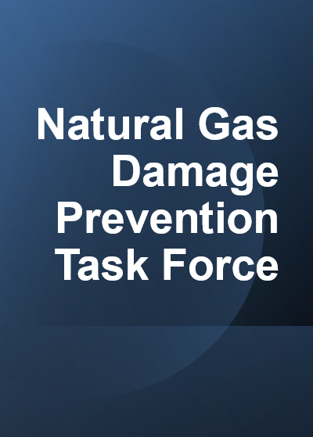
Executive Appointment and Support
Damage Prevention
Natural Gas Operations
Natural Gas Engineering
Communications
Human Resources (Safety)
Monthly Meetings in CY21
Review of prior month’s damages
Communication to 1st, 2nd and 3rd Parties and USIC
Review Responses
Document Mitigation Efforts
Recommend Additional Efforts
Review and Report Quarterly
Provide an Overview and Recommendations

Slide 42
Natural Gas Damage Prevention Task Force
Executive Support
1st Party Damages
Engineering
2nd Party Damages
Construction
Locating Damages
Damage Prevention
3rd Party Damages
Communications

Slide 43
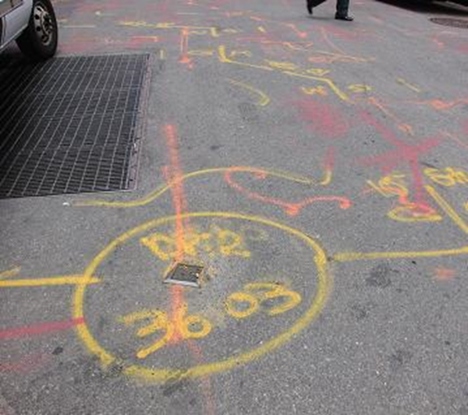
Locate Quality
Partnership
Locate Audits
Desk Audits
Field Audits
Communication
Excavator Feedback

Slide 44
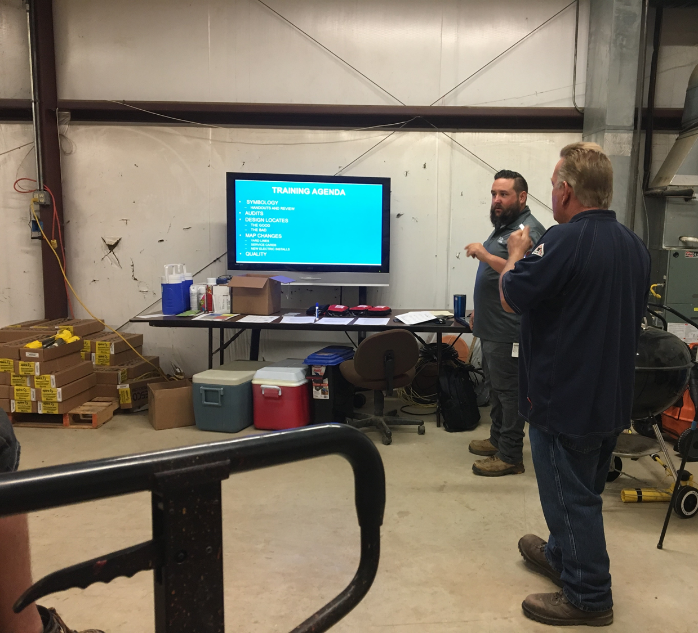
Locator Training
CU’s Damages
USIC’s Damages
Frustrations
Solutions
Roses & Thorns

Slide 45
Dennis Bennett Ameren Missouri
Missouri Public Service Commission
Notes:
Supervisor of Damage Prevention/Public Awareness for Ameren Missouri

Slide 46
Missouri Gas Operations
Facility Locating

Slide 47
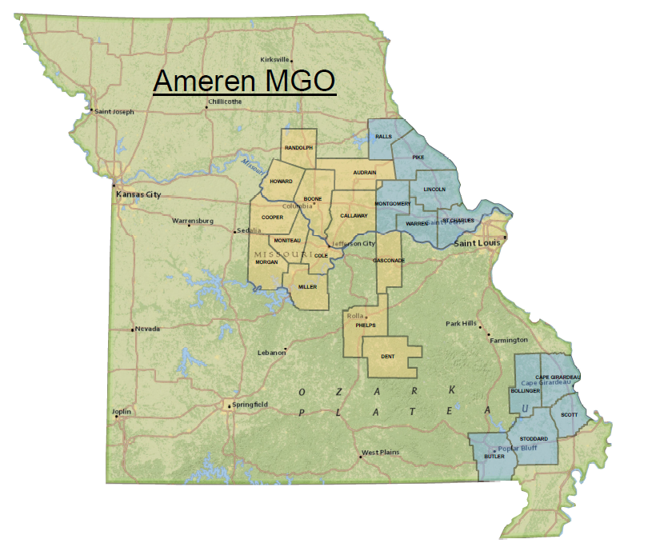
Missouri Gas Operations (MGO)

Slide 48
MGO Facility Locate Process
Ameren Missouri In-House
972 Miles of Gas Main
90 Sq. Ft. Mo. One Call Buffer
Contract Locate Services
2,486 Miles of Gas Main
276 Sq. Ft. Mo. One Call Buffer
Ticket Dates | In-House Ticket Count | Contract Ticket Count | Total Ticket Count
2019 | N/A | 71,159 | 71,159
2020 | 19,265 | 56,650 | 75,915
2021 YTD | 9,161 | 35,581 | 44,742

Slide 49
MGO Damage Prevention Group
Four Damage Prevention Specialists geographically positioned
Columbia, Jefferson City, Wentzville, Cape Girardeau
On-Site Safety Education to Excavators
MO One Call, AGA Best Excavation Practices, Natural Gas Safety
On-Site Damage Investigations
Process the damage site for documentation and records
Assess who is At-Fault, Educate Excavators on Safety and Identify Lessons Learned

Slide 50
Quality Assurance Auditing
MGO QA Audits
2 QA Auditors performing all Covered Tasks including Locating as needed
Contract QA Audits (Supplemental)
4 Locate Auditors located in each Wentzville, Cape Girardeau, Columbia and Jeff City
912 field Locate ticket audits between April 5th to June 4th

Slide 52
Keith Carter Macon Municipal Utilities
Missouri Public Service Commission
Notes:
Underground Facilities Supervisor
Do excavators in your area typically white-line proposed excavation areas?
Does MMU handle the locate tickets internally or contract them out?
As a municipal utility, on average, how many locates would you say you get in a typical week?
With that number, how does your staff handle the large project locates tickets?
How do you handle locating pipes underground that lack a Tracer Wire or have a damaged one?

Slide 53
When you have damages, what are some of the most common reoccurring causes?

Slide 54
How do you go about locating underground pipes that lack a tracer wire or have a damaged wire?

Slide 55
Is there anything you believe as utilities that can be done to help more accurately locate underground utilities?

Slide 56
As a utility how do you go about handling a large number of locate tickets for a project?

Slide 57
QUESTIONS OR DISCUSSION?
Missouri Public Service Commission

Slide 58
BREAK

Slide 59
Missouri Attorney General’s Office and Missouri One Call perspectives on locating performance issues
Missouri Public Service Commission
Presenters
Kaylee Sloan, Office of the Missouri Attorney General
Derek Leffert, Missouri One Call

Slide 60
Comments, Questions, and Suggestions
Missouri Public Service Commission
Jamie Myers
jamie.myers@psc.mo.gov
573-526-6036

