Slide 1
Spire Missouri PAYS Timeline
Q4-21 | Q1-21 | Q2-21 | Q1-22 |  |  | Q2-22 |  |  | Q3-22
J | A | S | O | N | D | J | F | M | A | M | J
Award Work
Contract Negotiations
Program Discovery & Onboarding
Marketing Plan
Soft Launch/Testing
Full Launch

Slide 2
Customer Journey
Tier 1
Home Visit
Tier 2
In-depth Energy Assessment
Tier 3
Easy Plan Offer
Tier 4
Direct Install by Trade Ally
Initial home energy assessment (“walk through”) including direct install measures
Energy & bill savings estimates analyzed, and cost-effective scope of work determined
Complete data collection performed
Blower door
Pressure pan test diagnostics test
Duct blaster
Monthly on-bill payments for upgrades begin
If a project is determined to be ineligible the participation will stop, and customer will be referred to other programs/resources as applicable

Slide 3
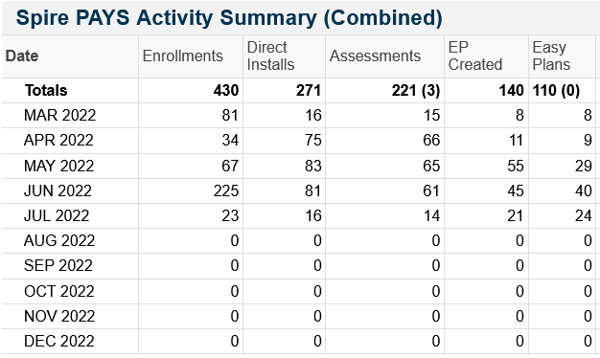
Spire Missouri PAYS

Slide 4
Questions/Discussion

