Slide 1

Are All Electric Vehicle Charging Stations Created Equal?
Missouri Public Service Commission EV Workshop
May 25, 2016
Prepared for:

Slide 2




The World’s Largest and Most Open
EV Charging Network
28,000+
Largest Community of EV drivers
+ 70% of new EV drivers join every month
+ A driver plugs into our network every 4 seconds
Charging Everywhere
+ 28,000+ charging spots
+ 300+ Express stations
We’re Established and Growing
+ 600+ ports added every month
+ International market growth
We Are the Industry Leader
According to Time, Bloomberg, CNBC, Navigant Research
and many others

Slide 3






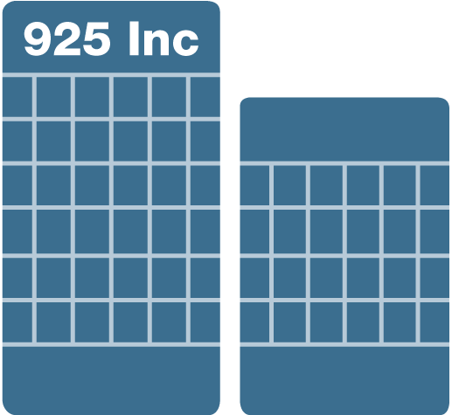



Our Mission: EV Charging, Everywhere
Get everyone behind the wheel of an EV and give them charging wherever they go.
Out of Town
Home
Convenient and connected charging for home, work, around town and out of town.
Work
Around Town

Slide 4








Powering the EV Charging Ecosystem
B2B
B2C
Commercial
Charging
Stations
Level 2 and Express DC fast chargers
Software-as-
a-Service
Cloud-based network
subscriptions
Service & Support
Reporting, analytics,
daily support and on going coverage
Advertising
& Promotion
Connecting
businesses
with EV drivers
Partners
Connecting the EV ecosystem from OEMs to autos to utilities and beyond
Home
Charging
Networked, residential charging
Driver
Services
Free membership, 24/7 support, mobile app, reporting and exclusive promotions
Advocacy
Driving policy and awareness to support EV adoption
5

Slide 5


Market Data
Market data:
The numbers speak for themselves
Its really all about the cars!

Slide 6
US EV Sales By Year

Slide 7

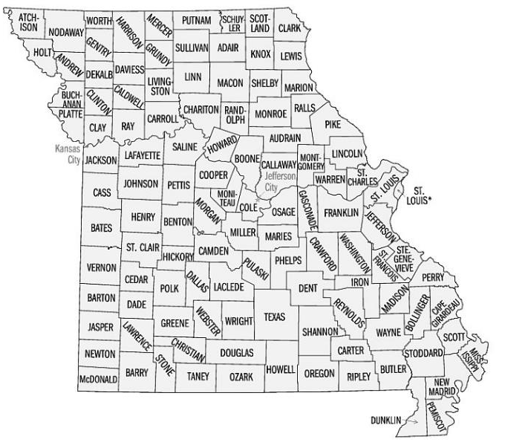
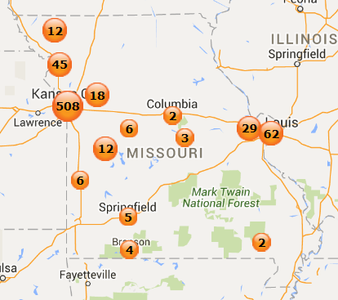
Missouri EV Market Snapshot as of 3/31/16
Plug-In Vehicles
Charging Stations
2530 PEVs
719 Stations

Slide 8

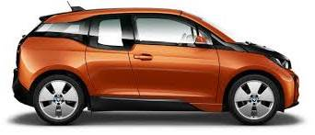

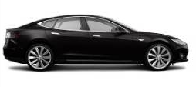
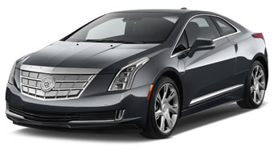

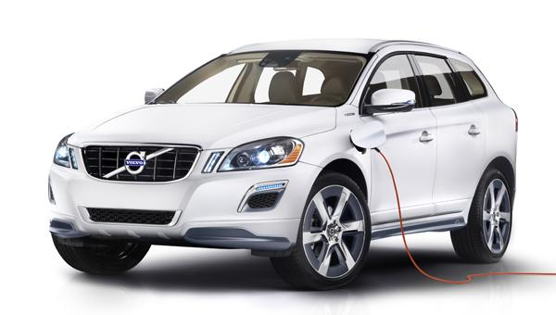
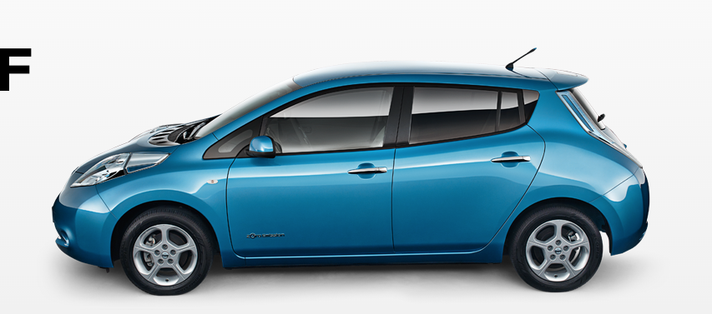
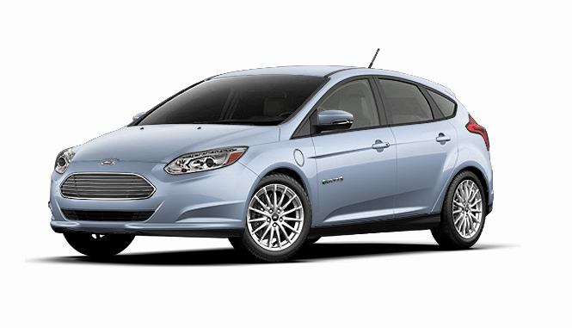
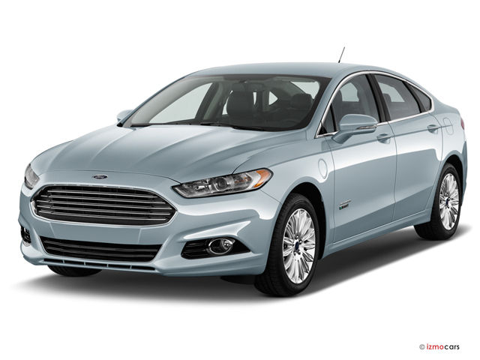
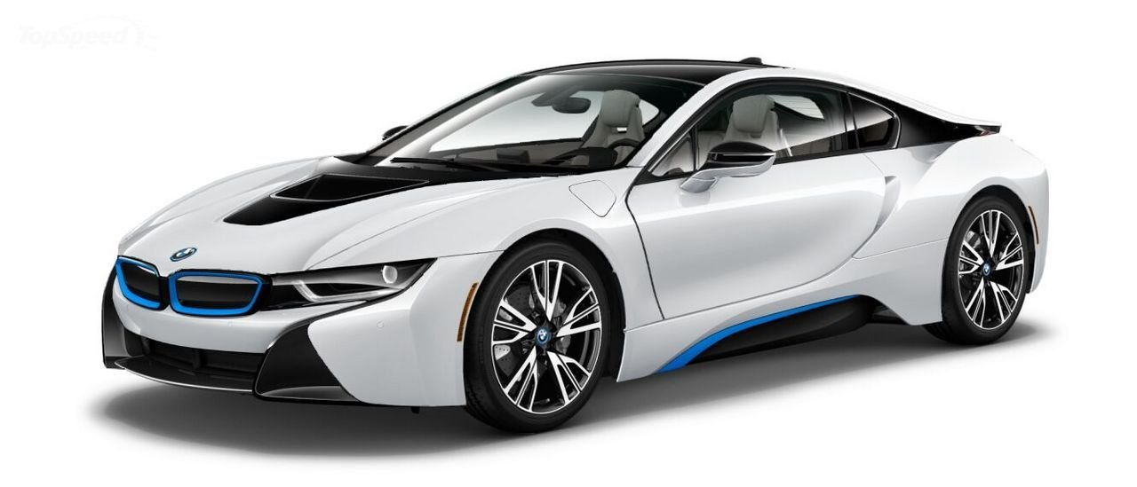
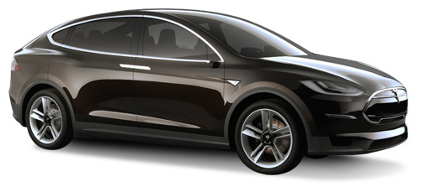
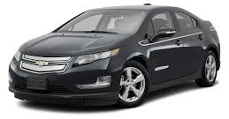

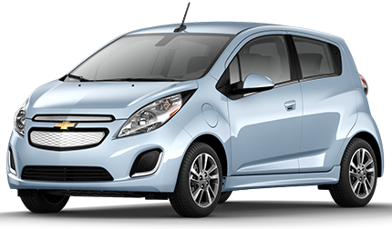

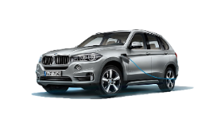
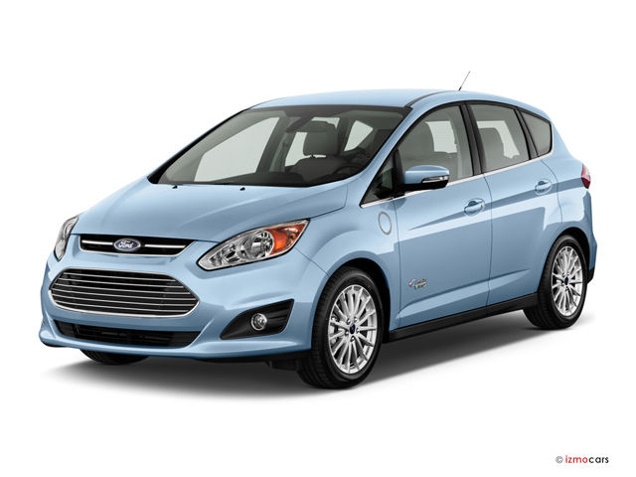

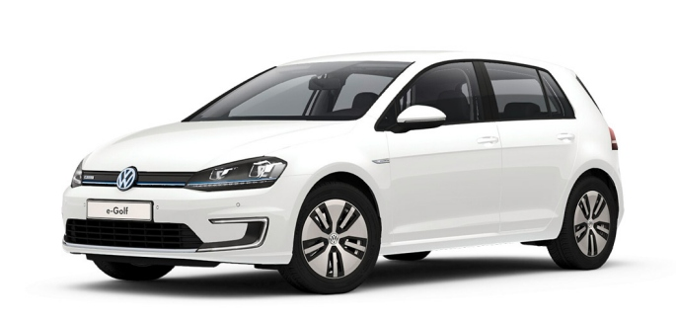
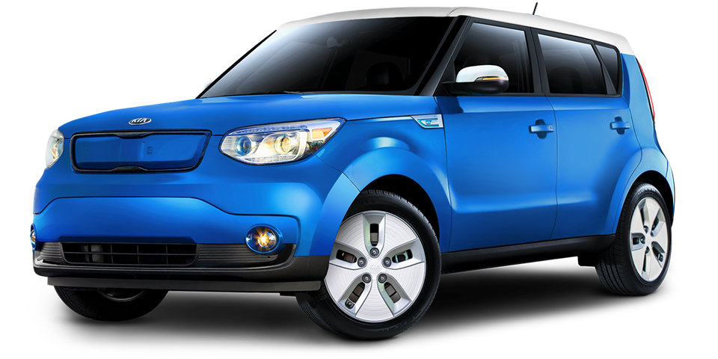
Electric Vehicles Are Here
PORSCHE: Panamera
BMW: i3
MERCEDES: S550e
TESLA: Model S
October 2013
May 2014
July 2015
CADILLAC: ELR
MERCEDES: B-Class
VOLVO: XC90
June 2012
Premium
December 2013
July 2014
August 2015
Volume
NISSAN: Leaf
FORD: Focus Electric
FORD: Fusion Energi
BMW: i8
TESLA: Model X
December 2010
January 2012
February 2013
August 2014
September 2015
CHEVROLET: Volt
TOYOTA: Prius PHEV
CHEVROLET: Spark EV
PORSCHE: Cayenne
BMW: X5 xDrive 40e
December 2010
February 2012
June 2013
November 2014
October 2015
FORD: C-Max Energi
FIAT: 500e
VW: e-Golf
KIA: Soul EV
BEV
PHEV
October 2012
July 2013
October 2014
October 2014
2010 - 2011
2012
2013
2014
2015

Slide 9


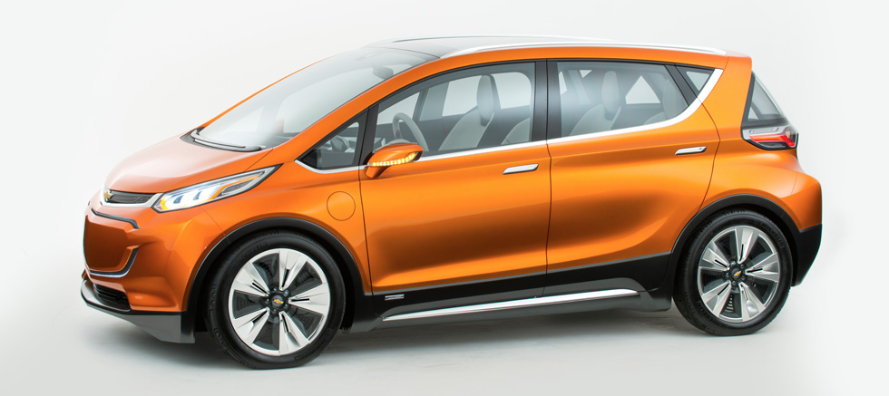
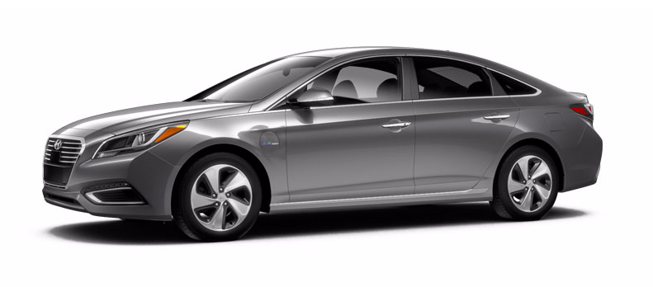
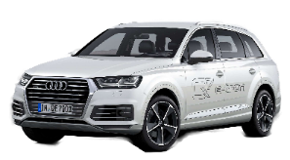

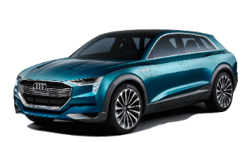
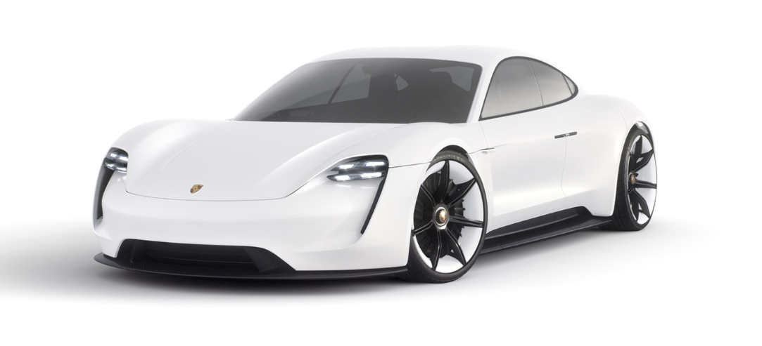

More Models Are Coming
AUDI: A3 e-tron
HYUNDAI: Sonata
MITSUBISHI: Outlander
CHEVROLET: Bolt
November 2015
Est. 2016
Est. 2016
Est. 2016
AUDI: Q7 e-tron
VW: CrossBlue
AUDI: e-tron quattro
PORSCHE: Mission E
Est. 2016
Est. 2017
Est. 2018
Est. 2018
HYUNDAI: New sedan
HONDA: New
FORD: New
TESLA: Model 3
HONDA: New
Est. 2016
Est. 2018
Est. 2018
Est. 2018
Est. 2018
Volkswagen Group, Volvo: all models will have a plug-in option
BMW: all models will have a plug by 2025
Hyundai: 12 PHEV models by 2020

Slide 10


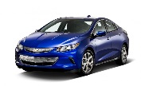

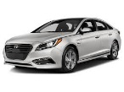

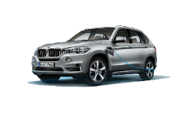




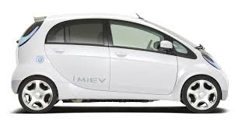
All EVs Are Not Created Equal…
Plug-In Models Vary
Chevy Volt
Toyota Prius Prime
Mercedez GLE 550e
Mercedez S 550e
Mercedez C 350e
PHEV
Battery Size
Range
Fuel Type
Charge Capability
Ford Fusion Energi
Ford C-Max Energi
Hyundai Sonata
Volvo XC90
Cadillac ELR
Porsche Panamera S E-Hybrid
Porsche Cayenne S E-Hybrid
Audi A3 E-Tron
BMW i8
BMW X5 xDrive40e
BEV
Ford Focus
Fiat 500 E
Mercedes B Class
smart EV
BEV with DC Fast Charge
Nissan LEAF
BMW i3
Tesla Model S
Tesla Model X
Chevy Spark
Kia Soul EV
Mitsubishi i-MiEV
VW e-Golf

Slide 11
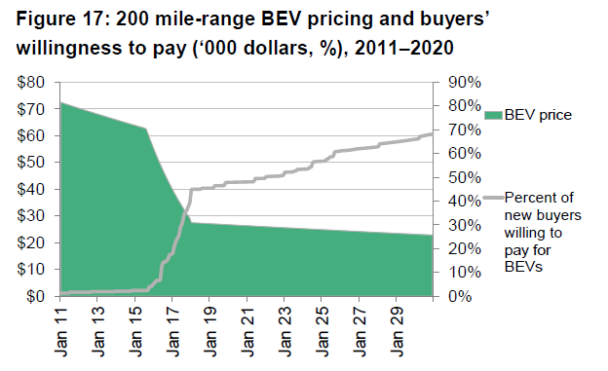
EVs On Threshold of Mass Market Adoption
$30K Price Point & 200 Mile Range Critical Cost & Performance Thresholds
200 Mile-Range BEV Pricing
and Buyers’ Willingness to Pay
(‘000 dollars, %) 2011–2020
Availability of ~200 mile Model 3, Bolt, LEAF & others in 2018 moves the BEV into mass market
Source: Bloomberg New Energy Finance

Slide 12
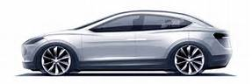
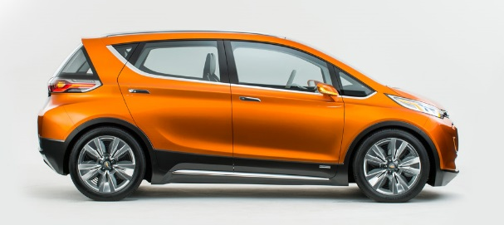
It’s Happening Already
Range
Price*
Availability
Model 3
215 miles
$35K
2018
Chevy Bolt
200 miles
$37.5K
2016
*Federal and other incentives will drive prices lower

Slide 13
Infrastructure 101
Type | Power Supply |  | Charger Power | Charging Level | Charger Location | Charge Time | Miles Per Hr Charge
Trickle Normal | 120VAC Single Phase | 12A | 1.4kW | Level 1 (L1) | On-board | 18+hr | 5
 | 240VAC Single Phase | 15A | 3.3kW | Level 2 (L2) |  | 8hr | 12
 |  | 30A | 6.6kW |  |  | 4hr | 25
DC Fast | 480VAC 3-phase |  | 50kW | DC Fast Charge (DC L2) | Off-board | <30min | 200

Slide 14
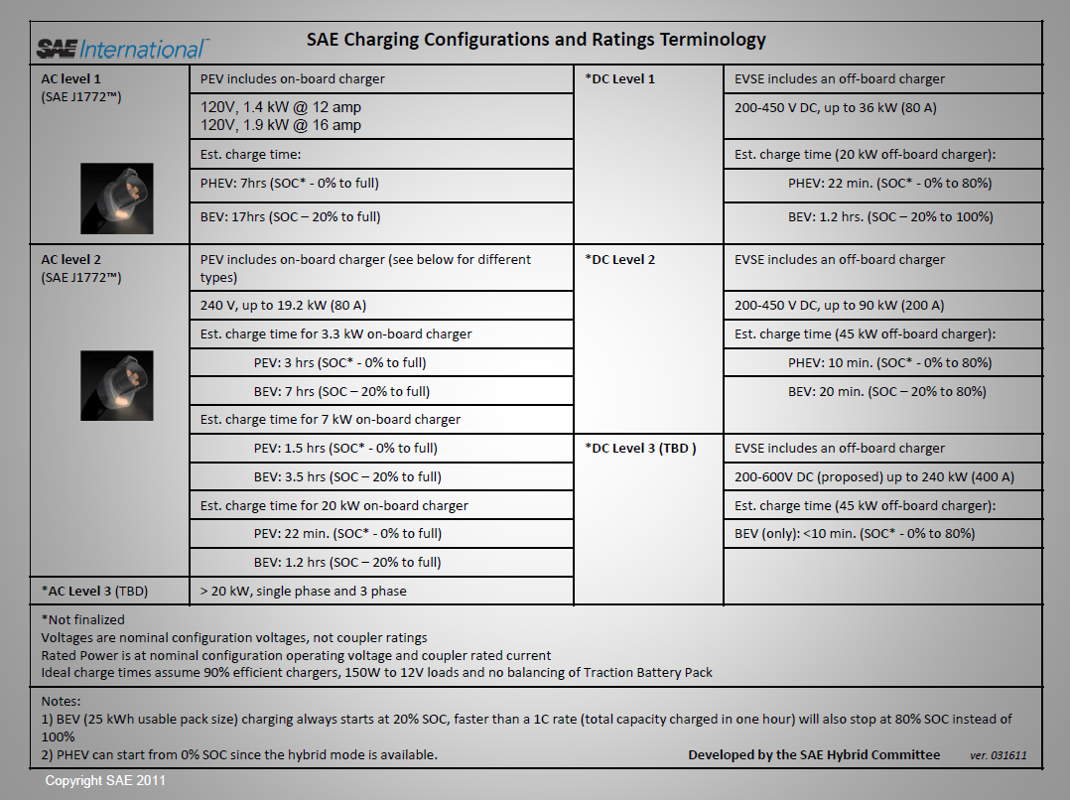

Slide 15


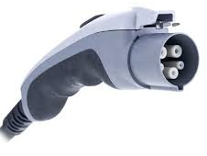




EV Charging Station Connectors
 | SAE J1772 (AC) | SAE J17772 CCS (DC) | CHAdeMO (DC) | Tesla
Connector
Vehicle Inlet
L1 & L2
DC L2
DC L2
L2 & SC

Slide 16
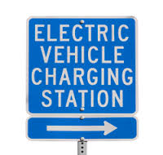
Industry Standards Developing on a National Scale
Connector
Communication protocols
Interoperability
Station ID
NIST HB144

Slide 17



Electric Vehicle Supply Equipment as defined by National Electric Code
Utility
EVSE
NEC Article 625
1
2
3
The provisions of this article cover the electrical conductors and equipment external to an electric vehicle that connect an electric vehicle to a supply of electricity by conductive or inductive means, and the installation of equipment and devices related to electric vehicle charging.
Utility Distribution Service
Site Host Electrical Facilities
Site Host EV Charger EcoSystem
Utility pad
transformer
Utility Meter
Electrical Panel and Line Extension
Site Host EV Charger(s) & Services
Plug-in electric vehicle
Utility Service Connection
Site Host EV Infrastructure
EV Charger Equipment & Services
Demarcation Line

Slide 18





Paradigm Shift:
Fueling when you arrive, not on the way there
Technology doesn’t require
a gas station model, so...
Drivers will want to top-off
wherever they park

Slide 19

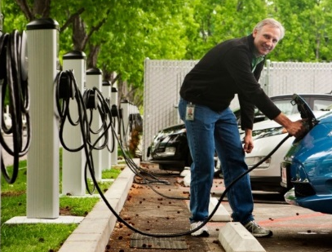
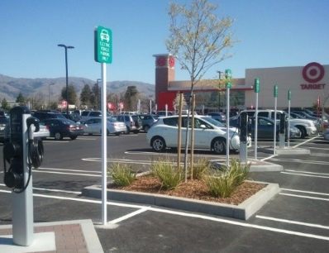
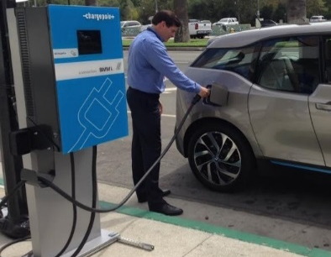
Where Are Drivers Charging Their EVs?
Home | Work | Public - Retail | Highway Charging
Single Driver | Employees | General Public, Customers | Long Distance Drivers
Level 1 and 2 | Level 2 | Level 2, Fast DC 20KW | Fast DC 50KW
Overnight | Daytime | Business Hours | Occasionally, Quick Charge
Residential Garage/Driveway | Designated Parking Spaces | Retail Outlets, Public Parking | InterCity. Highways

Slide 20



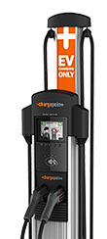
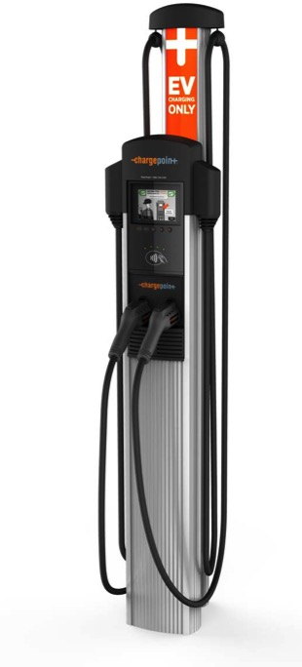
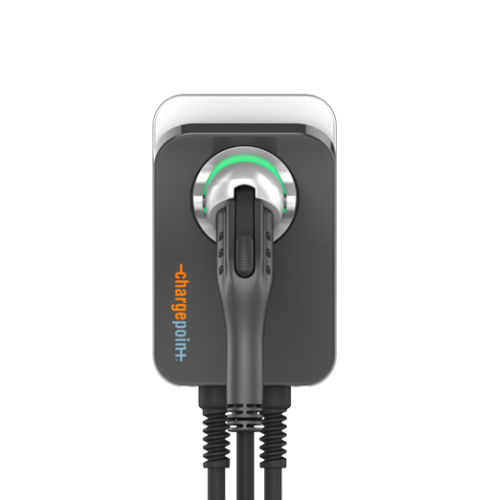

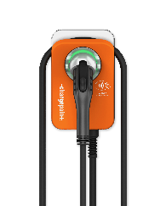
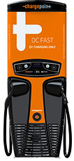
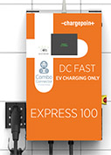
Different Sites Require Different Charging Stations…
Home
Workplaces
Retail & Hospitality
Multi-family
Homes
Fleet
Hotel and Travel
Home:
Single Family Home
CT4000: “Mixed Use” Level 2 charger
CPF25*: “Multi-Family and Fleet Applications
CPE100: 24kW DC Fast Charger
CPE200: 50kW DC Fast Charger

Slide 21
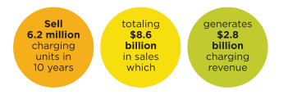
The EV Charging Industry
Globally more than 50 players make up the EV charging industry providing equipment, infrastructure and services.
In the next 10 years, the EV charging industry is expected to generate $8.6 billion in sales.
Source: Navigant Research, “Electric Vehicle Charging Services” Q1 2015

Slide 22

Network Services
Our network:
Smart charging for everyone
Smart Charging for Everyone

Slide 23
Power of the Network
Cloud services….
Access control by time, vehicle, individuals or groups
Set varied pricing by time, energy or driver
Generate usage reports and track environmental figures
Remote station services support
Mange ROI, energy usage and cost
24/7 remote support for drivers
Real-time availability
Dynamic Load Management

Slide 24











Charging services are not all created equal…
Time of Use Access Control per user type
Flexible pricing and automated collections
Station Reporting and Analytics
Energy management/
Demand response
Waitlist
APIs for back end integration
Cloud solution: new features and no software to install
Unlimited logins of varying role and scope
Same interface for all station models
Advertising & branding
Host/Station support
24/7 Driver support

Slide 25
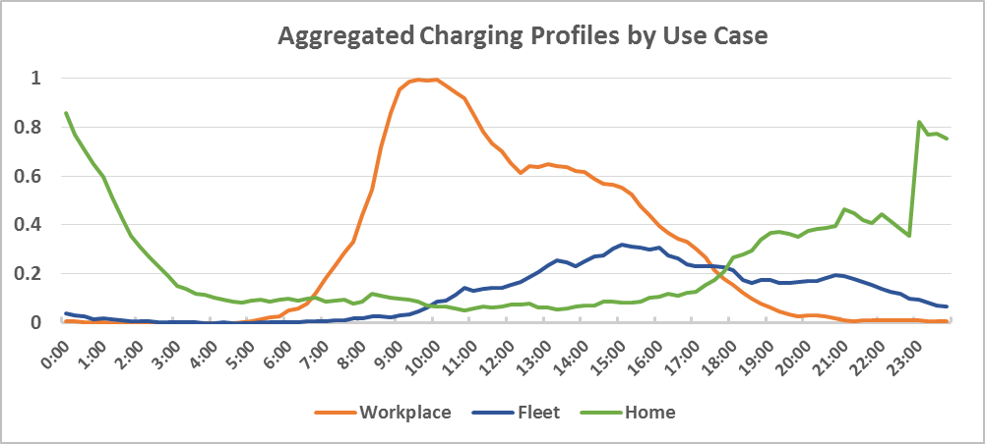

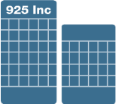

Intelligent and Connected Charging Solutions Enable Renewable Integration
Charge Incentives
Notifications
“Green” Fuel
Employee / Tenant Services
GHG Tracking
Enhanced Sustainability
Energy Mgt.
Visibility
Flexible Load
Load Balancing
Distribution Planning
Driver
Site Host
Different use cases can provide different value to the grid
Profiles are aggregated loads from groups of customers for each use case
Meant to capture trends only, actual profiles vary by customer!
Utility

Slide 26


Driving a Better Way

Slide 27
Thank You

