Slide 1
Combined Heat and Power (CHP) For Resiliency Accelerator
The CHP for Resiliency Accelerator supports and expands the consideration of CHP solutions to keep critical infrastructure operational every day and night regardless of external events.

Slide 2
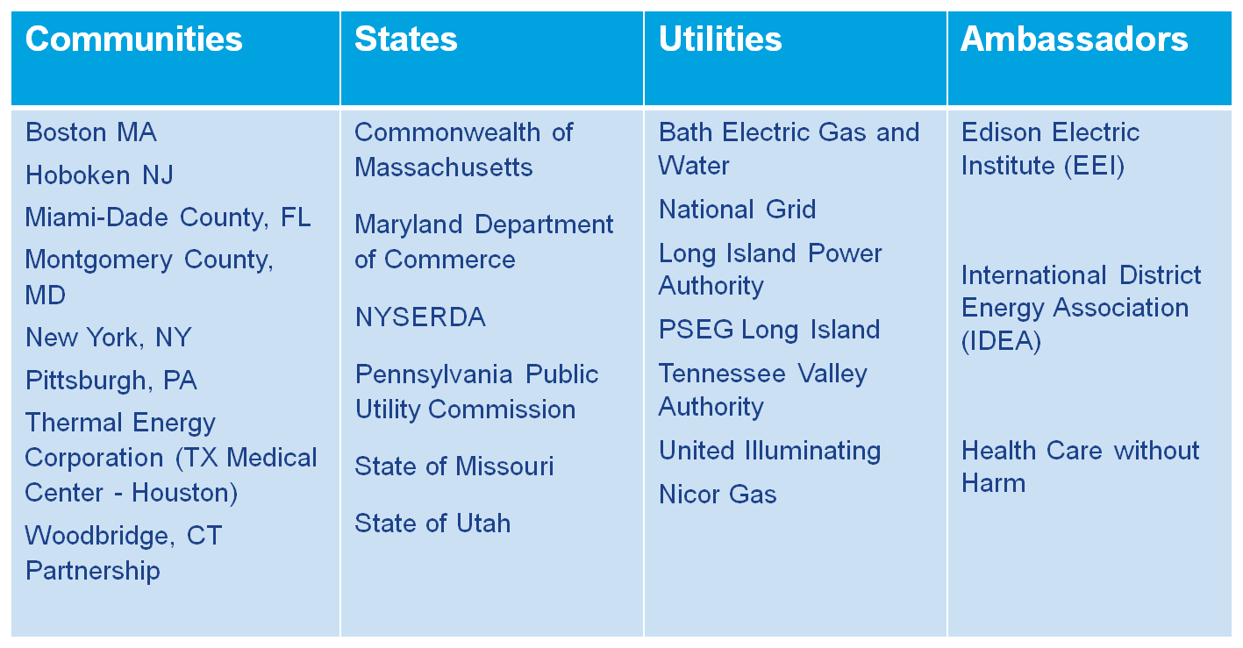
CHP for Resiliency Accelerator
In a program facilitated by DOE, Accelerator partners collaborate to share visions, goals, and approaches to consider and value CHP in their resiliency planning and investment strategies.

Slide 3
Partner Benefits and Participation
Benefits to Accelerator Partners:
Exchange lessons learned with other leading Partners on critical infrastructure planning and the technologies, policies and solutions in place and available.
Be leaders in resiliency planning, introducing CHP solutions to local critical infrastructure with support from DOE in assessing strategies to overcome local barriers.
Bring developed tools and resources back to the community that will lead to increased resiliency while also maximizing economic and environmental benefits.
Receive national recognition for leadership, innovation, and commitment to CHP and resiliency.
Accelerator Participation:
Appoint a lead to coordinate the Partner’s involvement in the Accelerator.
Convene or actively participate in a local dialogue around the value proposition for CHP in resiliency planning.
Identify barriers in your community to including CHP in resiliency planning for critical infrastructure
Develop a community resiliency action that incorporates CHP in resiliency planning for critical infrastructure and identifies specific facilities where CHP can provide a solution.
Share processes and procedures utilized to support replication in other communities.

Slide 4
Current Missouri Participation - DED
Resiliency Goals – Department of Economic Development, Division of Energy
Promote energy resiliency in critical facilities during utility provider outages caused by severe weather and similar events.
Enhance economic development activities by promoting the combined energy efficiency and resiliency benefits associated with CHP.
Key Activities
Completed - Feasibility study to utilize CHP in the Capitol Complex.
Planned – Identify one target sector for Lead-By-Example collaboration.
Goal - Initiate one Lead-By-Example project within target sector.
What hope to gain from the CHP Accelerator
Better understanding of CHP applied to critical facilities.
Learning and development through peer-to-peer exchange.
Contact barbara.meyer@ded.mo.gov (573) 526-5017

Slide 5
How to participate
Contact DOE for more information, fact sheet and partnership agreement.
Claudia Tighe Deployment Program Manager Office of Energy Efficiency and Renewable Energy U.S. Department of Energy claudia.tighe@ee.doe.gov
Anna Shipley
CHP for Resiliency Accelerator Coordinator
On Contract to the USDOE CHP Deployment Program
Anna.Shipley@icf.com
703-272-0007
Participation is voluntary and free. Expectations are that you will make a good-faith effort to:
Participate in collaborative phone meetings moderated by DOE.
Respond to information requests from DOE and partners by phone or email.
Support DOE efforts to provide resources of common interest to be made available to all partners via a members-only forum.
Optionally, participate in onsite meetings held annually in conjunction with the Better Buildings Summit in Washington, D.C. in May.

