Slide 1
Tower Grove Community Development Corp is an affordable housing developer and provider in St. Louis City.
TGCDC’s mission is to promote and improve quality of life by attracting public and private investment and providing real estate and other community services.
Dana Gray, Community Outreach Coordinator, info@danagray.com
https://www.towergrovecdc.org/
Member of the Missouri Energy Efficiency for All coalition, MO-EEFA

Slide 2
Suggestions for reaching households with low income levels
Create 20% set aside for low-income multifamily buildings.
Provide one-stop shop technical assistance to affordable multifamily housing providers.
Streamline income eligibility requirements. Robert Garber shared on 4/20/2023 the MO DOE is already doing this for Weatherization program.
Require affordability; no rent increase beyond annual cost of living increase. If property is sold, require the new owner to maintain the affordability agreement.
Application process & reporting, consider how this can be simplified / streamlined.
When ready, send notice of programmatic applications through MO-EEFA, MO Workforce Housing Assoc, Community Builders Networks of STL & KC, Public Housing Authority(s), MHDC.

Slide 3
Suggestions for reaching households with low income levels
Provide up-front pre-development funds for qualified energy efficiency and electrification projects in affordable MF housing.
Affordable housing owners have very thin operating budgets and often can’t afford to pay for the design/development fees, feasibility studies and legal fees associated with comprehensive energy efficiency projects. This can be a significant barrier to getting these projects done.
Predevelopment loans for affordable rental housing projects are often the hardest resources for developers and owners to obtain. Affordable housing owners have limited cash flow, which is a significant barrier to undertaking energy upgrades. These owners don’t have access to capital to pay for predevelopment costs such as electrification feasibility studies, or to bridge costs throughout the retrofit process. Early-stage capital is needed to pay for predevelopment costs but is not widely available in the context of decarbonization. Affordable housing developers often struggle to receive predevelopment loans since they are covering early stage soft costs which is riskier from a financing perspective.
Many state and utility incentive programs do provide some incentives for predevelopment work. The IRA Rebate Programs should do the same.

Slide 4
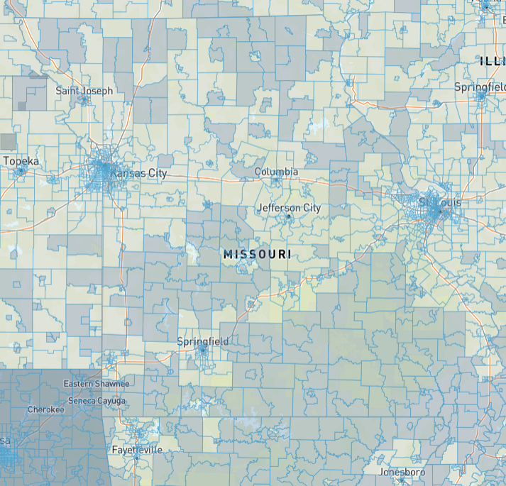
The Climate and Economic Justice Screening Tool (CEJST) is a geospatial mapping tool designed to identify disadvantaged communities that are marginalized and overburdened by pollution and underinvestment.
The darker areas are those identified as disadvantaged
This mapping tool identifies communities who will benefit from the Justice 40 Initiative
https://www.whitehouse.gov/environmentaljustice/justice40/.

Slide 5
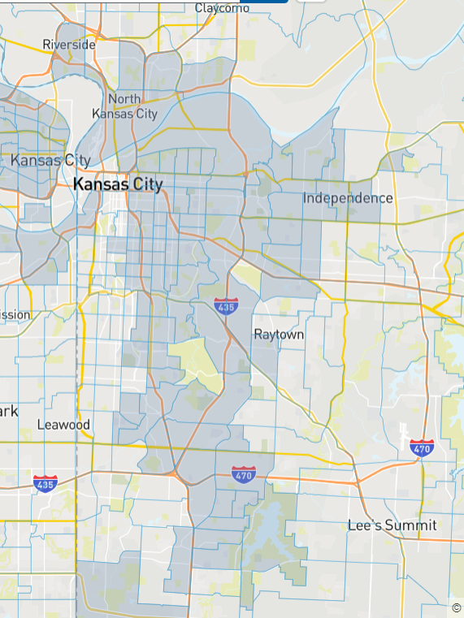
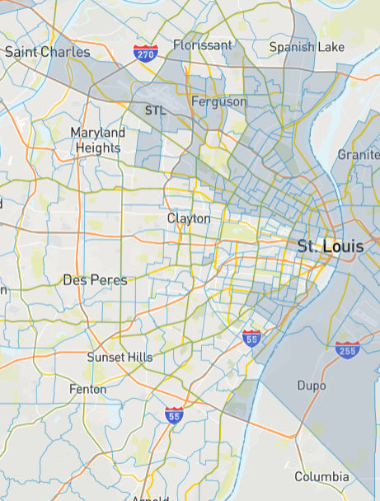
These maps from the Climate and Economic Justice Screening Tool (CEJST) show the Kansas City and St. Louis area’s disadvantaged communities that are marginalized and overburdened by pollution and underinvestment.
https://screeningtool.geoplatform.gov/en/#9.92/38.6529/-90.4478

Slide 6
Suggestions for reaching households with low income levels
Encourage MO Housing Development Commission to align QAP with IRA.
Who will ensure Justice 40 is implemented into the State Plan for deployment of IRA funds?
How can energy efficiency advocates assist?

