Slide 1
A Decoupling Foundation
Missouri PSC Workshop on Decoupling
Presented by Richard Sedano
September 17, 2015

Slide 2
Introducing RAP and Rich
RAP is a non-profit organization providing technical and educational assistance to government officials on energy and environmental issues. RAP staff have extensive utility regulatory experience.
  Richard Sedano directs RAP’s US Program. He was commissioner of the Vermont Department of Public Service from 1991-2001 and is an engineer.

Slide 3
This Presentation
Basics of decoupling
  Why states do it
  The Calculations
  Design Principles
Decoupling and Water Utilities
Some Decoupling Experiences

Slide 4
Specific Issues Called out by staff
Legality of decoupling in Missouri
Preferences of Missouri stakeholders for decoupling features found in mechanisms elsewhere
Rate impact effects of decoupling

Slide 5
If the answer is decoupling, what is the question?
Traditional regulation motivates a utility
  to increase sales, and
  to resist reducing sales
  This is the ‘throughput incentive’

Slide 6
Is there something wrong with the throughput incentive?
There are many reasons why utility sales might go up or down, but what should the utility motivation be?
Aligning utility incentives with the public interest to the maximum degree
  Public interest appears to be in conflict with the throughput incentive
  An aggressive EERS is likely to be in conflict with the throughput incentive

Slide 7
Deeper: What’s the Problem with the Throughput Incentive?
Utility rate designs recover fixed (investment and labor) costs in the volumetric charge
Instability - If sales decline, profits decline, if sales increase, profits increase
EE, DG, other policies reduce sales …
  Not just what utility does, but markets do too
Decoupling is a tool to address the throughput incentive

Slide 8
At a high level, what does decoupling do?
Decoupling is a regulatory mechanism to ensure that utilities have a reasonable opportunity to collect roughly the same revenues that they would under conventional regulation, independent of changes in sales volume for which the regulator wants them to be indifferent.

Slide 9
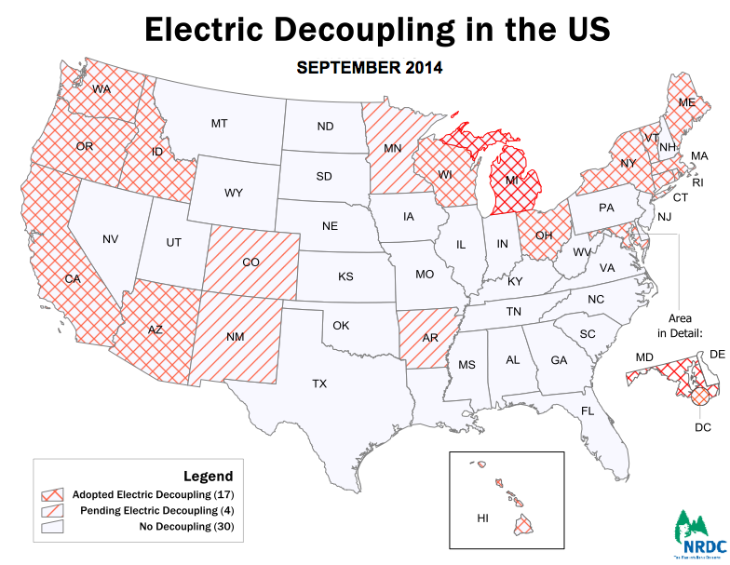

Slide 10
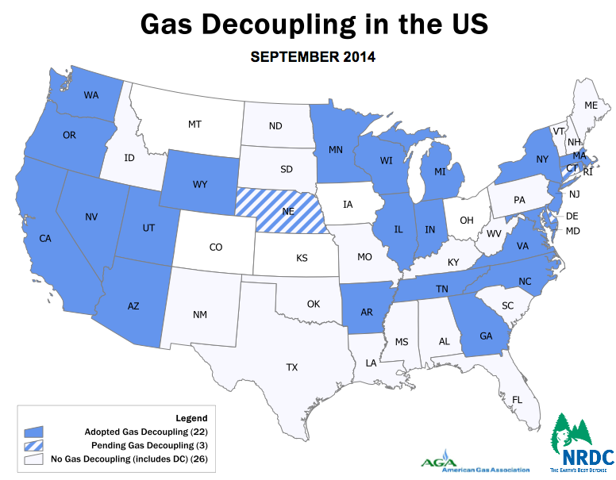

Slide 11
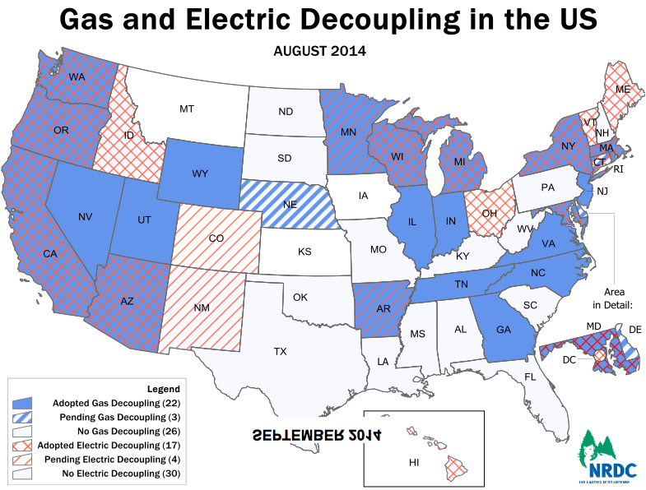
The MAP goes here

Slide 12
Legality of Decoupling
Some states ban changes to rates outside a rate case
  This stops decoupling
  Some states have clarified this in statute
Some states have a longstanding assignment of discretion to regulate utilities as appropriate
  Allowing reconciliations in decoupling without an explicit statute

Slide 13
What does decoupling do?
Adjusts rates (prices) and usually revenues between rate cases
Relies on found revenue requirement
When sales deviate from rate case assumption, rate is adjusted to collect calculated revenue
  Basis can reflect changes owing to trends or forecasted events, an added level of complexity

Slide 14
Revenue Regulation: a more descriptive term for what we are doing

Slide 15
Comparing Decoupling with Traditional Regulation
Traditional regulation sets prices and lets revenues rise and fall with sales volumes
Most utility costs, other than power supply vary little in the short run with respect to sales
If prices are set to recover non-power costs by volume, then lower/higher sales means lower/higher profits
Decoupling resets revenues to recover non-power costs by adjusting the price

Slide 16
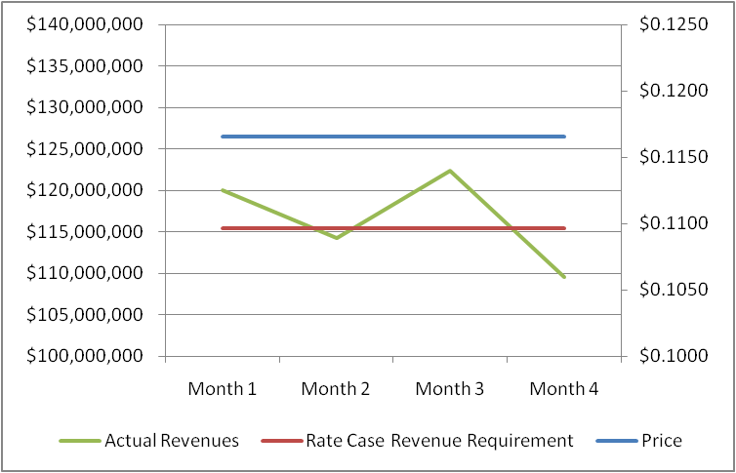
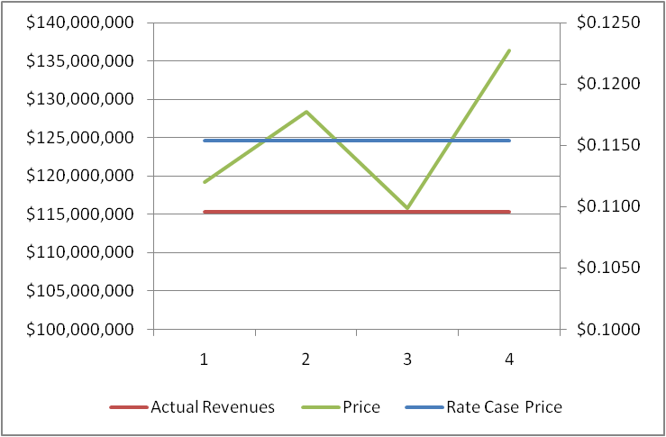
A Well-Designed Decoupling Mechanism Provides Predictable Revenue Independent of Sales
Traditional Regulation:
Constant Price =
Fluctuating Revenues/Bills
Decoupling:
Precise Revenue Recovery =
Fluctuating Prices
Revenues = Price * Sales
Price = Target Revenue ÷ Sales

Slide 17
Simple Calculations: Basic Regulation
(electric)
Rate Base x Rate of Return = Return
Return + Operating Expenses + Taxes = Revenue Requirement
Revenue Requirement / Sales (kWh) =
Rates ($/kWh)

Slide 18
The Decoupling Calculation
Utility Target Revenue Requirement determined with traditional rate case
  By class & by month (or other period coinciding with how often decoupling adjustment is made)
Each future period will have different actual unit sales than Test Year
The difference (positive or negative) is flowed through to customers by adjusting Price for that period (see Post Rate Case Calculation)
No change in target revenue

Slide 19
The Revenue per Customer
Decoupling Calculation
In any post-rate case period, the Target Revenue for any given volumetric price (i.e. demand charge or energy rate) is derived by multiplying the RPC value from the rate case by the then-current number of customers

Slide 20
Rate Design Elements (nothing new here)
Use a Customer Charge for customer specific costs (metering, billing)
Use a Demand Charge (generally for larger customers) for costs that vary with peak demand
Energy charge generally recovers most production, T&D/delivery costs
  Full recovery in volumetric charges
  Time, Usage sensitivity (inclining blocks)

Slide 21
Effect of decoupling on rate design
(this page left blank intentionally)

Slide 22
Decoupling and Rate Design
Rate design is getting increased attention for the price signals sent to customers
  Align price signals to public policy and efficient investment, including but not limited to traditional rate design practices
Decoupling does nothing to interfere with price signal or allocation objectives, public policy orientation is consistent

Slide 23
A Well-Designed Decoupling Mechanism Provides Predictable Revenue Independent of Sales
Traditional Regulation:
Constant Price =
Fluctuating Revenues/Bills
Decoupling:
Precise Revenue Recovery =
Fluctuating Prices
Revenues = Price * Sales
Price = Target Revenue ÷ Sales

Slide 24
Decoupling and Power Costs
Fuel part of power costs can be volatile
  Not easily adaptable to decoupling
  Fuel adjustment clause in wide use anyway
Fixed part of owned generation costs are adaptable to decoupling
  One of many decoupling design choices

Slide 25
Is there an analog to power costs in water utilities?
Throughput incentive: Yes to both
  Decoupling enables efficiency
Capital portion of costs: Higher for water
Decoupling mechanisms can have reopeners or exceptions
  Dealing with exogenous or huge effects
  Large (lumpy) capital events in water systems

Slide 26
Analog to Natural Gas
Throughput incentive: Yes to both
  Decoupling enables efficiency
Capital portion of costs: Higher for Gas

Slide 27
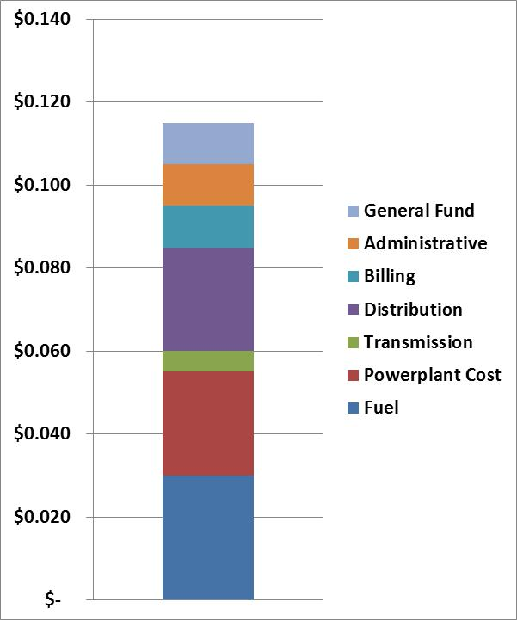
What Causes
Net Revenue Instability?
To encourage economic efficiency, rates should reflect long-run marginal costs, including societal costs like emissions.
In the short run, utility expenses vary with short-run marginal costs.
These may be VERY different from long-run costs.
In the long run, all costs are variable.
In short run, you incur or avoid market cost for power
Notes:
Not sure about keeping this one

Slide 28
How Changes in Sales
Affect Earnings
Revenue Change
Impact on Earnings
% Change
in Sales
Pre-tax
After-tax
Net Earnings
% Change
Actual ROE
5.00%
$9,047,538
$5,880,900
$15,780,900
59.40%
17.53%
4.00%
$7,238,031
$4,704,720
$14,604,720
47.52%
16.23%
3.00%
$5,428,523
$3,528,540
$13,428,540
35.64%
14.92%
2.00%
$3,619,015
$2,352,360
$12,252,360
23.76%
13.61%
1.00%
$1,809,508
$1,176,180
$11,076,180
11.88%
12.31%
0.00%
$0
$0
$9,900,000
0.00%
11.00%
-1.00%
-$1,809,508
-$1,176,180
$8,723,820
-11.88%
9.69%
-2.00%
-$3,619,015
-$2,352,360
$7,547,640
-23.76%
8.39%
-3.00%
-$5,428,523
-$3,528,540
$6,371,460
-35.64%
7.08%
-4.00%
-$7,238,031
-$4,704,720
$5,195,280
-47.52%
5.77%
-5.00%
-$9,047,538
-$5,880,900
$4,019,100
-59.40%
4.47%
Notes:
28

Slide 29
Full Decoupling
All effects on sales reflected
  Sales, weather, economy
  Throughput incentive fully resolved
Options to partially address the throughput incentive
  Normalizations
    Weather (degree days)
    The economy

Slide 30
Two approaches to Decoupling both start with rate case revenue requirement
Revenue per customer
  Calculated by dividing rev reqmt by number of customers = RPC
  Distinguish appropriate classes
  Periodic Ministerial process: RPC x actual customers = new rev reqmt, then divide by actual sales = new rates
  “K factor” option to account for identified trends and future changes
Attrition
  Periodic Evidentiary proceedings: what has changed, reset rev reqmt
  Use actual sales and new rev reqmt to set new rate
  Comfort needed in this “exception-based” process

Slide 31
Why RPC might be appealing
In many utility systems, short term costs are correlated with customer counts
  Especially in a territory that is not “built out”
  It might be lumpy, but Δ customer count still representative of Δ fixed cost

Slide 32
What is this K Factor?
Why might the future be different from the past?
Adjust for identified trends or forecasts that are likely to change the basis of the revenue requirement
  Inflation -- Size of Households
  Productivity -- Capital Budgets
Can be applied to the revenue requirement
  Or can be applied to the RPC
Has a shelf life as long as the assumptions are reliable
Decoupling 201 – balance value with complexity (first time out, keep it simple)

Slide 33
Decoupling Advantages
RPC simple to administer, customizable
Stabilizes utility revenues
Utility focuses on costs it can control,
Removes utility throughput incentive
  Accommodating aggressive EE
  Maintaining rate design as price signal
  Focus on Policy Priorities? Service?
Delay general rate case (and associated attention and expense) to when driven by underlying cost shifts (not by usage changes)
Process ought to reveal priorities

Slide 34
Decoupling And Performance
Decoupling does not promote:
  EE, DG, etc.
  It does remove sales-driven attitudes that utilities properly have in traditional system – “Enabling”
  It can promote cost cutting
Decoupling is compatible with a performance system
  Build in public interest priorities (new)
  Roll any rewards or penalties into periodic rate adjustment
  Protect against disruptive cost cutting

Slide 35
Decoupling Downsides
Rates change more frequently (generally < power cost adjustment riders) and outside a general rate case
Great success with EE and DG will increase rates, even as total costs may ⬇⬇
  Note that EE participants tend to save far more than rates tend to rise
PUC, others unfamiliar with decoupling
Delays rate cases, which can be illuminating

Slide 36
How Does Decoupling Differ from Conventional Regulation
Conventional Reg.
  Set rates based on cost, and let the revenues flow as sales volumes change between rate cases.
Decoupling
  Set revenues based on cost, and let the rates flow as sales volumes change between rate cases.

Slide 37
A Well-Designed Decoupling Mechanism Provides Predictable Revenue Independent of Sales
Traditional Regulation:
Constant Price =
Fluctuating Revenues/Bills
Decoupling:
Precise Revenue Recovery =
Fluctuating Prices
Revenues = Price * Sales
Price = Target Revenue ÷ Sales

Slide 38
If there will be a rate case every year, do we need decoupling?
Do you want a rate case every year?
Do you need a rate case every year?
If you have a rate case every year, the rate and revenue results of each will be similar if each is done well

Slide 39
Frequent Rate Cases
Having rate cases every year means utility will not keep extra revenue, “the margin,” from increased throughput very long
But
  Rate cases are expensive
  Consume the time of your best thinkers
  Decision-makers reacting, not looking ahead
  Utility still has the throughput incentive

Slide 40
Design Goal for Decoupling
Over time, utility revenues track what frequent rate cases would have produced
  Note emphasis on revenues
  Because over the term of the decoupling mechanism, non-power costs do not change that much
Works best if decoupling becomes the norm

Slide 41

Decoupling comes in various colors

Slide 42

Some proposals to solve our problem are not decoupling

Slide 43
Decoupling is Not
Straight fixed variable rate design
  Shifting all short run fixed costs to the customer charge

Slide 44
Decoupling is not
A lost revenue adjustment mechanism
  That identifies revenues lost specifically due to consumer funded energy efficiency programs and restores that revenue

Slide 45
Third Party Administration of EE
May address concerns about EE program design and delivery
But does not address the motivation of the utility to support EE and DG or its motivation to load build

Slide 46
Decoupling Choices
Regulators Are Asked to Make
Apply to non-power costs or all costs?
Frequency of rate adjustments?
Limits on rate adjustments, disposition of deferrals*
Assessing the risk of the firm, WACC, what to do?
Full, or Factor in weather?
RPC, attrition, both, other revenue requirement Δs?
Addressing changed risk profile of the utility*
Include industrial customers?
Trigger for next mechanism?
Overlay performance?
What to do with earnings above and below target ROE?
Other public interest progress

Slide 47
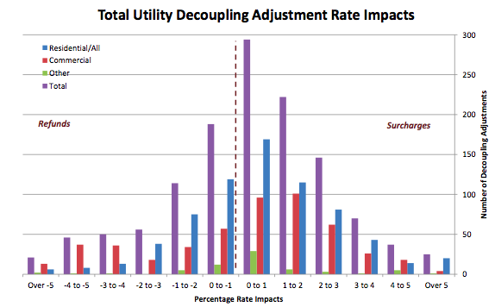
From Pamela Morgan

Slide 48
Return on Equity
Path A
  Let the markets tell us how firm risk has changed
  Evaluate in next rate case
    Be sure to use comparable group of utilities
Path B
  Take an adjustment to ROE right away
    Downpayment on benefits
    Generally works better in a settlement so utility can get something it wants

Slide 49
Decoupling and Risk

Slide 50
Decoupling Choices
Regulators Are Asked to Make
Making these choices in a public, transparent process helps to promote confidence that participants understand what the mechanism is doing, that there is a common understanding, that information is not being withheld, that priorities are built in, that there is value in moving from traditional regulation

Slide 51
Decoupling comes in various colors

Slide 52
Advanced Decoupling Choices
Use the K factor for trends and forecasts
  i.e. The MacMansion effect, or Electric Vehicles, or structural cost Δ (i.e. transmission capital), or productivity
In RPC, adjust customers for outages
  Motivates low outage frequency and duration
Price adjustments monthly, current (MD)
  Conveys information to customers

Slide 53
Words matter: Advantages of the term
“Revenue Regulation”
Focus on revenue
Focus on stabilizing revenue
Avoids conflation of meanings attached to decoupling
Juxtaposes with “Rate Regulation” to aid compare and contrast with a rate cap
Juxtaposes with “Performance- or Incentive-regulation”

Slide 54
Communicating with Customers
Answer: why are my rates changing?
  With relevant policy context and trends
  Transparency makes for clear messages
How is decoupling changing utility priorities and decisions?
How is utility performance?
  Hopefully good news
What do customers want (for future)?
Is there coherence with policy goals?

Slide 55
How Does the “Utility of the Future” Happen?
Service (not throughput) the priority
Customers: service and resources
Public Policy - driven
Risk Management to manage cost
Regulation focuses on value
How can decoupling assist?

Slide 56
Oregon PUC Order 09-020 pg 27
“… PGE does have the ability to influence individual customers through direct contacts and referrals to the ETO. PGE is also able to affect usage in other ways, including how aggressively it pursues distributed generation and on-site solar installations; whether its supports improvements to building codes; or whether it provides timely, useful information to customers on energy efficiency programs. We expect energy efficiency and on-site power generation will have an increasing role in meeting energy needs, underscoring the need for appropriate incentives for PGE.”
Notes:
Important language to signal the scope of what decoupling can do, which fully realizes the influence the utility has in the community.
Beyond EE to all customer resources.

Slide 57
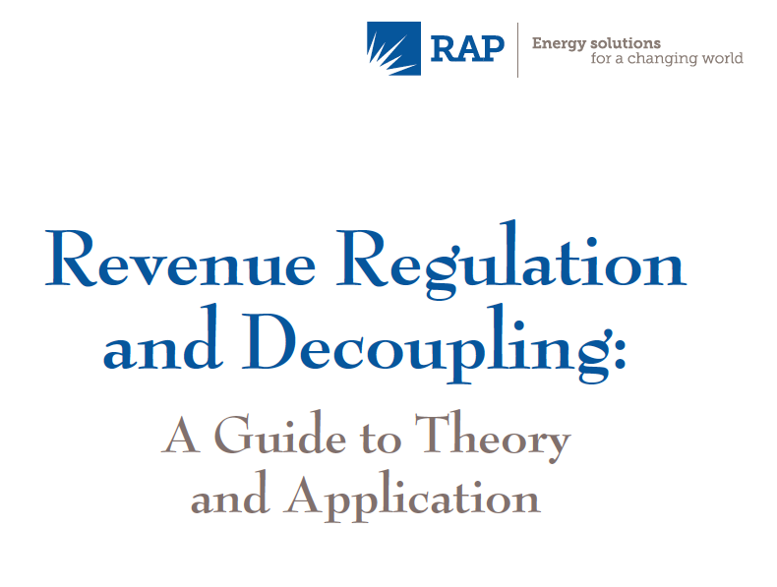
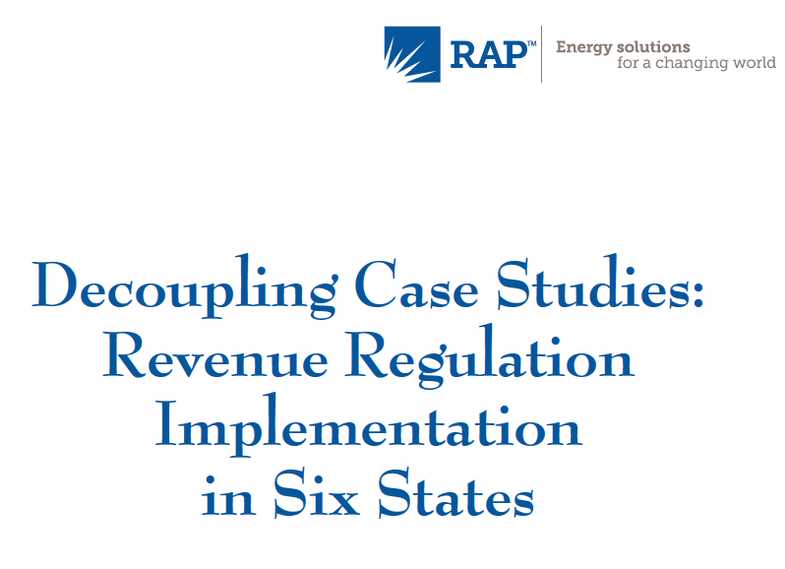
Revenue Regulation and Decoupling
Decoupling Case Studies
A Decoupling Spreadsheet Model
A Decade of Decoupling
Pamela Morgan

Slide 58
rsedano@raponline.org

Slide 59
Rest of the day:
Discussion of Decoupling
The issues called out by the staff
  Legality of decoupling in Missouri
  Preferences for Decoupling mechanism features
  Rate Changes associated with decoupling
Any issues about decoupling any stakeholder wants to discuss

Slide 61
Puget Sound: recent decoupling approval
RPC, applied to delivery costs (power has its own adjustment)
Service quality mechanism pre-existed
More EE, low income Wx and bill assistance
K factor addressing historic utility cost ⬆
Rev reqmt stale, no change to rate design
No EE performance
Resolved other local issues

