Slide 1

Physical Security Concepts & Strategy
Missouri Public Service Commission
John Breckenridge, Director, Corporate Security & Business Continuity
December 2017

Slide 2

Overview
KCP&L Corporate Security Overview
Industry Participation
Emerging Threats
Case Study Example

Slide 3
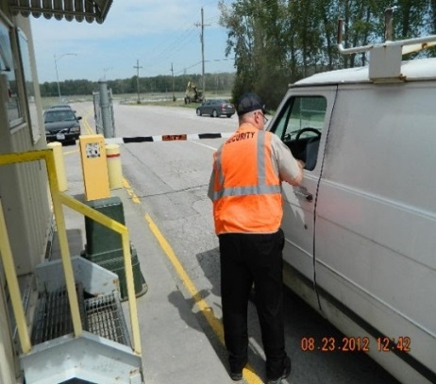
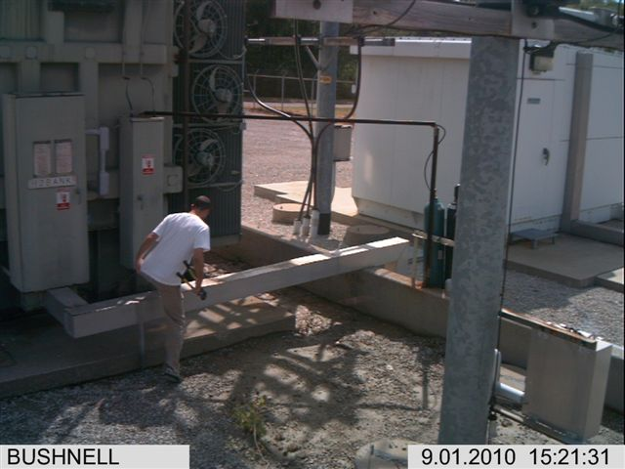
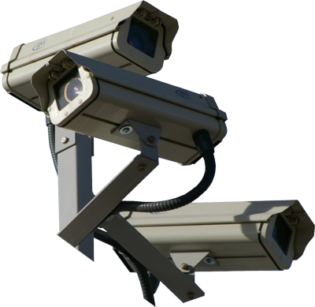
KCP&L Corporate Security Overview
Proactively protecting corporate assets: People, Property and Information
Protective Services
Physical Security
Crisis Management & Business Continuity

Slide 4
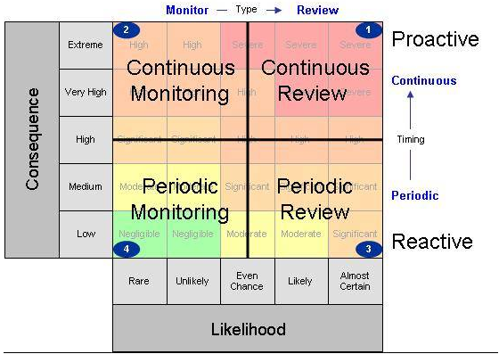
KCP&L Corporate Security Overview
Risk Based Security
Security should be based on risk.
Risk based security identifies the true risks to an organization’s critical assets and directs spending where it is needed most.

Slide 5
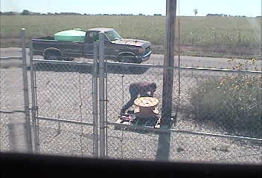
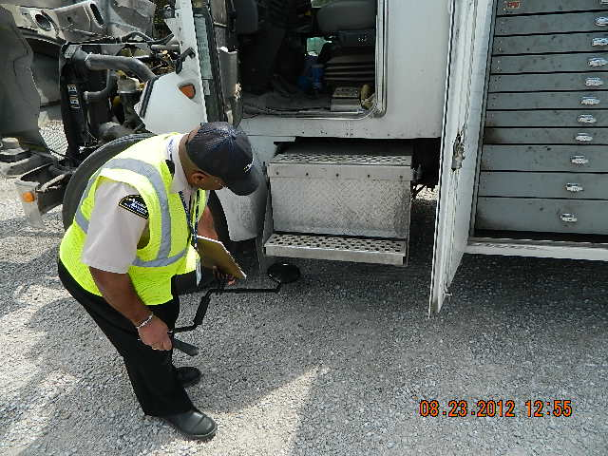
Protective Services
Investigations
Threat Response
Law Enforcement Liaison

Slide 6
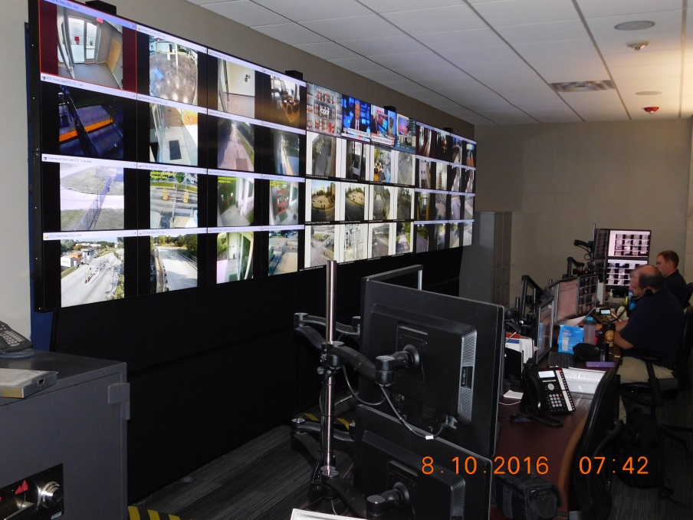
Protective Services
Security Operations Center 816-654-1499
24 x 7 x 365
Access Control
Situation Monitoring
Mobile Responses
  Alarms
  Thefts
  Threat Response
Video Surveillance

Slide 7
Physical Security
Concepts and Strategies
Deter – Visual deterrents such as lighting, signage, visible security systems, vegetation control, security officer presence
Deny/Delay – Fences, lockable gates & windows, natural features, CPTED protection, security screens and quality locks
Detect – Alarm systems, cameras, dogs

Slide 8
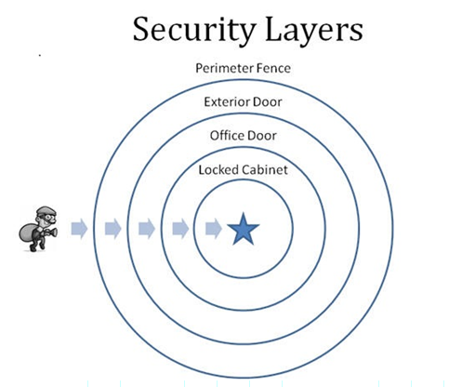
Physical Security
Crime Prevention Through Environmental Design (CPTED)
Layers of Protection
Natural Surveillance
Natural Access Control
Territorial Reinforcement
Maintenance

Slide 9
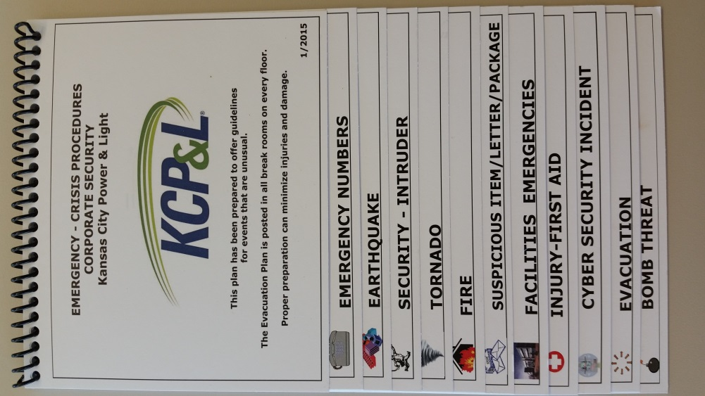
Crisis Management & Business Continuity
Emergency Crisis Procedures
Available at all Company locations
Emergency Numbers
Intruder
Tornado
Fire
Suspicious Items
Facilities Emergencies
Injury First Aid
Cyber Incident
Evacuation
Bomb Threat (telephone)
Earthquake Procedures

Slide 10
Crisis Management & Business Continuity
Active Shooter Program
In-person and on-line Awareness training. (required in 2017).
Base level physical security (4 D’s, DinD, CPTED).
“No Tailgating” policy and Counter surveillance (SOC).
Close partnership with H/R.
Threat Assessments.
Defensive Posture Escalation Plan.
Close Protection Specialists.
360 close the loop processes.
(Overview of Active Shooter Program)

Slide 11
Industry Participation
(Different ways we are involved in the community and industry organizations in leadership capacities)
Government clearances. (JTTF, KCTEW, CIPC, DHS, etc.)
FBI Domestic Security Advisory Council.
Infraguard. (Current President)
Area Maritime Security Council. (Board member)
Crime Stoppers TIPS Hotline. (Board member and Vice President)
NERC CIPC and regional CIPWG. (International voting member)

Slide 12
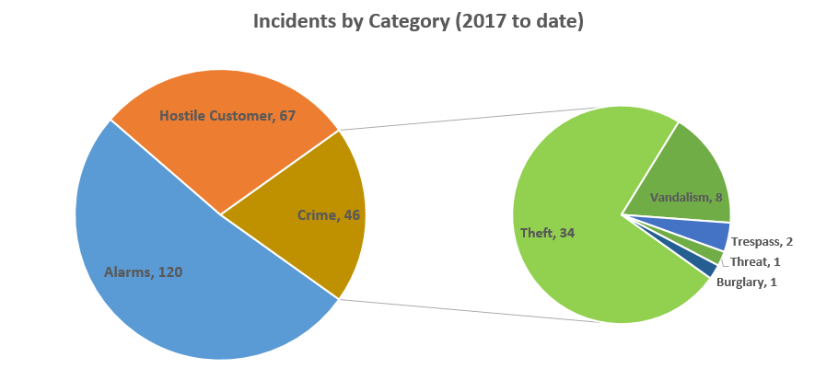
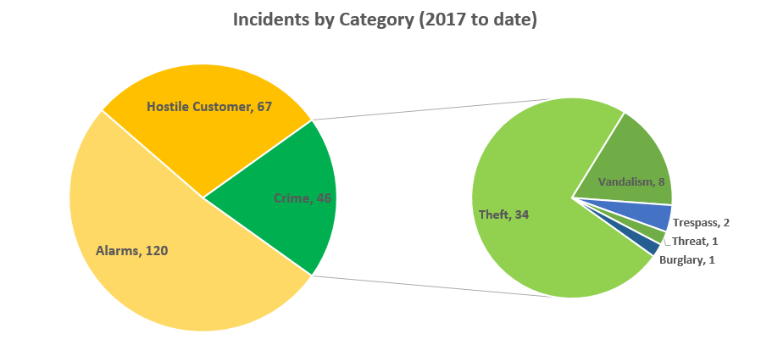
Emerging Threats
(pie chart of key incidents today)

Slide 13
Emerging Threats
(List of new and emerging threats)
Combined physical and cyber attack.
Insider threat.
Civil disturbance.
Availability of firearms.
Drones.
Terrorism.
Low tech attacks.

Slide 14
Case Study
(case study of actual incident, how we responded, etc.)

Slide 15
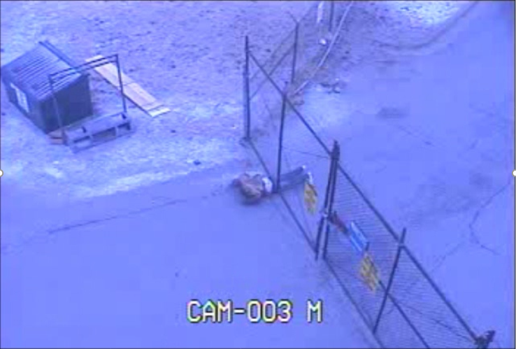
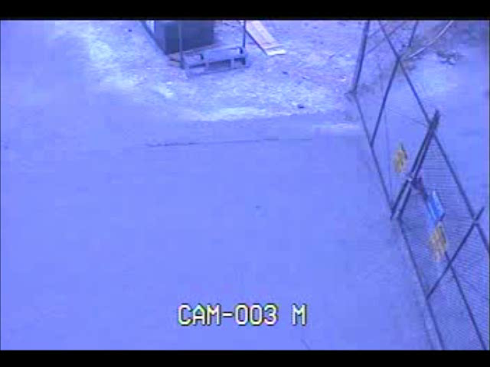
Video

Slide 16
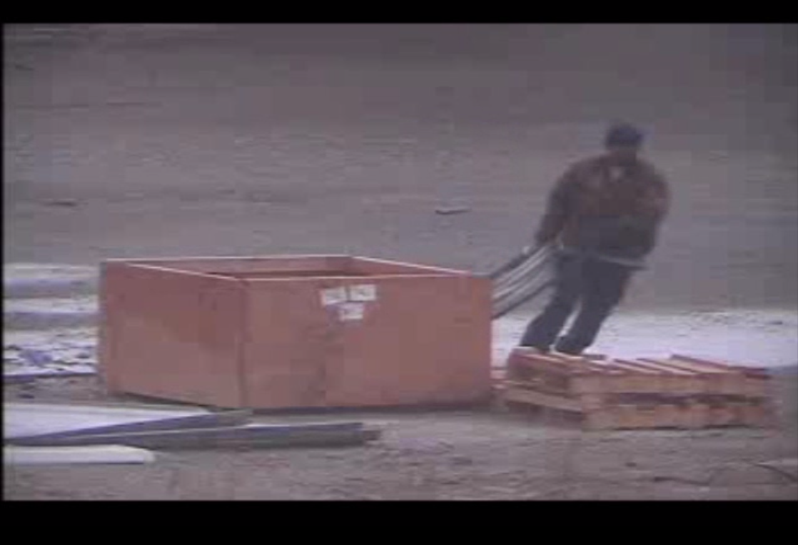
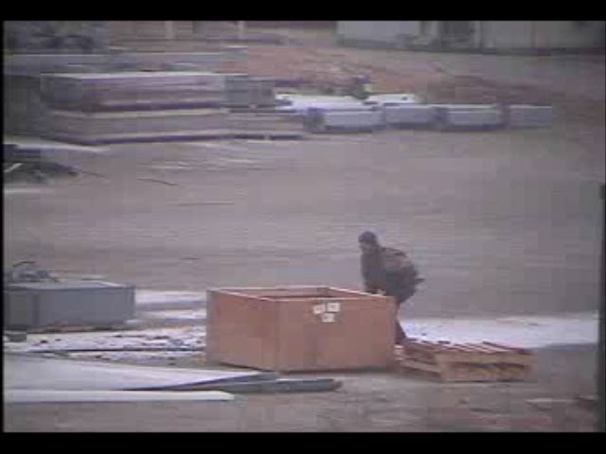
Case Study
(case study of actual incident, how we responded, etc.)

Slide 17
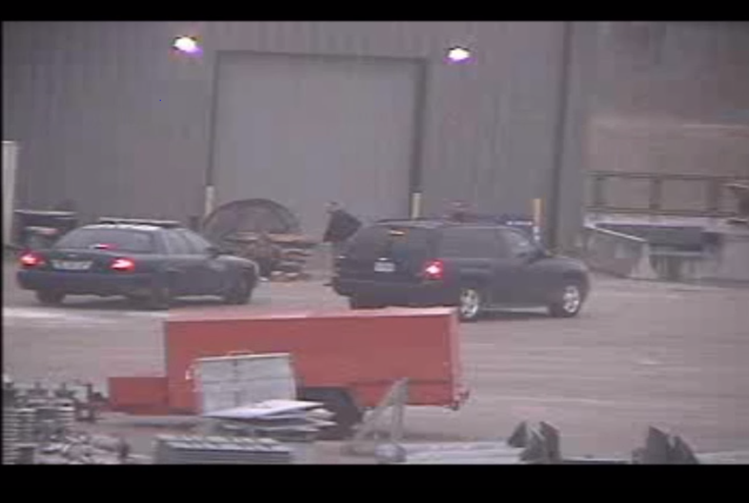
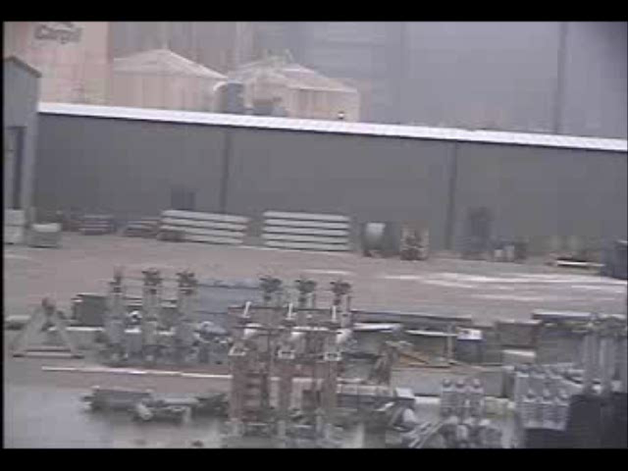

Slide 18
Questions?
John Breckenridge C.P.P.
Director – Corporate Security and Business Continuity
816-654-1725

