Slide 1


Missouri Public Service Commission
Workshop on
EPA’s Clean Power Plan
February 4, 2016
Andy Knott
Sierra Club Beyond Coal Campaign
andy.knott@sierraclub.org

Slide 2

Overview: Missouri Is Well-Poised To Meet Its Clean Power Plan Target
Actual, Announced and Under-Consideration Retirements: 40-68% Toward 2030 Goal
Renewable Energy Investments and Growth: Strong Tailwinds (Literally and Figuratively)
Energy Efficiency: Clean Power Plan Compliance with Lower Electric Bills
Notes:
Read list of plants/units: Independence Blue Valley plant, AECI’s Chamois plant, KCP&L Lake Road Unit 4, Ameren’s Meramec plant, KCP&L’s Montrose plant, KCP&L Sibley Units 1-2, and City Utilities of Springfield’s James River plant, Units 3-5. Mention that these numbers assume this generation is not replaced with carbon-emitting sources.
Explain Ameren’s 2014 IRP and its treatment of Sioux (20133 Retirement) and AECI’s January 2014 presentation to PSC that mentioned Thomas Hill 1.

Slide 3
Retirements in Aging Coal Fleet
Missouri Mass-Based w/ New Source Complement 2030 Reduction Target = 22 million tons CO₂
Actual + Announced Retirements = 8.6 million tons CO₂
Additional Retirements Under Consideration (Ameren Sioux and AECI Thomas Hill Unit 1) = 6.4 million tons CO₂
Total Actual, Announced and Under Consideration = 15 million tons CO₂ (~68% of MO Target)
Notes:
Read list of plants/units: Independence Blue Valley plant, AECI’s Chamois plant, KCP&L Lake Road Unit 4, Ameren’s Meramec plant, KCP&L’s Montrose plant, KCP&L Sibley Units 1-2, and City Utilities of Springfield’s James River plant, Units 3-5. Mention that these numbers assume this generation is not replaced with carbon-emitting sources.
Explain Ameren’s 2014 IRP and its treatment of Sioux (20133 Retirement) and AECI’s January 2014 presentation to PSC that mentioned Thomas Hill 1.

Slide 4
Renewable Energy: Growing Source of Carbon-Free Energy and Local Jobs
Missouri’s Existing Renewable Energy Standard Requires IOUs to Reach 15% Renewables by 2021 (Clean Power Plan Compliance Period 2022-2030+)
  Current requirement only 5%
  Increases to 10% in 2018
  Increases to 15% in 2021
Notes:
Add picture

Slide 5
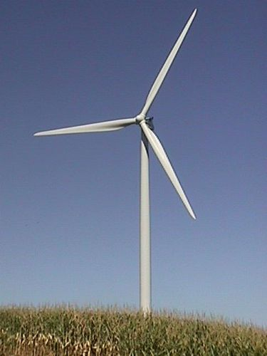
Renewable Energy: Economic Benefits
Missouri’s Existing Wind Economy:
10 wind turbine parts manufacturing companies
More than 500 jobs
252 existing wind turbines
$1.4 million annual lease pay-
  ments to farmers and other
  property owners
Notes:
According to the American Wind Energy Association, in 2014 there were 10 companies in Missouri involved in wind turbine parts manufacturing with between 501 and 1,000 Missourians employed directly and indirectly in the wind energy sector. Missouri’s 252 wind turbines were also generating $1.4 million in annual land lease payments to farmers and other property owners.
Add picture?

Slide 6
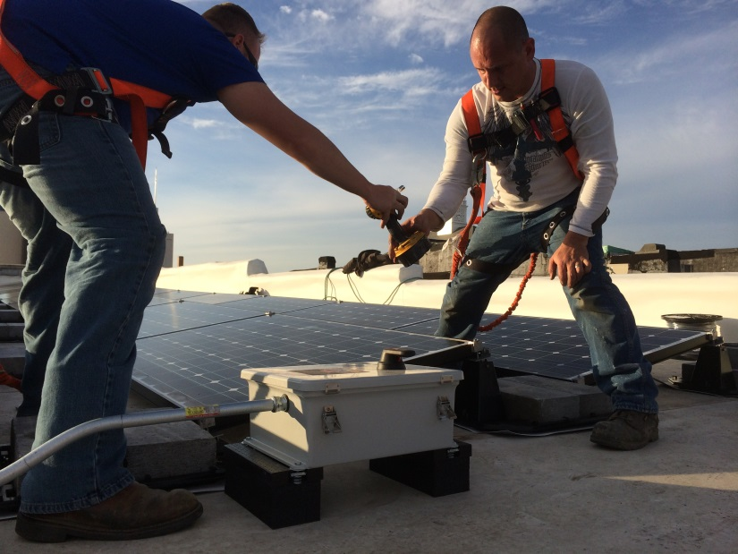
Renewable Energy: Economic Benefits
Missouri’s Existing Solar Economy:
89 manufacturing and
  installation companies
2,500 jobs – Ranked 16th
  in nation
Notes:
Add picture

Slide 7
Municipal Utilities Already Investing in
Low-Cost Renewables
Springfield City Utilities:
5MW solar farm
New 200 MW wind contract
  (adding to existing 50MW contract)
1/3 of City’s electricity from renewables once new wind online
New wind contract: 15% lower than cost of electricity from CU’s Twitty Plant
Notes:
Municipal utilities are leading the way. Springfield 5 MW solar farm in 2014. New wind contract in 2014. RFP was for 50 MW. Bids were too good to pass up – settled on 200 MW. 15% lower than Twitty plant. (News Leader Article)
Keep in mind that Twitty Unit 2 is one of the newest and largest coal units in the country (2011, 300 MW) , so presumably one of the most efficient in the country.

Slide 8
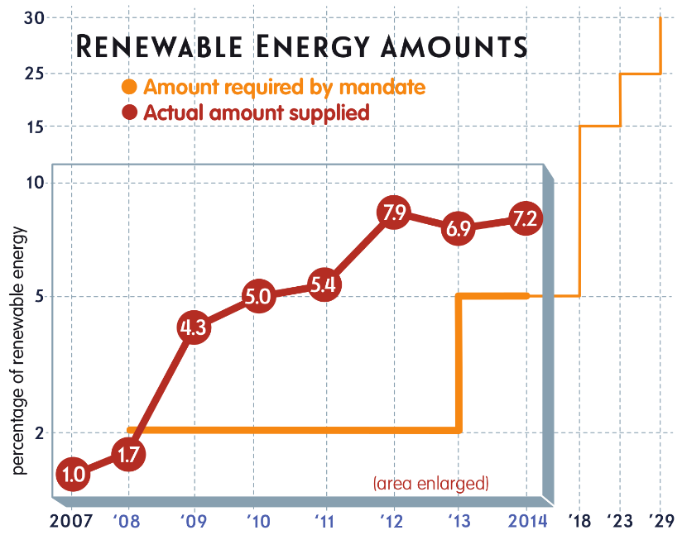
Municipal Utilities Already Investing in
Low-Cost Renewables
Columbia:
Local Renewable Energy Standard of 30%
  renewables by 2028
2014: At 7% renewables,
  exceeding 5% target for
  2013-2016
Source: Columbia Water & Light 2015 Renewable Energy Report

Slide 9
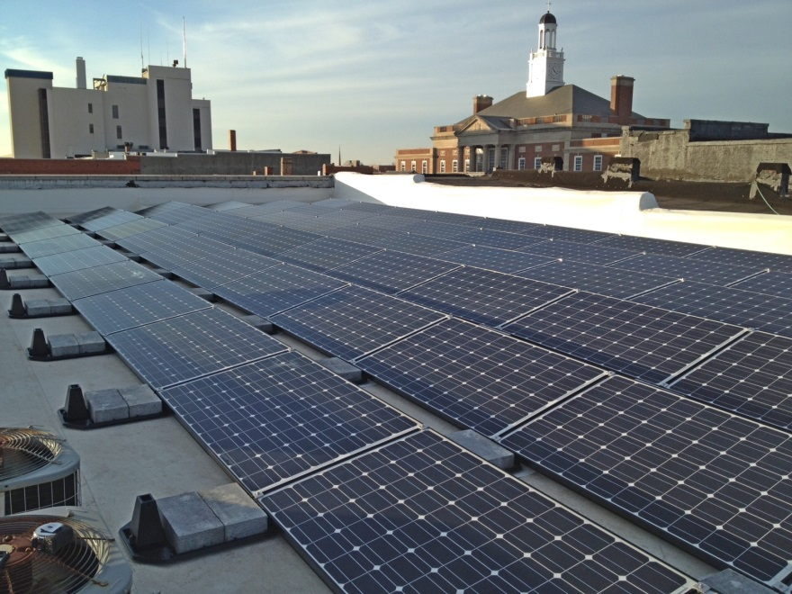
Municipal Utilities Already Investing in
Low-Cost Renewables
Independence:
Renewables goal: 15% by 2021
2015: At 7%
End of 2016: 13.5%
  with new wind contract
  and solar farm
Rooftop solar installed with financial assistance from Independence
Power & Light.

Slide 10
Smaller Cities Also Investing in Low-Cost Renewables
Missouri Public Utility Alliance – Solar Farms:
Butler 3.2 MW
Macon 3.2 MW
Trenton 3.2 MW
Marshall 3.2 MW
Rolla (broke ground yesterday) 3.2 MW
TOTAL 16 MW
Notes:
Other utilities are also making great strides in renewables: KCPL is purchasing 400 MW of wind. AECI last year brought on 150 MW, bringing their total to 750 MW.

Slide 11
Increased Energy Efficiency (EE) Under the CPP = Enormous Benefits To Missouri
State Energy Plan emphasizes benefits of EE; Recommends making MEEEIA mandatory
Untapped potential: ACEEE ranks MO 44th in nation on EE programs
EE widely seen as least-cost option for CPP compliance while also enhancing reliability
Recent Synapse Study: Missouri residents would save nearly $10/month under CPP state plan that maximizes EE programs
Notes:
State Energy Plan includes recommendation that MEEIA become mandatory for IOUs and set voluntary goals for non-IOUs…Sierra Club supports this

Slide 12
Certain Plan Elements Are Essential If Missouri Uses A Mass-Based Approach
Allowance Allocation Should Be By Auction:
Creates direct economic incentive for generators to reduce emissions as much as possible to minimize allowance purchases
Leads to efficient distribution of allowances
Provides immediate price signals in the market
Notes:
Requiring generators to pay to emit CO₂ into the atmosphere creates a direct economic incentive for them to reduce CO₂ emissions as much as possible to avoid having to purchase allowances.

Slide 13
Certain Plan Elements Are Essential If Missouri Uses A Mass-Based Approach
RGGI’s Successful Allowance Auction Experience:
Since 2009, RGGI disbursed nearly $2 billion in auction proceeds back into the economy:
  Energy Efficiency Measures
  Community-Based Renewable Power
  Low-Income Customer Bill Assistance
  Education and Job Training Programs

Slide 14
Certain Plan Elements Are Essential If Missouri Uses A Mass-Based Approach
Plan Should Avoid Adverse Impacts to Environmental Justice Communities:
Sierra Club generally supports trading-ready program with multi-state trading, but
Trading program must contain limitations to ensure health benefits of co-pollutant reductions are equitably distributed
Notes:
EPA EJ Analysis Found Half of MO’s 21 CPP-Affected Plants Have Higher-Than-Average % of Low Income and/or Minority Populations w/in 3-Mile Radius

Slide 15
Certain Plan Elements Are Essential If Missouri Uses A Mass-Based Approach
Missouri Should Take Advantage Of The Clean Energy Incentive Program:
  Missouri Should Tailor Its Program Such That the Requirement That Projects be Implemented in Low-Income Communities in Order to Qualify Would Apply to Both Energy Efficiency and Renewable Energy Projects.

Slide 16
Conclusion
Missouri already on the road to CPP compliance
Additional steps – increased energy efficiency and renewable energy – will help Missouri achieve CPP compliance while
  Lowering customers’ bills
  Generating in-state jobs and economic development
Notes:
MO is 4th Largest Coal Expenditure in Country; 2nd Largest Per Capita Expenditure. Missouri Needs to Craft State Plan That Maximizes Economic and Environmental Benefit for Missourians

