Slide 1
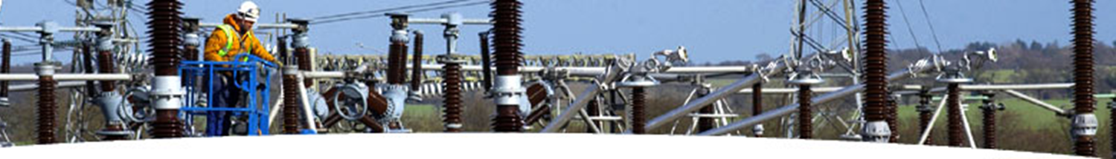
The Intrinsic Benefits from Utility Electric Networks in the Deployment of Distributed Resources
Alex Rojas
Director
Distributed Technologies
November - 2017

Slide 2
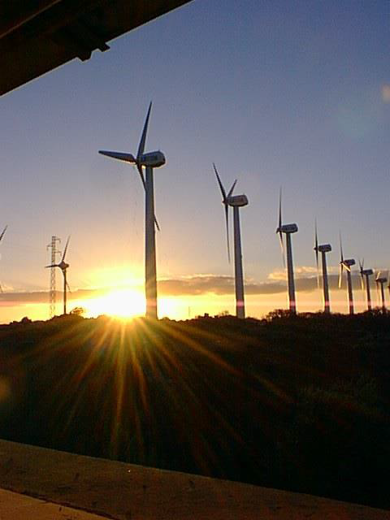
overview
Union Electric Company’s Tradition in Innovation
Integrated DERs
  Local Generators
  Energy Efficiency and Load Response
Evolving Generation And Load Components
  Traditional synchronous machine interfaces
  Microprocessor-controlled inverter interfaces
Electrical Network Frequency And Voltage Stability
Small Electrical Networks That Have Been Challenged To Maintain System Stability
Key Benefits From a Utility's Communication Infrastructure

Slide 3
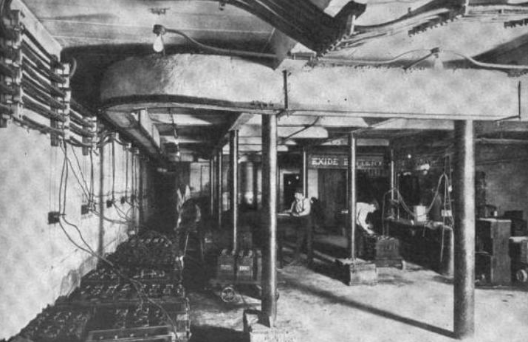
where was this picture taken ? Hint: facility in St. Louis, MO - Year 1909

Slide 4
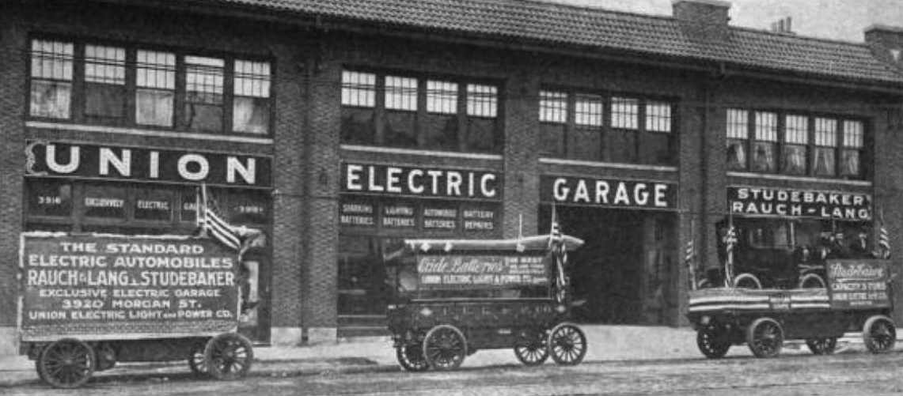
No description needed

Slide 5
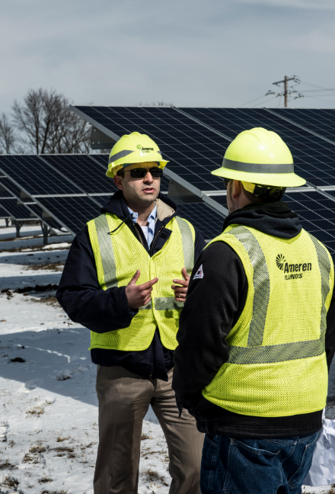
Local Generators
distributed generators
Many are non-dispatchable
They change the premise’s energy and capacity requirements from central generation and the energy delivery network
Most distributed generators depend on the utility’s electrical network to operate
The premise can export power onto the grid when the instantaneous production of energy exceeds the local load

Slide 6
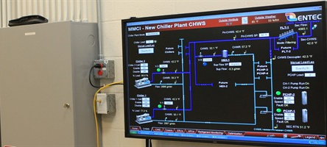
Load Response and Energy Efficiency
Energy efficiency
Building Automation Systems (BAS) can change the energy and capacity requirements from central generation and the energy delivery network
Traditionally installed to manage facility energy usage through
Monitoring and control of large loads (i.e. fan motors, lighting of large areas)
Monitoring and control of operating conditions such as humidity and temperature
Methods to achieve benefits include: regulating temperature, humidity, and lighting based on parameters such as occupancy, ambient light & timing schedule
Illustration Source: http://www.entecservicesinc.com/aspx/servicesdetail.aspx?srid=1

Slide 7
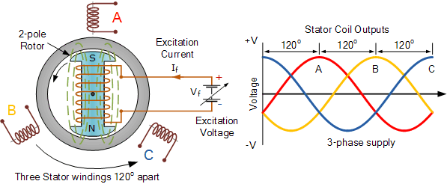
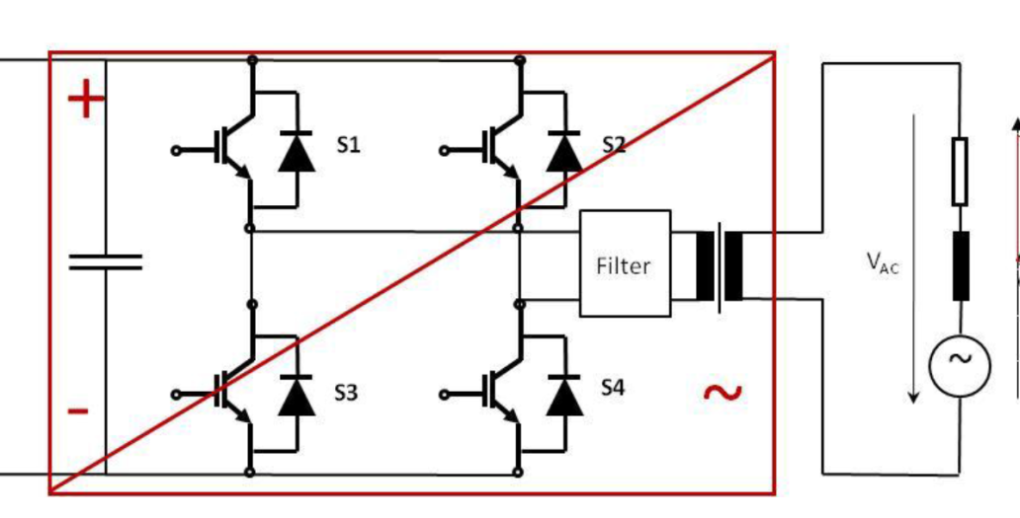
Evolving generator and load interfaces
Traditional Synchronous Machine Interfaces for
Fossil fuel generators
Motor loads
Growing Number of Inverter Interfaces for
Solar PV and Wind generators
Motor loads

Slide 8
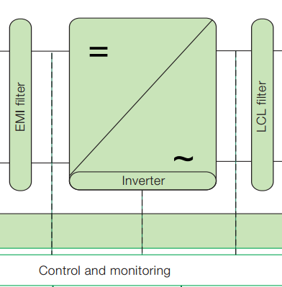
Evolving system Component inertia
Rotors store angular momentum in Generators
Motors
Inverters have no Angular Momentum
Microprocessor controlled
Non-dispatchable energy from Solar, Wind or similar

Slide 9
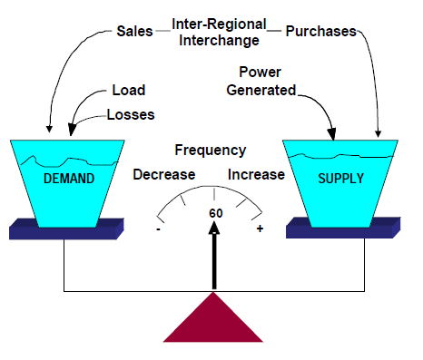
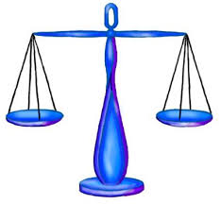
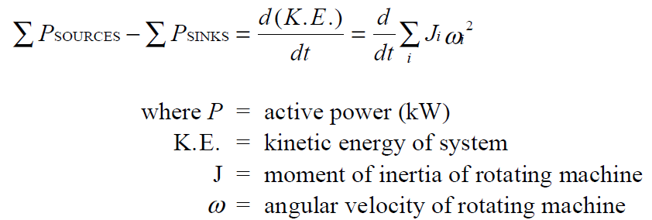
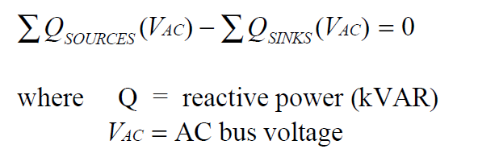
Electrical network stability

Slide 10
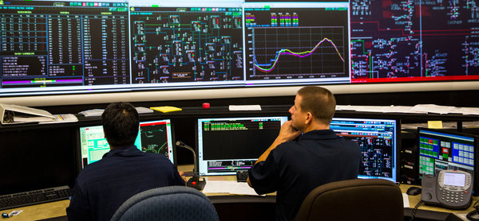
Small electrical networks challenged to maintain system stability - Hawaii
April/2015 - Load dispatchers monitor the electrical grid at the Hawaiian Electric Company’s operations center in Honolulu. The utility says power from household solar panels can destabilize the system.
Credit: Kent Nishimura for The New York Times

Slide 11

Small electrical networks challenged to maintain system stability - pr
Dec/2013 – In Puerto Rico, under new regulations, operators of renewable energy projects will be required to:
Add 30% of the installation’s rated capacity in storage to aid frequency control
Keep 45% of the project’s capacity in reserve for at least one minute for ramping control
Credit: Andy Colthorpe – PVTECH

Slide 12
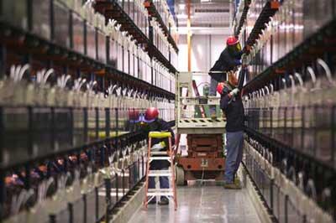
Small electrical networks challenged to maintain system stability - alaska
Aug/2010 - The world’s largest battery was inaugurated in Fairbanks, Alaska. In addition to stabilizing the local grid, it will reduce power outages in the area by 65%. Spinning reserve has the highest priority of all the modes. It is initiated at a system frequency of 59.8 Hz, with the BESS loading to full output at 59.4 Hz if system frequency continues to drop.
Credit: Paul Dvorak – Windpower Engineering Development

Slide 13
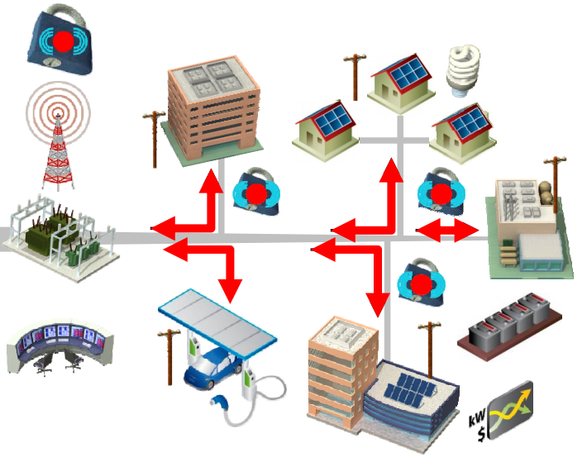
Key benefits from a Utility's communication infrastructure
Utility communication infrastructure can enable proper integration of distributed generators and controllable loads by enhancing:
  Safety (relay protection coordination)
  Operational performance (aggregation)
  Economic performance (can allow participation in future energy market frameworks)
Illustration Source:
EPRI final report “Estimating the Costs and Benefits of the Smart Grid ” – March-2011

Slide 14
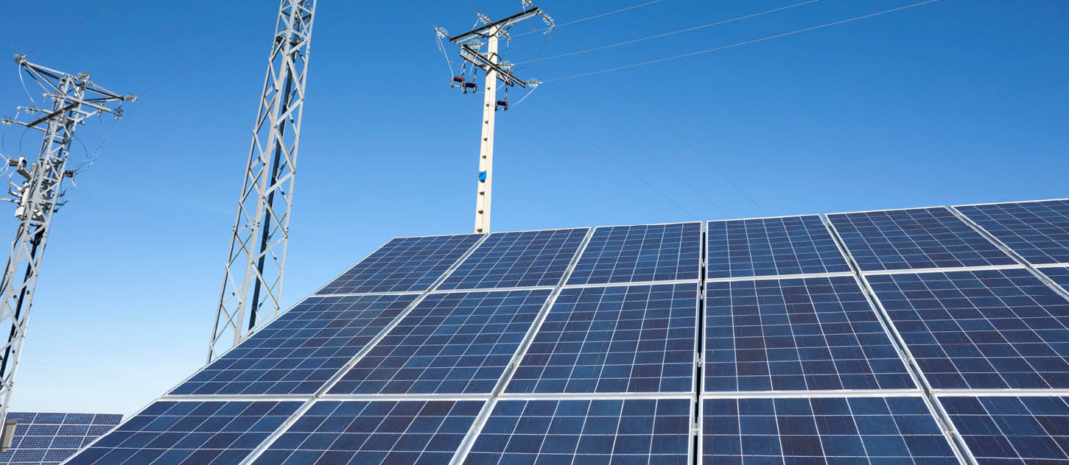
Questions

