Slide 1
Roeslein Alternative Energy

Slide 2
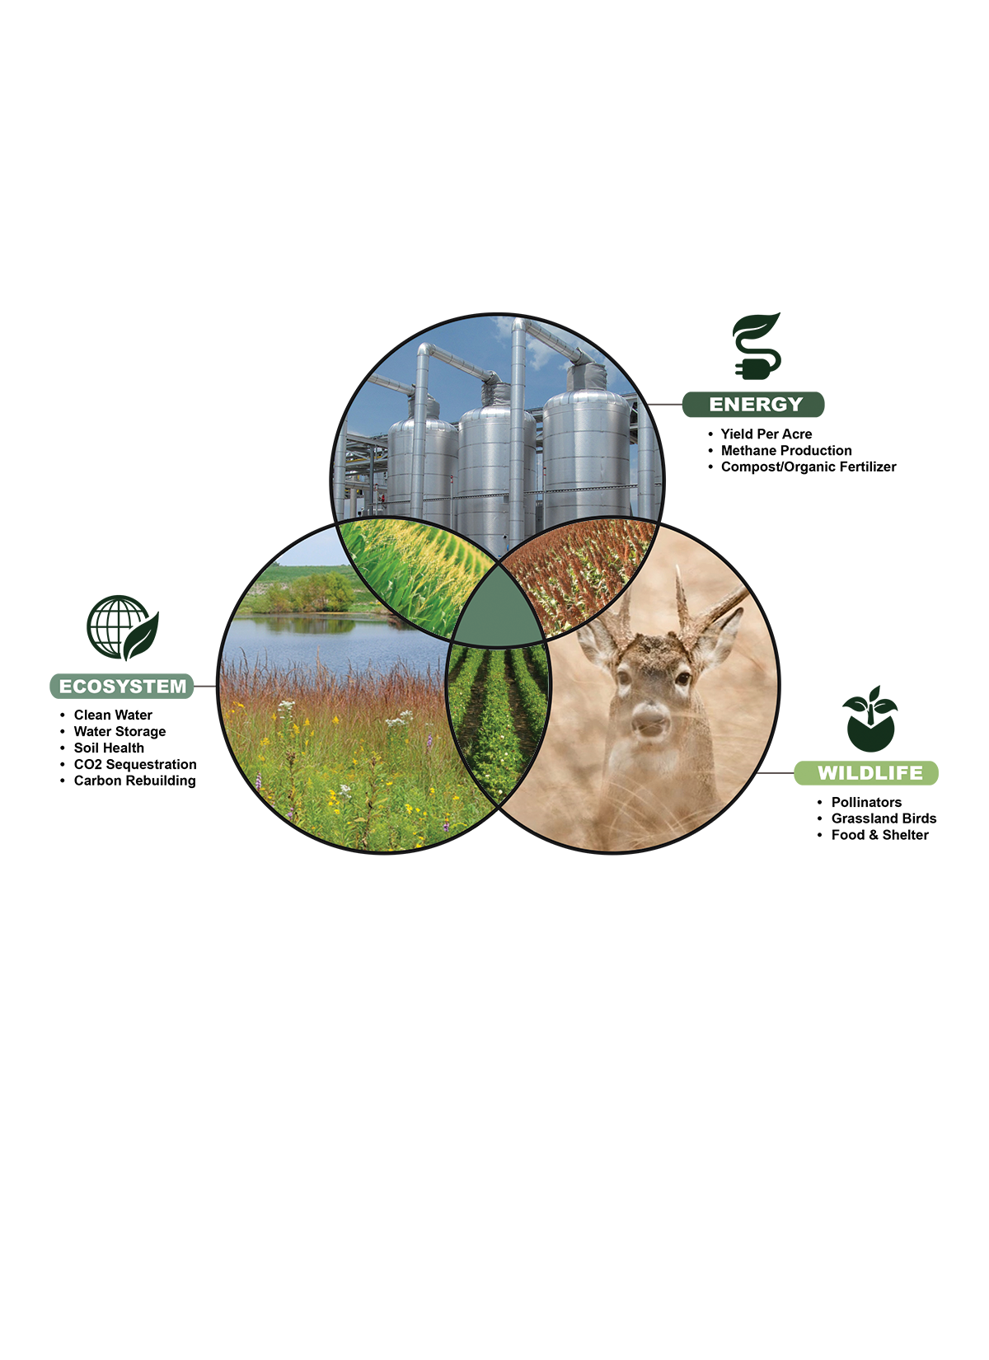

Energy, Ecosystem, and Wildlife
in Balance
2

Slide 3
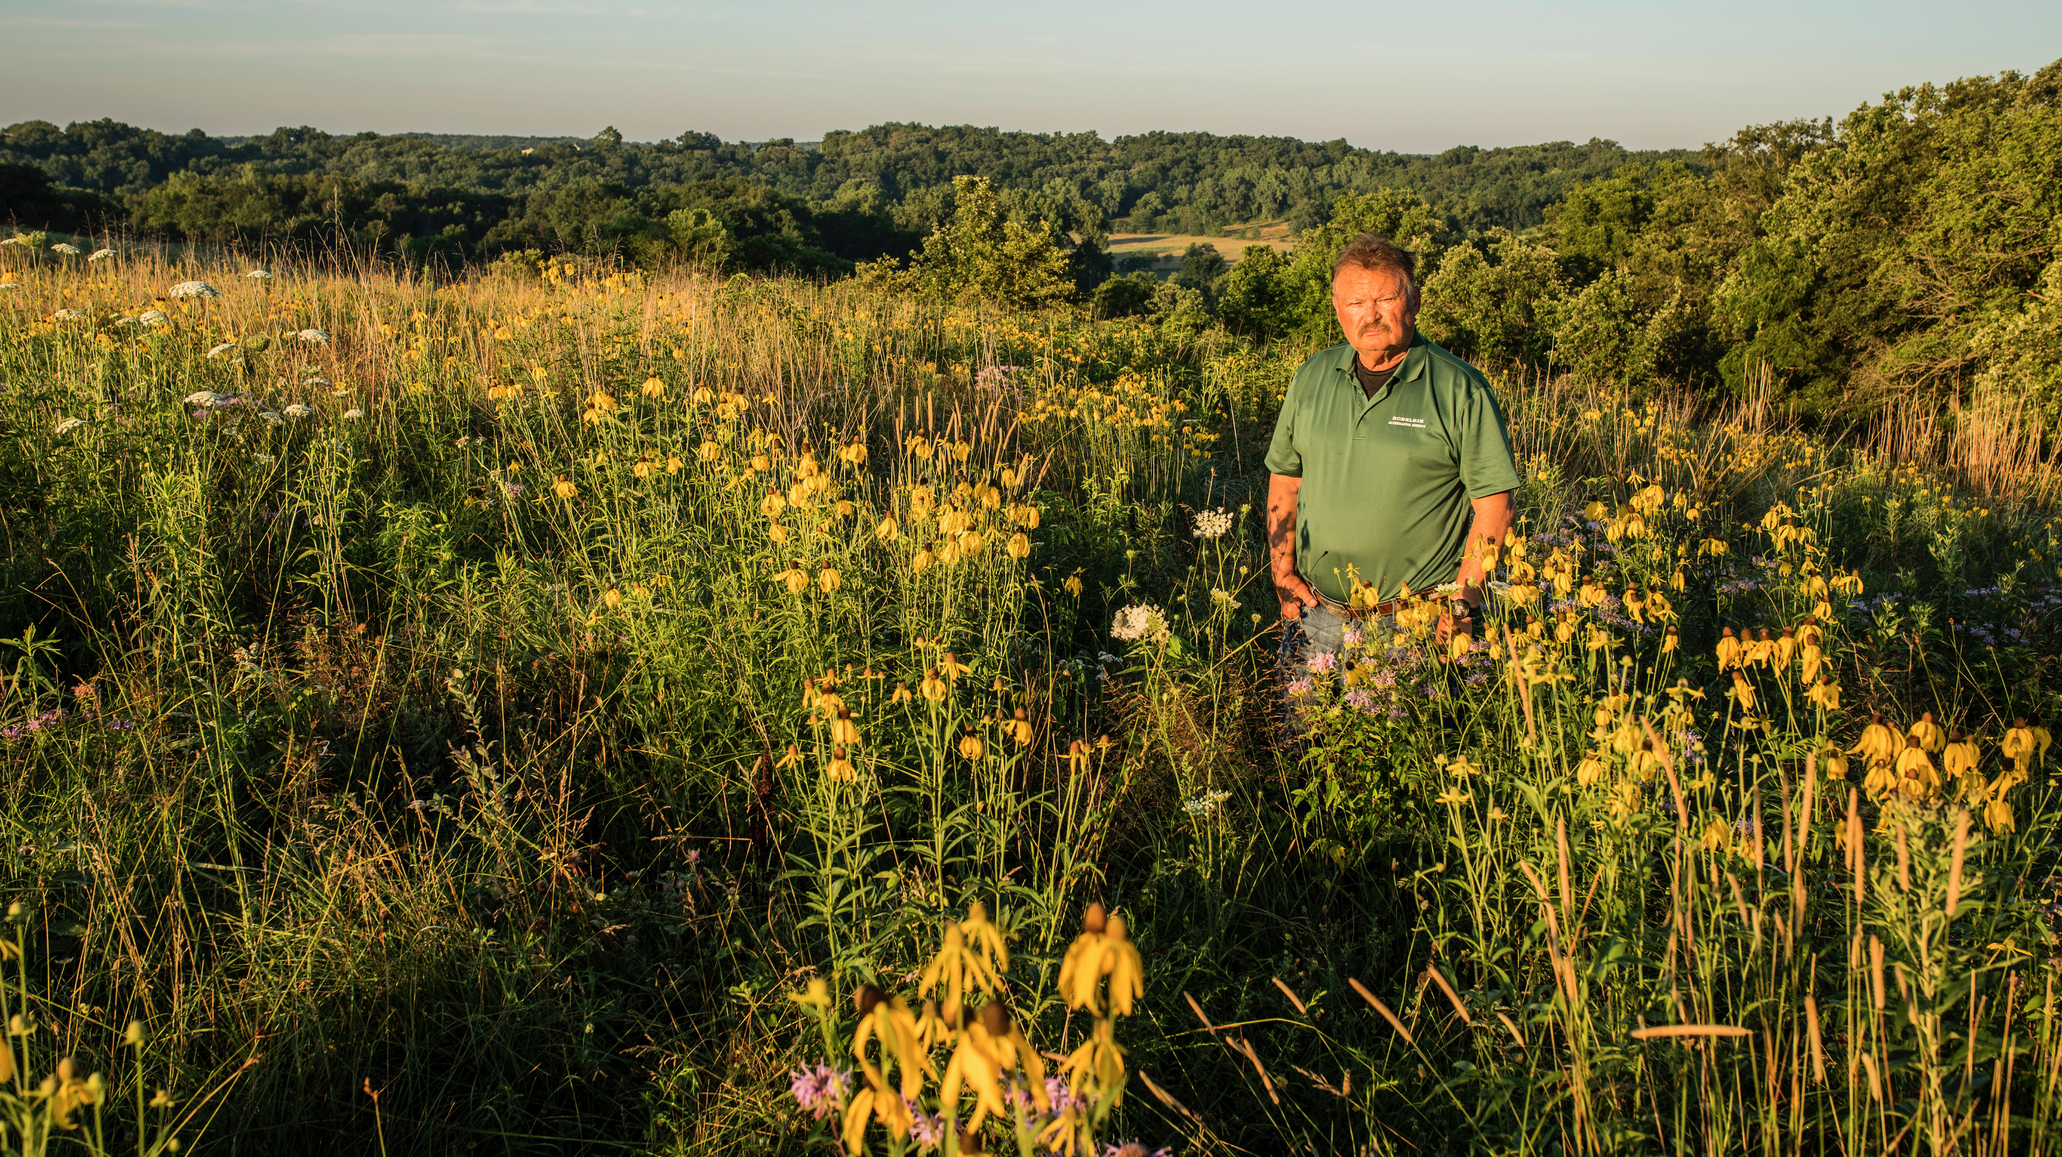
RUDI ROESLEIN

Slide 4
Roeslein Alternative Energy, LLC
Roeslein Alternative Energy (“RAE”) is an owner, developer, and operator of renewable energy production facilities that convert agricultural and sustainable biomass feedstocks to renewable natural gas and sustainable co-products.
RAE is engaged in the business of developing, installing, owning, operating, and maintaining such facilities, with a focus on incorporating native prairie restoration.
RAE is a limited liability corporation, with its principal offices located in St. Louis, Missouri.
4

Slide 5
RNG Project Experience
Biomethane Hog
Biomethane Hog
Biomethane Dairy/Beef
Biomethane Dairy
Biogas from Rendering/Poultry/Food Waste
Biomethane from Poultry/Food Waste
Prairie Grass Pilot Plantings

Slide 6
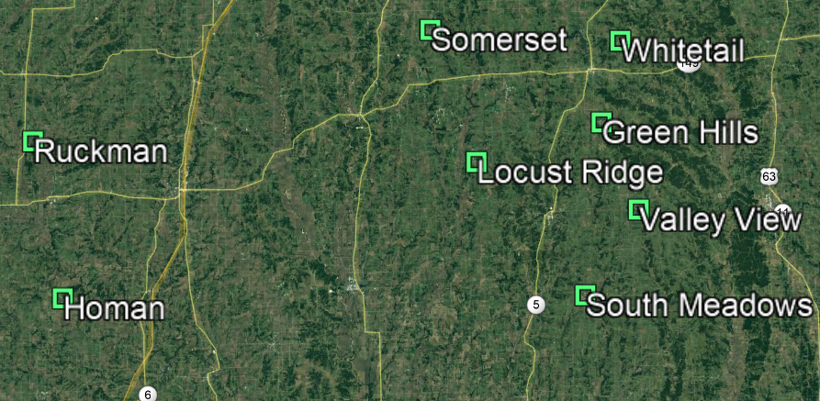

RAE Projects in MO
Unionville Interconnect
South Lineville Interconnect
Albany Interconnect
Milan Interconnect
Hog Manure to renewable natural gas
Projected 2 million finishing hogs per year
Program Value ~ $150M
Schedule – 2014 - 2021
Anaerobic Digestion → Biogas to RNG
  Cover 83 Existing Lagoons
  Eight operating facilities
  Four interconnects = four direct connect sites, four virtual pipeline
  Two multi-farm CNG truck offloading facilities
  Produce >800k dekatherms per year RNG
6

Slide 7
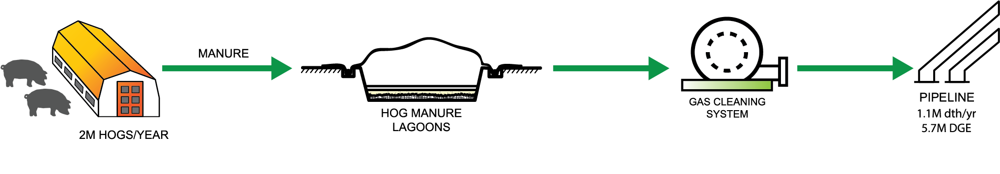
Anaerobic Digestion of Manure
65% Methane
35% CO2
98% Methane
<2% CO2
HOG:
BENEFITS:
Separation of rain water from manure
Reduced odor and volatile organic compounds (VOC)
Production of renewable biofuel
The solid fraction of the digestate is used as soil amendment.
20

Slide 8
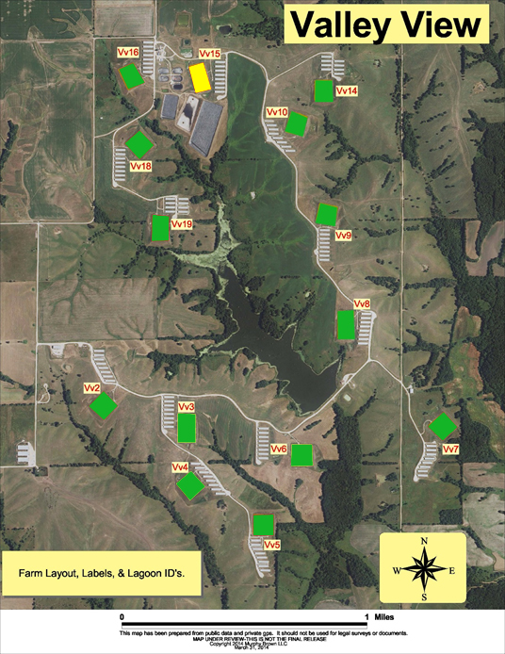
Valley View
RAE
Project Metrics:
14 lagoons, 8 barns per site
1100 spaces per barn, 123,200 total permitted spaces
First year of operation, 2017
2020 - 119K MMBtu
CI score current, -429 = 0.49 LCFS credits / MMBtu
8

Slide 9
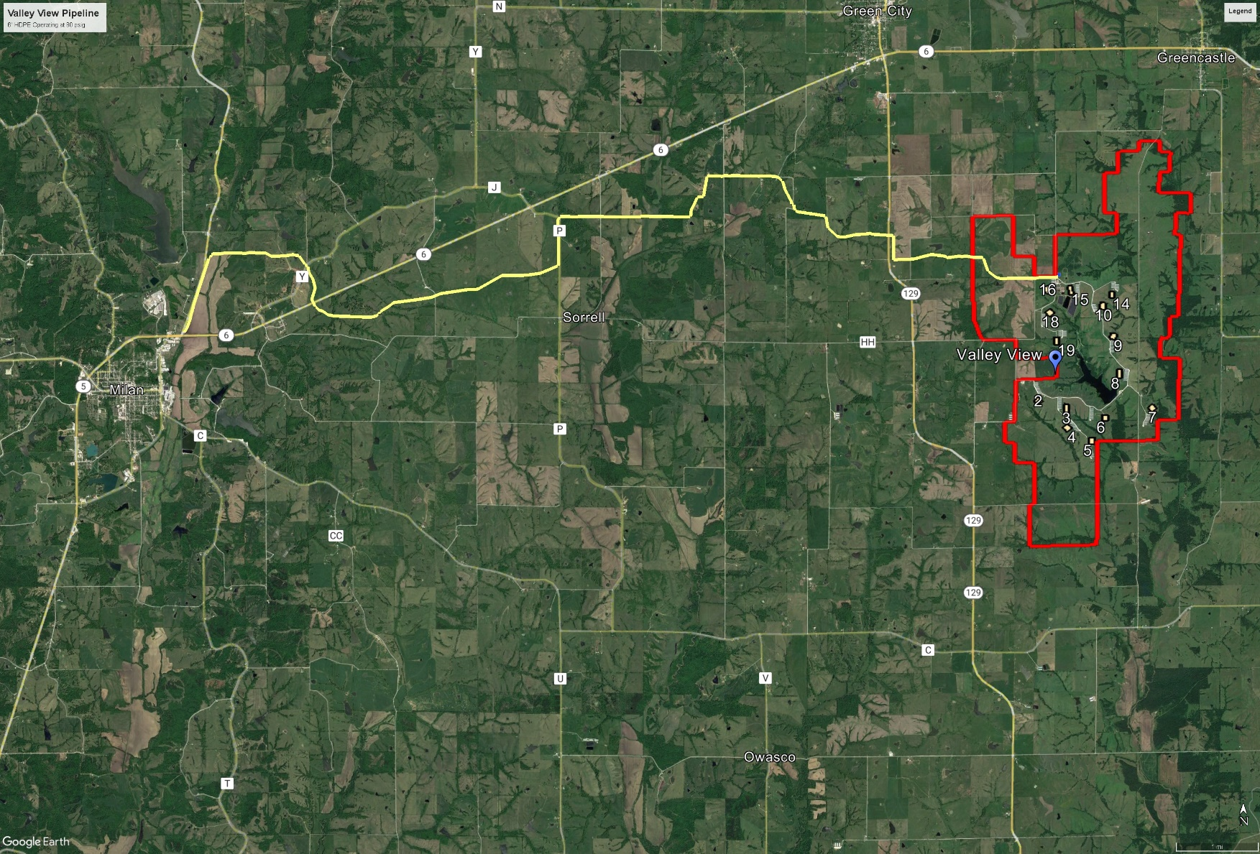
Valley View Pipeline
Length 11 miles
Materials 6” SDR 11 HDPE
MAOP 100 psig
OP 80 psig
9

Slide 10
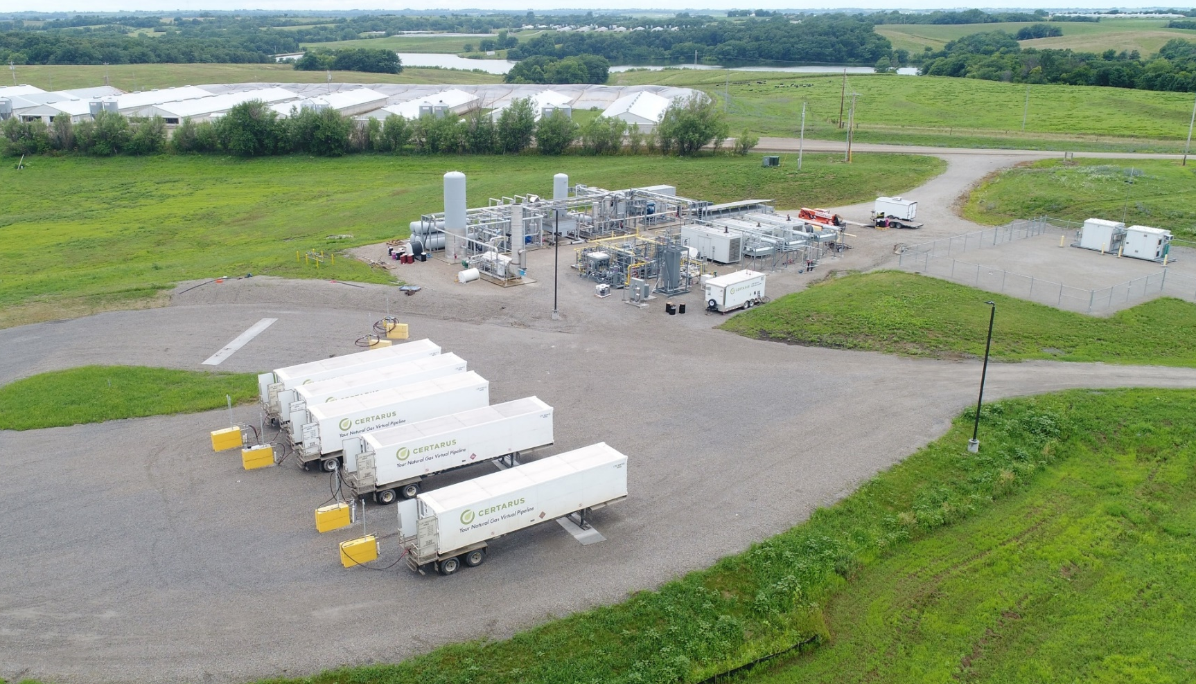
Ruckman

Slide 11
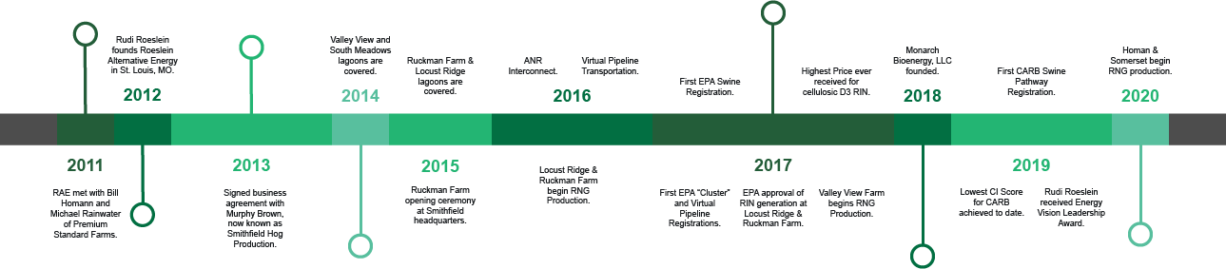
RAE timeline
2014 Valley View and South Meadows Covers and Flares
2015 Ruckman and Locust Ridge Covers, Ruckman RNG project start
2016 Ruckman RNG project complete – first injection into ANR interconnect #1, Locust Ridge RNG project complete
2017 EPA Approval – Ruckman and Locust Ridge D3 RIN – Virtual Pipeline, Valley View 1 RNG project completed
2018 Re-approval by EPA of Locust Ridge and Valley View, started LCFS process, formed Monarch Bio Energy JV
2019 Achieved highest CI score in industry, built Valley View 2 + pipeline to Milan, Locust Ridge 2, South Meadows
2020 Secured CoBank financing, completed Homan and Somerset w/new ANR interconnect (#2)
2021 Completed Whitetail w/new ANR interconnect (#3), Green Hills, met original commitments
11

Slide 12
Sources of Energy and Revenue Potential
NORTHERN MISSOURI
5.5M DEKATHERMS PER YEAR
REVENUE POTENTIAL OF $243M
EQUIVILANT TO REMOVING 29M DIESEL GALLONS
UNITED STATES
1.8B DEKATHERMS PER YEAR
REVENUE POTENTIAL OF $63.6 B
EQUIVILANT TO REMOVING 9.5B DIESEL GALLONS
12

Slide 13
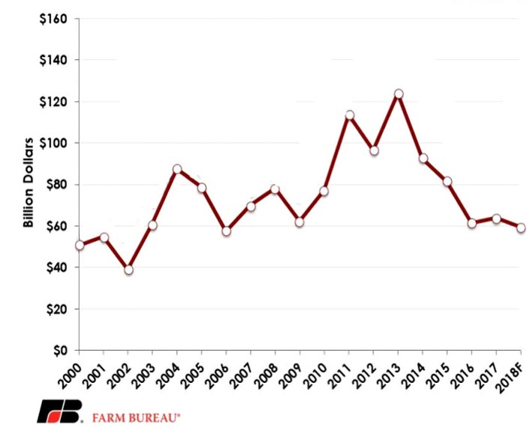
Net Farm Income with RNG Production
Forecast with RNG Production $115.1 Billion
32

Slide 14
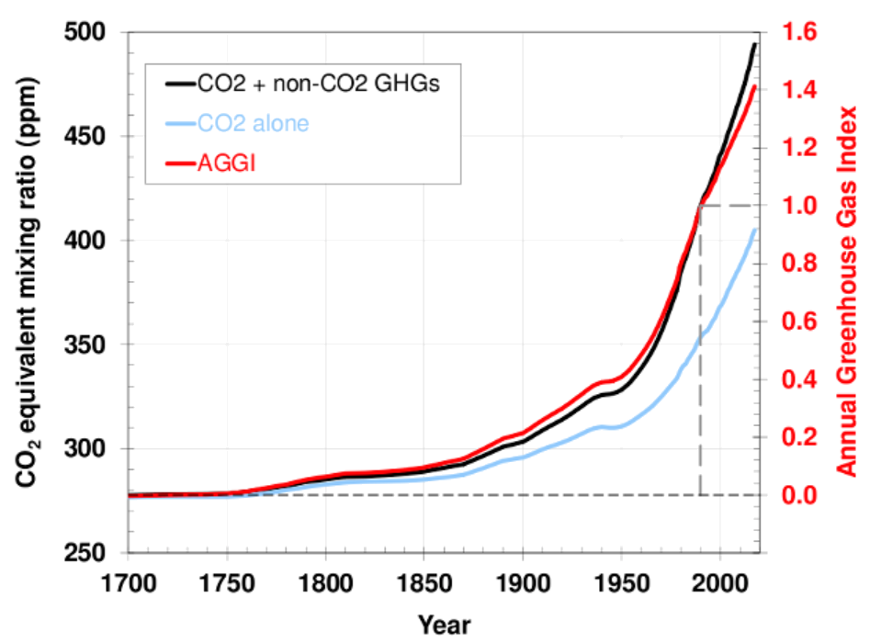
Annual Greenhouse Gas Index
Source: https://www.ersl.noaa.gov/gmd/aggi/aggi.html
5

Slide 15
Major Accomplishments
$180M investment in successful first-of-a-kind swine waste to RNG projects
Successfully created operations team, created over 30 new permanent full-time on farm positions recruited from local communities
Monarch partnership for all Missouri RNG projects, potential to expand
First EPA and CARB/LCFS pathway approval swine RNG
First RNG project utilizing virtual pipeline, project “hub” solution
Developed membrane-based gas cleaning system with 10 successful operating installations
Lowest CI score achieved for swine RNG, -449, (four approved projects ranging from -360 to -449)
800K MMBtu / year = 5.8 million Diesel Gallon Equivalents = 375K LCFS credits (Metric tons CO2) = 80K passenger cars per year
15

Slide 16
Awards and Recognitions
Biogas Visionary Award, American Biogas Council (2022)
Corporate Conservationist of the Year, Conservation Federation of Missouri (2022)
National Lewis and Clark Conservation Award (2021)
Project of the Year Award, American Biogas Council (2019)
Energy Vision Leadership Award, Energy Vision (2019)
Air Conservationist of the Year Award, Conservation Federation of Missouri (2017)
Groundbreaker of the Year Award, BBI International (2016)
Friend of the ABC Award, American Biogas Council (2016)
16

Slide 17
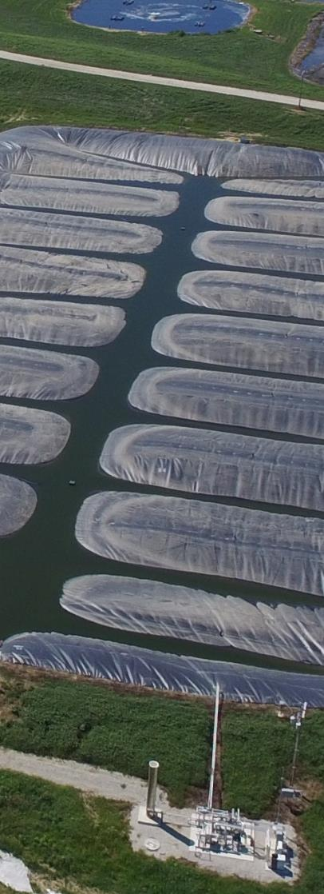
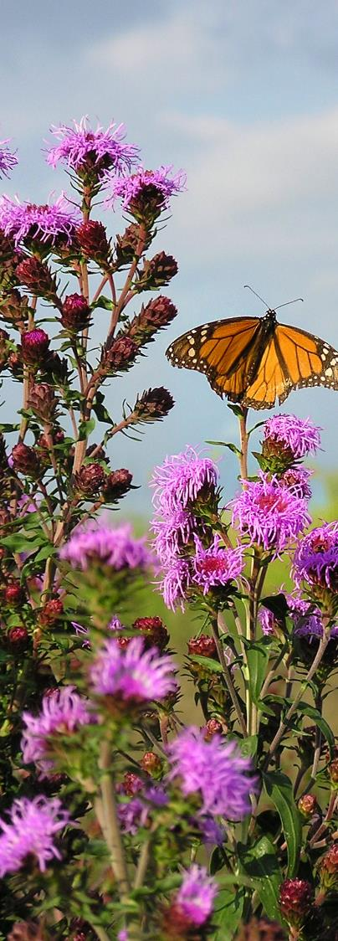
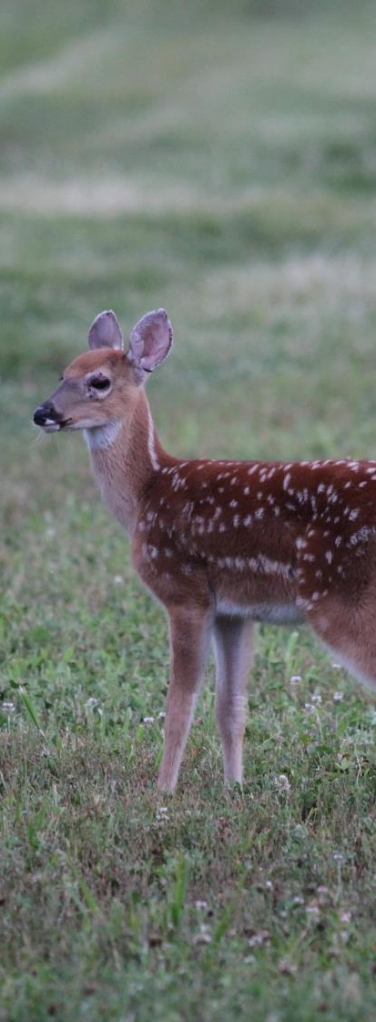

Thank You

