Slide 1

Helping You Weather the Storm
KCP&L Energy Center
October 6, 2017

Slide 2
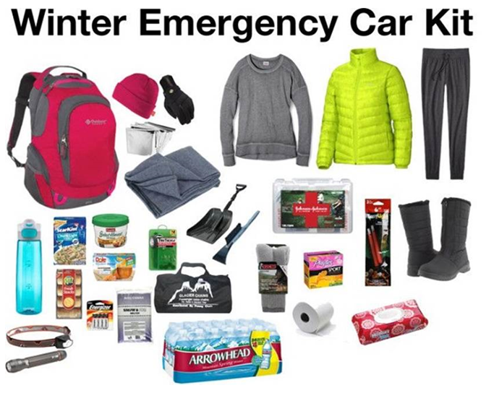
Safety Topic

Slide 3
2017 Highest Impact Storms
2017 Storms B, J, & M
Storm Event | Sept. YTD | Customers Impacted | Duration | KCP&L manpower & contractors
3-6-17 Storm B, IV | $9,414,439 | 128,000 | 3-6-17 from 8 p.m. to 3-8-17 9:30 p.m. | 506
6-16-17 Storm J, IV | $13,946,354 | 162,070 | 6-16-17 from 8 p.m. to 6-20-17 6 p.m. | 1053
7-22-17 Storm M, IV | $14,101,117 | 145,029 | 7-22-17 from 9 p.m. to 7-24-17 6:30 p.m. | 1419
Total 3 storms | $37,461,910 | 435,099 | Less than 6 month period | 2,978

Slide 4
Assistance Beyond Restoration
Corporate Communications
Craft storm narrative for internal and external messaging
Proactive media communication and events to shape the storm storyline
Reputation management and rumor control
20 hour a day social media posting and customer response
24/7 updates to www.kcpl.com
Customer Relations & Public Affairs
Monitor, respond to and (where possible) prioritize medical customers
Identify and coordinate restoration for other at-risk customers or special situations
Coordinate with Red Cross and municipalities on cooling centers or shelters
Dry ice (19 volunteers, 4 tons and more than 700 customers) and water distribution centers
Energy Consultants & Business Center
Identify and work with operations to coordinate the prioritization of critical customers
24/7 proactive outreach and coordination with Tier One customers
24/7 coordination with smaller business customers
69 large customers and 200 + phone calls
Government Affairs
Coordination with local and state governments on emergency response and infrastructure
Proactive messaging on restoration efforts to more than 130 cities
Q&A and messaging assistance with elected officials

Slide 5
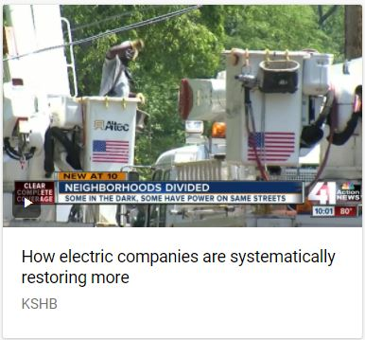
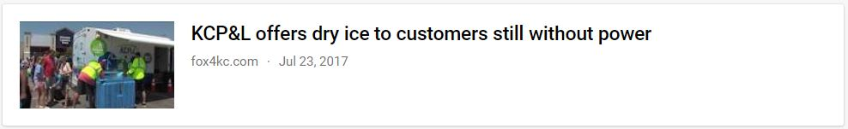
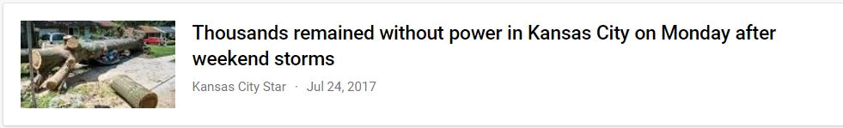
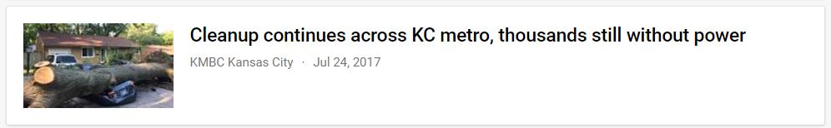
Corporate Communications
We proactively tell the story of the storm, restoration and convey useful information.
200 + media calls
12 storm talking points updates used by Customer Service, Customer Relations, Government Affairs, the Business Center and Energy Consultants
4 proactive media events
150 + TV and radio stories
500 + print and online stories

Slide 6
Social Media Strategy
Used to dispel rumors, learn about trouble spots and assist customers.
Social Media Statistics
Customers viewed social media posts 1.9 million times
Interaction with more than 21,000 customers
40 update posts with pictures of damage to the system, homes and restoration work
Nearly 11,000 specific questions from customers over a 72 hour period (many were given an estimate of when their power would be restored)
Social Media War Room staffed by volunteers during normal business hours
Distributed teams of 3-6 volunteers responded to customers between 6 p.m. and 1 a.m. and then from 5 a.m. until 8 a.m.
Less than a one hour wait time for a customer response
Used multiple times to obtain useful information and prevent a problem or escalation

Slide 7
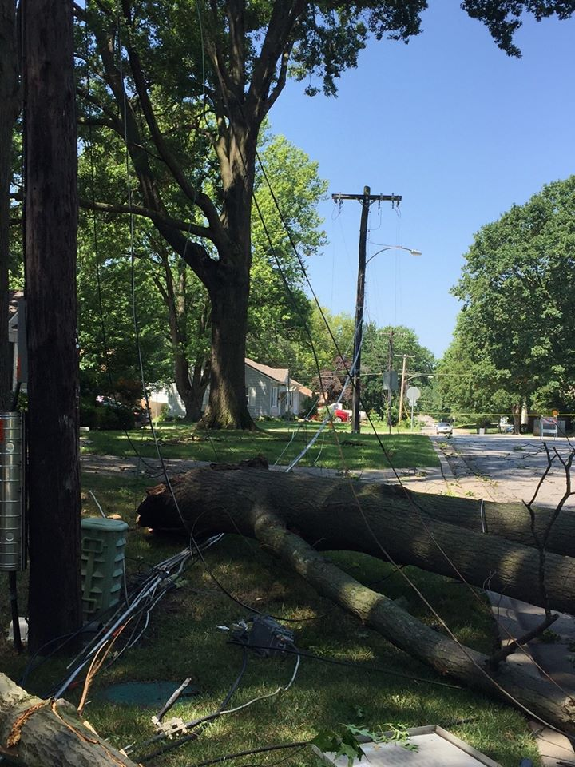
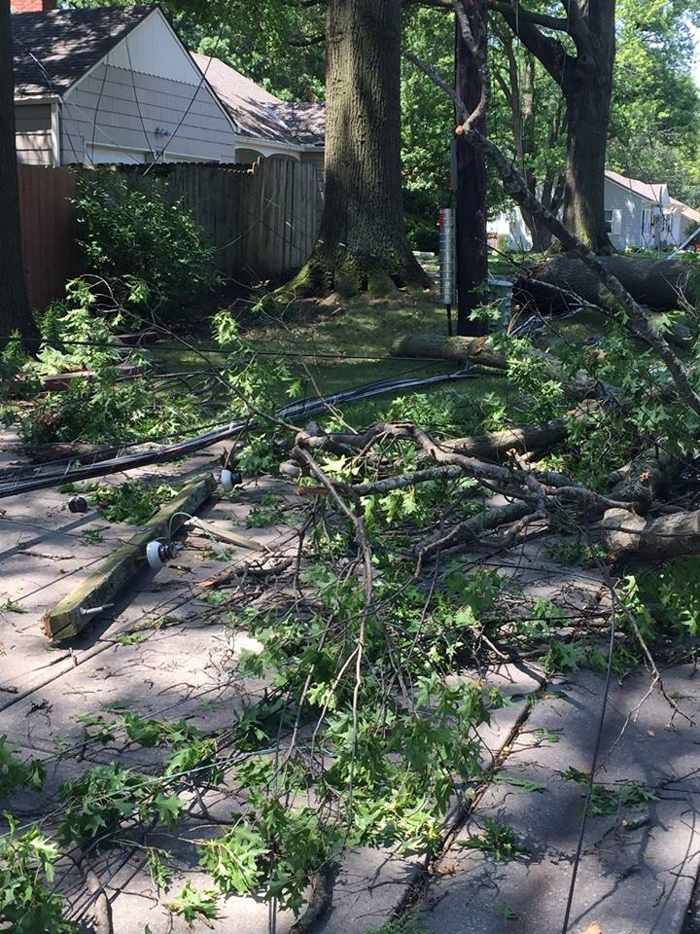
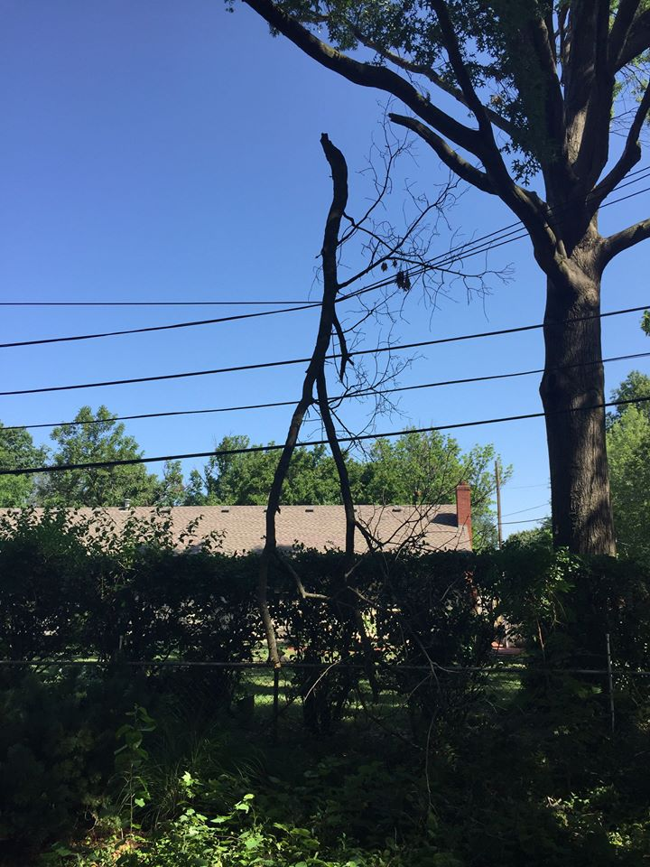
Social Media Posts
Social media tells a story with pictures and video, then talking points.

Slide 8
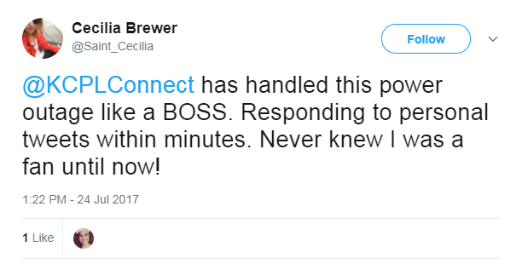
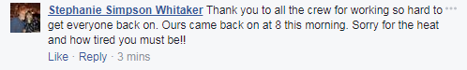
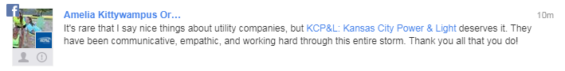
Customer Response On Social Media
Social media efforts were generally viewed extremely positively by customers.

Slide 9
Vegetation Management
David Martin
Program Manager
Vegetation Management

Slide 10
Vegetation Management
Routine Maintenance
Circuits Trimmed on a Preventative Maintenance Cycle
  4 year cycle in Urban areas
  6 year cycle in Rural areas
Mid-cycle Inspections to ensure reliability for duration of cycle
Trimming approximately 250,000 trees on 3,300 miles of overhead power lines annually. Remove approximately 10,000-25,000 trees annually
Process:
  Plan: Utility Forester inspects circuit from top to bottom to identify each individual tree for trimming
  Notify: Customers notified in advance of tree crews and work orders created.
  Trim: Tree crews mobilize and execute work orders
  Audit: Inspection to ensure trim work carried out according to work orders, quality of workmanship, effective tree to conductor clearance

Slide 11
Vegetation Management
Outage Restoration, Customer Requests, Misc.
  Outage Restoration: VM role is to assist linemen
    Clear vegetation that interferes with power lines to ensure restoration is performed safely and quickly
    Resulting debris left on site: customer responsibility
  Customer Requests:
    Field & Investigate 12,000 – 15,000 requests annually
    Trim for safety clearance – 10’ safety zone
    Service Line: customer responsibility, KCP&L will disconnect service free of charge
  https://www.kcpl.com/about-kcpl/safety/tree-trimming-and-planting

Slide 12
Frequent Outage Investigations
and Maintaining Reliability
Andy Alexander, PE
Manager Central Design

Slide 13
Central Design Responsibilities
Large Industrial and Commercial Distribution Designs
Road and Highway Projects
Frequent Outage Investigations
Power Quality Investigations

Slide 14
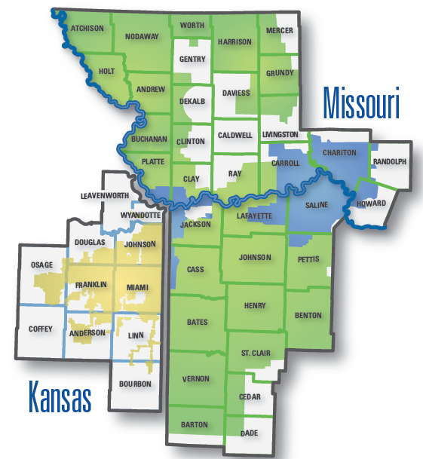
Service Territory
18,000 Square Miles
800,000+ Customers
3,600 Miles of Transmission Lines
22,700 Miles of Distribution Lines
400+ Substations

Slide 15
What Constitutes an Outage?
Official Definition: Total Loss of Power Greater than 5 minutes
Momentary Interruption: An Event Less than 5 minutes
  Breaker and Recloser Operations
  “Blinking Lights”
Power Quality Investigations → Sub-Cycle Events
  60 Hz System = 60 Cycles per second
  1 Cycle = 0.01667 Seconds
  Typically Limited to Industrial Customers

Slide 16
Frequent Outage Investigation Process
Contact Center Forwards Complaint to Local Office
Review of Outage Causes → Look for Common Cause
Personalized Phone Call
Cross-Reference with Previously Identified Projects
Patrol if Necessary → Multiple Work Groups
Design & Sponsor System Improvement Job Through the Construction Process
Follow-Up with Customer
CALL US!

Slide 17
Common Causes
Varmints/Animals
Trees/Vegetation – Preventable & Non-Preventable
Storms
Material Failure
Underground Cable Faults
Vehicles
Dig Ins
Copper Theft
Human Error < 1%

Slide 18
Inspection and Maintenance Programs
Pole Inspections
  12 Year Cycle ~600k poles total (50k/year)
Padmount Inspections
  4 Year Cycle ~96k units total (24k/year)
  Visual External Inspection for Safety
Manhole Inspections
  8 Year Cycle ~5,200 total (650/year)

Slide 19
Inspection and Maintenance Programs - Continued
Reactive URD Program – Replace after 2nd Failure
  Based on internal economic study done in 1998
Old Proactive URD Program – Replace entire loop
  Based on failure data (if greater than 40 % of segments have failures)
New Proactive URD Program – Started in Aug 2014
  Based on Partial Discharge Testing
  800 Cables Tested per Year ~39% Identified to be Replaced
  Remainder Guaranteed for 15 Years

Slide 20
Worst Performing Circuits Program
Identify Circuits in July
Ultrasound Backbone in August/Sept – new in 2016
Visual Patrol
Historically Focused on Backbone
  Shifting Focus to Problem Laterals
Additional Resources Allocated for Repeaters
Complete Designs in Year Identified
Complete Construction in Following Year
  Preferably in 1st Quarter

Slide 21
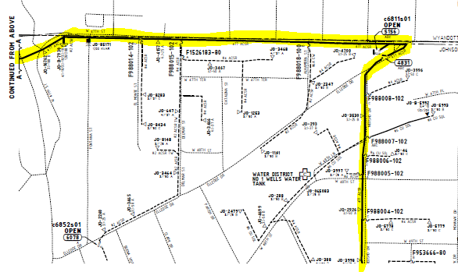
Backbone vs. Lateral

Slide 22
Lateral Improvement Program
Similar to WPC Program, but Focused on Laterals
  Identifies Improvement Needs on Circuits not Meeting the WPC Thresholds
KCP&L Driven Initiative
Wide Range of Solutions
  Varmint Guards
  Complete Rebuild to Current Construction Standards
310 Jobs Complete Since 2014

Slide 23
Planned Temporary Power Interruptions
Janet Waddell
Community Business Manager

Slide 24
Planned Temporary Power Interruption
Need and Benefit
Important to maintaining and improving reliability
De-energize only when necessary, and if safe weather conditions exist
Plans to de-energize lines to specific group of customers
Crews can safely perform work in an area
Can affect an entire circuit or a partial circuit
Regular maintenance, equipment upgrades, emergency and non-emergency repairs
Work to coordinate scheduling/timing with key customers impacted whenever possible
Notification of date, approximate time of start, expected duration

Slide 25
Planned Temporary Power Interruption - Continued
Communication with Municipalities, Key Stakeholders
Notifications to key stakeholders
City officials, police, fire, critical infrastructure/customers
Taxing entities impacted (water districts, schools, other public services)
Other community contacts
Work to coordinate scheduling with key customers impacted whenever possible
Security concerns
Communication with Customers
Proactive whenever possible
Letters to customers
Automated notification calls (to numbers provided by each customer)
Follow up contact number for any customer concerns or questions
Internal communication to serve customers

Slide 26
Medical Customer Program
Lori Shaffer
Sr. Manager
Customer & Community Affairs

Slide 27
Medical Customer Program
What it is
  Program offered to customers with qualifying medical needs
  Provides another channel for communication during outages
Who qualifies
  Permanent member of household that is homebound for medical reasons
  Reliant on life-sustaining equipment that requires electricity and not supported by back-up power supply
What the program offers
  Special handling during outage events and communication on restoration updates
  Customer receives confidential phone number to report outages
What the program is not
  High priority restoration during outage events
  Prevention of disconnection for unpaid electric bill
Notes:
KCP&L does this for our customers because it’s the right thing to do
Additional channels for communication include the dedicated phone number and direct communication with Customer Relations
Planned outages for equipment maintenance and storm outages
Equipment not portable or battery back-up
Confidential phone number is: 816-654-1330 **Do Not Present This Phone Number**
Priority given once critical infrastructure and large groups of customers of customers restored

Slide 28
Medical Customer - Continued
Process for application
  Customer indicates medical need in home and application is mailed
  Application requires Doctor’s information and signature
    Then mailed directly to KCP&L Medical Department
  Review and determination made by KCP&L Medical Staff
    Approved or Denied
  Customer mailed letter stating outcome of application
    If denied, the reason why is given
    If approved customer receives confidential phone number and reminder that program does not prevent loss of power
  Annual renewal repeats the process
Notes:
Medical Program application usually initiated because of difficulty in paying or during major outage events
Denial letter includes reason for denial
Form incomplete; battery back-up available; patient not homebound; equipment not required to sustain life
If medical customer moves to new home, the medical customer designation moves with them

Slide 29
Storm Preparation and Restoration
Corey Miller
Sr. Manager
Distribution Systems Operation
Emergency Response

Slide 30
Safety
Safety is the top priority for our employees and our customers
Refresher Training
Centralized Control Authority
Foreign Crew Safety Briefing
Generators

Slide 31
Storm Preparation – Operations
Fully redundant standby site in Lee’s Summit, MO
Ops center fed by two circuits from two different subs
Redundant UPS providing uninterrupted power
Generator backup providing power for up to 12 hours without refueling
Looped fiber feed to Ops Center
SERP (System Evaluation and Restoration Process)

Slide 32
Historical Statistics – Storm History
Storm Summary
Storm Day
Storms | Class
Year | I | II | III | IV | Total Storms
2017 | 9 | 9 | 3 | 3 | 24
2016 | 18 | 11 | 4 | 0 | 33
2015 | 17 | 16 | 1 | 1 | 35
2014 | 13 | 12 | 5 | 0 | 30
2013 | 2 | 6 | 4 | 2 | 14
2012 | 19 | 6 | 2 | 0 | 27
2011 | 8 | 9 | 4 | 1 | 22
2010 | 5 | 13 | 7 | 0 | 25
Class I: 5,000 up to 8,000 customers affected
Class II: 8,000 up to 24,000 customers affected
Class III: 24,000 up to 80,000 customers affected
Class IV: 80,000+ customers affected

Slide 33
Storm Restoration – First Response
Restoring power after an outage is a complex process. Our job is to get electricity to the largest number of people in the shortest amount of time.
After a major outage, KCP&L prioritizes:
Public safety by restoring power to critical services like hospitals, police and fire stations, and water treatment plants
Substations and Main Feeder Lines
Lateral lines
Secondary lines
Individual homes and businesses

Slide 34
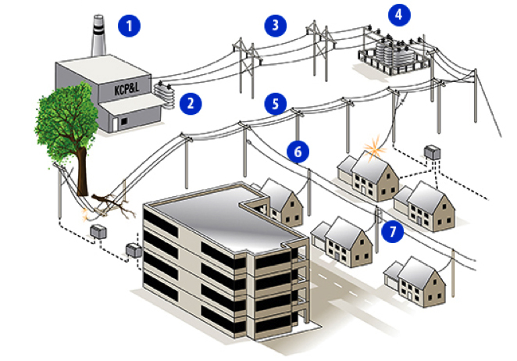
Storm Restoration – Prioritization

Slide 35
Dry Ice
Cindy Circo
Public Affairs Manager

Slide 36
Dry Ice Engagement
Pre-Storm
Post-Storm
Activation Emergency Support Volunteer Team
Communication
Training for KCP&L volunteers:
Handling of dry ice
Distribution & Traffic flow
Personal Protective Equipment (PPE)
Personal Safety
Triggers for activation:
Storm path or footprint of outages
Accessibility & availability of safe distribution sites
Availability of dry ice
Activation of Emergency Support Volunteer Team (ESV):
Alert email sent to ESV
Dry ice ordered
Site coordinated
Notify ESV of time & place
Media Team informs the public:
Contact media outlets
Communicate info on KCP&L’s social media outlets
Update KCP&L website with Dry Ice event details

Slide 37
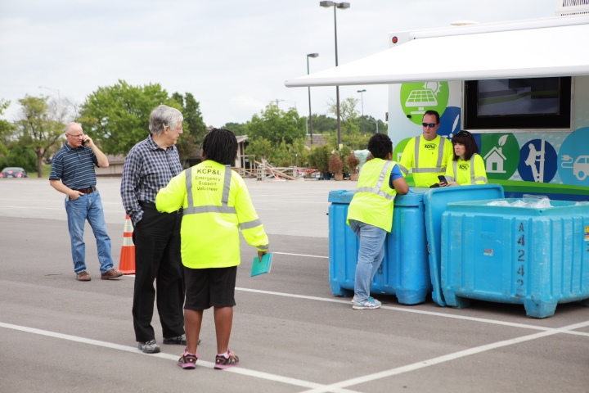
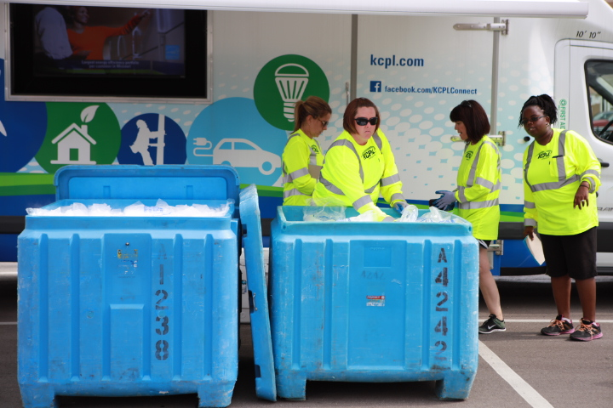
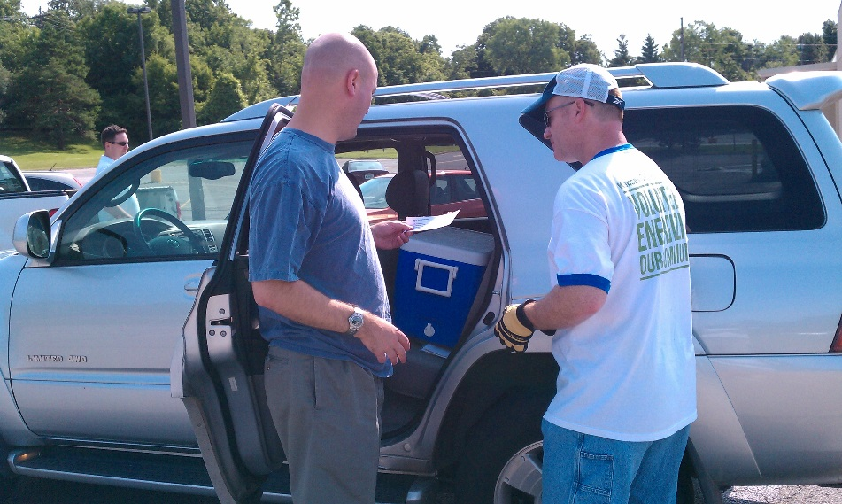
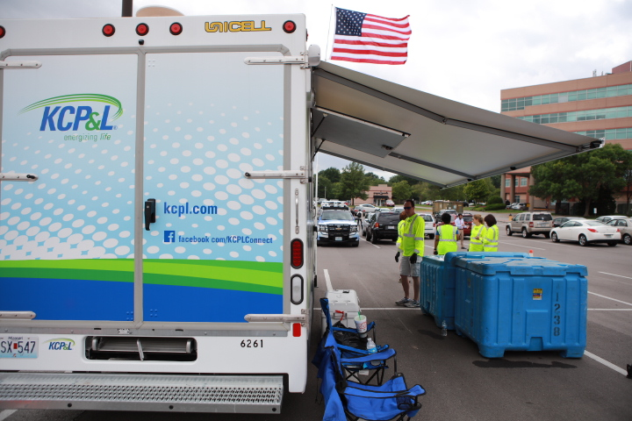

Slide 38
Communications
Rebecca Galati
Communication Specialist II

Slide 39
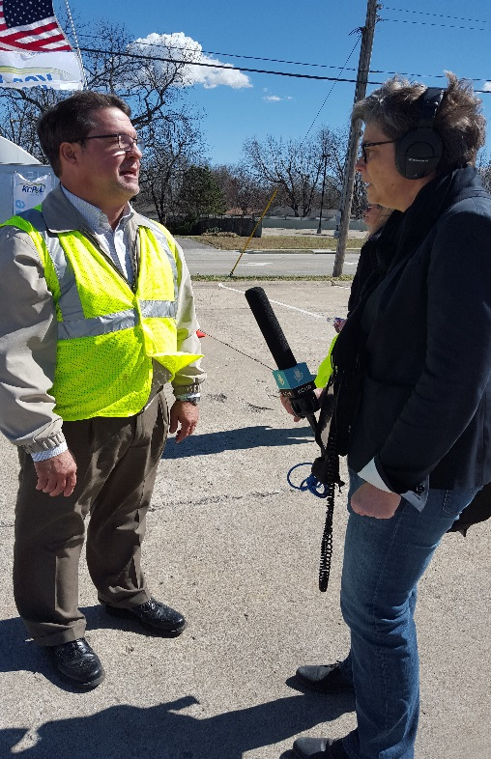
Storm Mode – Customer Communications
Advanced Notice
  Update and highlight relevant webpages
  Send a customer email
  Post on social
  Send press release
Storm Mode
  Update and highlight relevant webpages
  Post on social
  Media events
    Interview with Subject Matter Expert
    Footage of crews working

Slide 40
Storm Safety Talking Points
Please remind customers to report a power outage at their homes or businesses to call 1-888-544-4852 (LIGHTKC) or report online at: www.kcpl.com/reportoutage.
Storm tips:
For a list of warming (or cooling) centers in your area please call 2-1-1.
Never touch or attempt to pick up a fallen power line. Assume any downed power line is energized. If you see a downed power line, call KCP&L immediately at 1-888-LIGHTKC.
During an outage do not open your refrigerator or freezer more than necessary. Undisturbed food will remain frozen in most freezers for up to 48 hours.
If using a portable generator during an outage, follow the manufacturer’s safety and operating guidelines. Operate the generator in a well-ventilated area; never indoors or your garage. Dangerous carbon monoxide fumes can build up and cause serious injury or death.
For more information and tips visit: www.kcpl.com/storms.

Slide 41
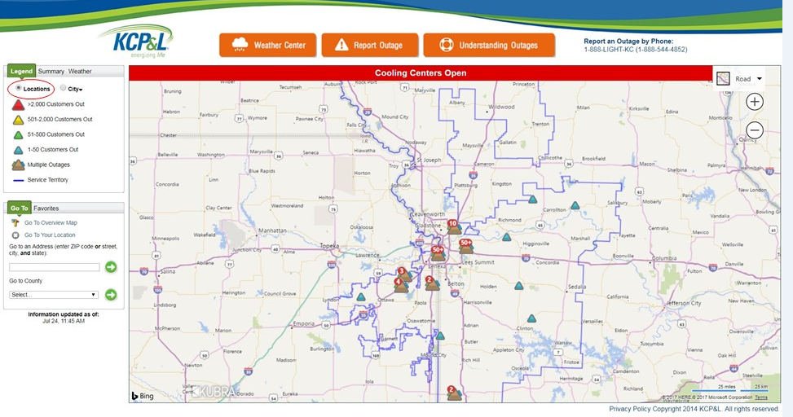
Outage Map by View: Location

Slide 42
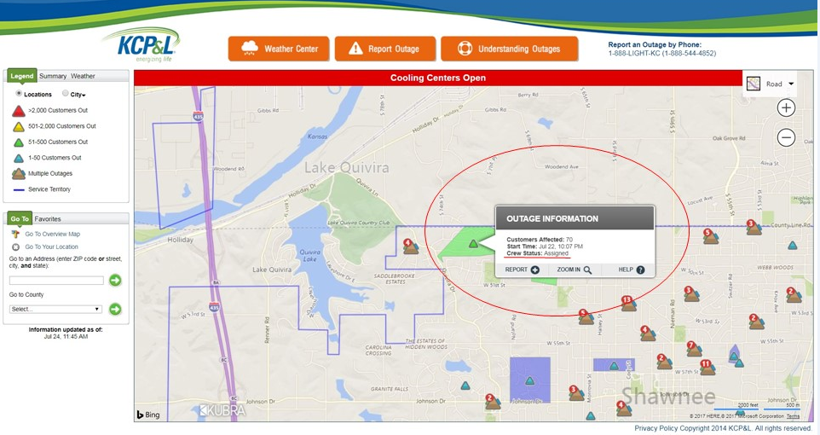
Outage Map by View: Location cont.

Slide 43
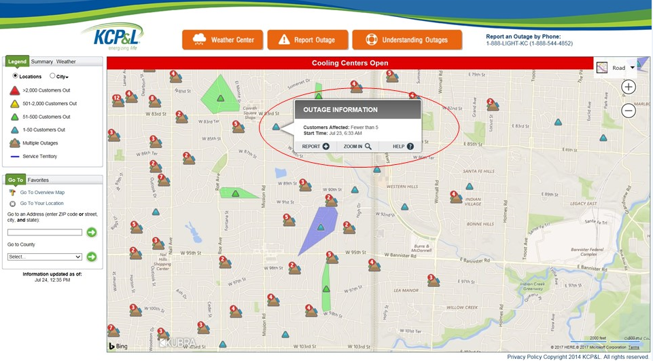
Outage Map by View: Location cont.

Slide 44
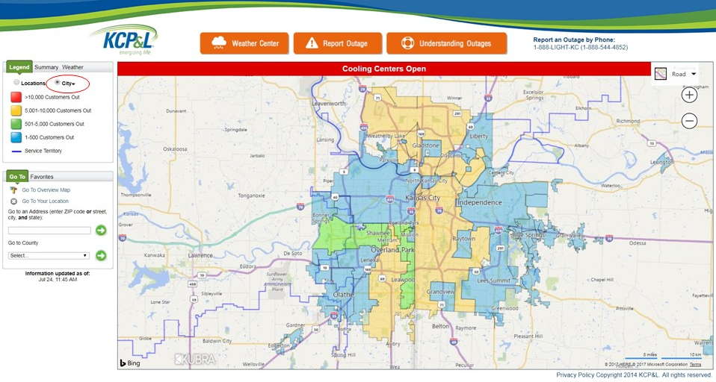
Outage Map by View: County/City

Slide 45
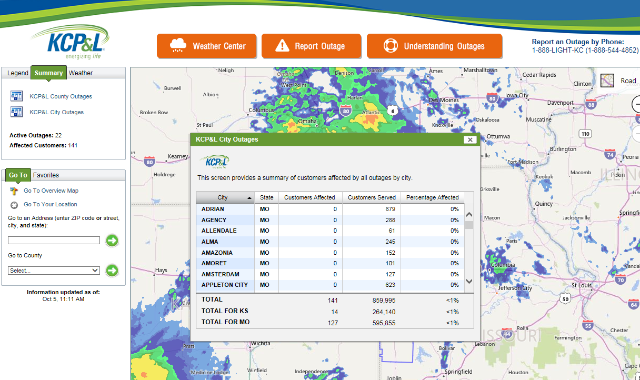
Outage Map by Summary: City

