Slide 1


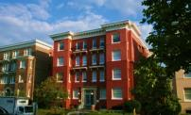


Improving Energy Efficiency in Affordable Multifamily Housing
Annika Brink
October 21, 2014

Slide 2
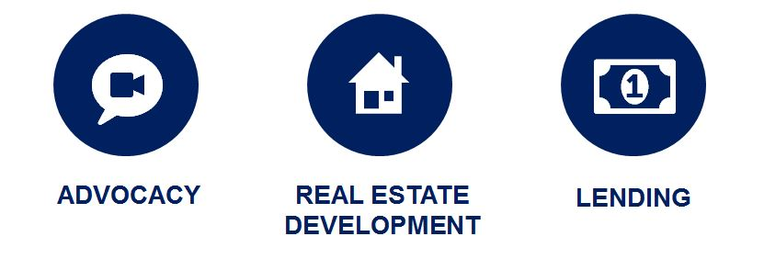
National Housing Trust
NHT protects and improves existing affordable rental homes so that low income individuals and families can live in quality neighborhoods with access to opportunities.
$


Slide 3





Goal of the “Energy
Efficiency for All” Project
Making multifamily homes affordable and
healthy through energy efficiency.
Stakeholders + Programs + Owner Demand

Slide 4
Where will utilities find savings as programs continue to expand?
Credit: ACEEE

Slide 5
Significant opportunity to better serve the multifamily market
Utility spending on targeted multifamily programs relative to housing markets
Credit: ACEEE

Slide 6
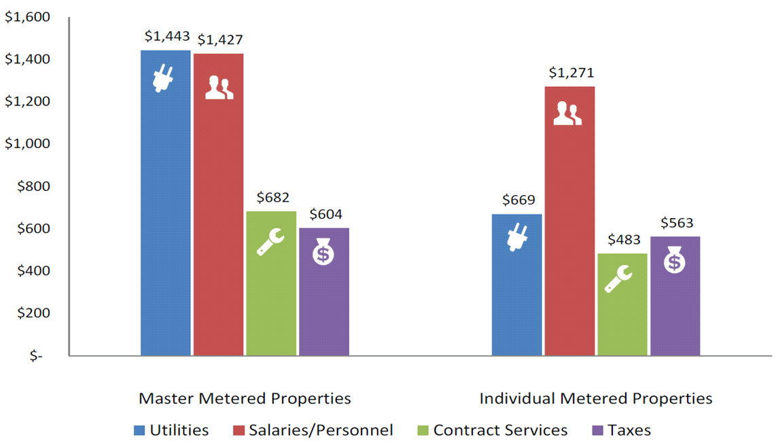
Energy costs present the best opportunity to reduce operating expenses and help sustain affordable housing.
Credit: NAA

Slide 7
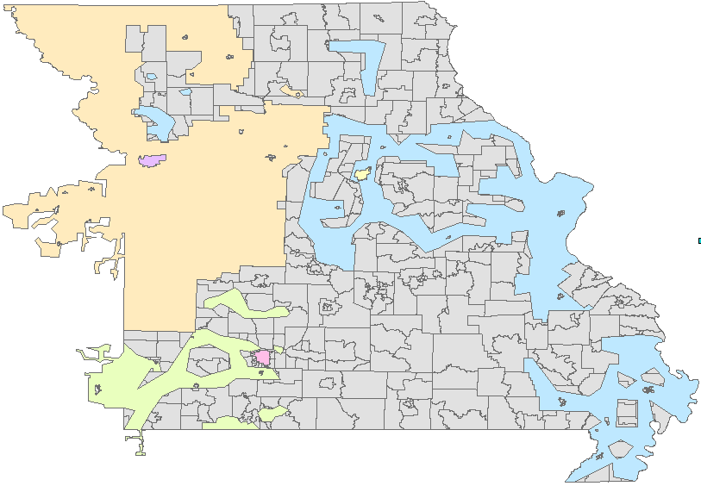
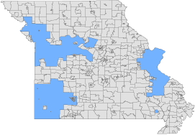
Size of the opportunity
 | MF | Aff MF
State | 380,000 | 221,000
Ameren | 186,000 | 92,000
KCP&L | 104,000 | 69,000
Springfield | 18,000 | 14,000
Empire | 17,000 | 9,000
Independ. | 10,000 | 7,000
Columbia | 10,000 | 6,000
Elsewhere | 37,000 | 24,000
221,000
157,000

Slide 8
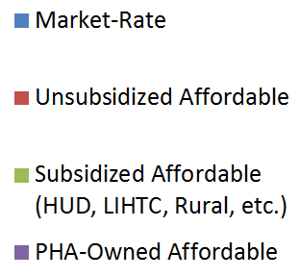
Multifamily Apartments in MO
380,000 units
Affordable

Slide 9

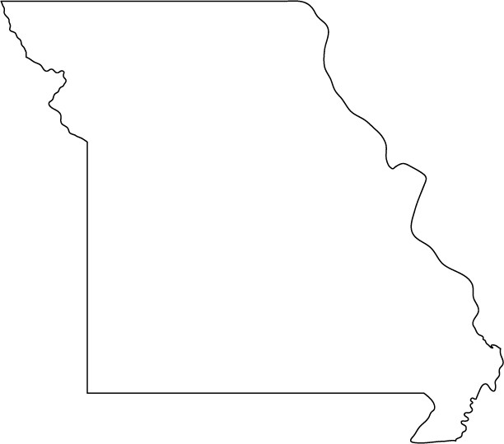
Potential energy and bill savings
Potential analysis forthcoming…
For now, a rough estimate can be based on a survey of 57 buildings participating in an affordable multifamily one-stop shop program in Illinois…
Up to -30%
Average -$195 per year
Across 221,000 units
$4.3 million per year

Slide 10
Local stakeholders working together
Kansas City
St. Louis Area (MO & IL)
Diverse stakeholder engagement
Convening in December
Potential integration with city efforts, e.g. financing and benchmarking
Diverse stakeholder engagement over…
5 convenings (#5 on 10/29)
Launched by Commissioners and St. Louis Mayor
Ameren MO/IL and Laclede
Consensus white paper

Slide 11

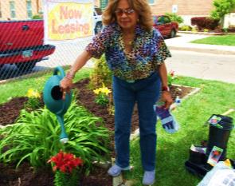
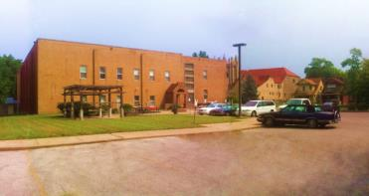
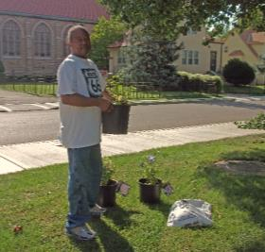

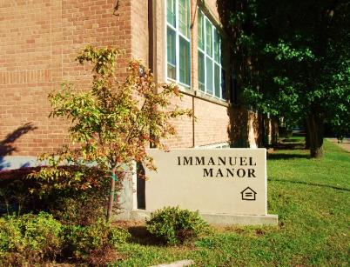

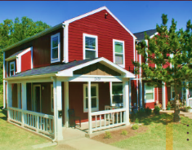
Kansas City Partner:

Slide 12

























St. Louis Network

Slide 13
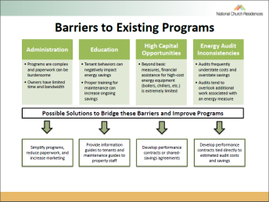
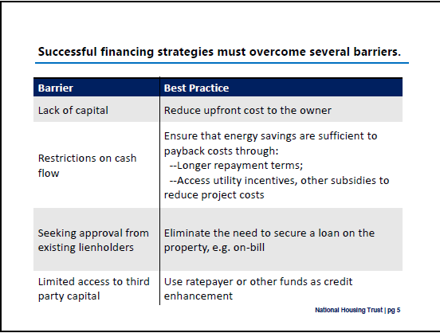
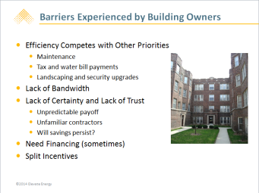
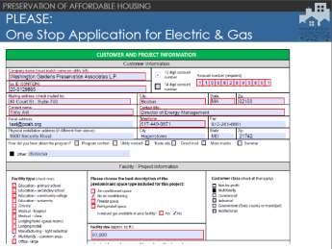
Learning from each other

Slide 14
Consensus barriers and potential solutions have emerged
Barriers
Financing
Cross-program coordination
Program user-friendliness
Eligibility
Information/education
Scale of programs
Restrictive cost-effectiveness tests
Misaligned incentives

Slide 15
Consensus barriers and potential solutions have emerged
Potential Solutions
Comprehensive, easy-to-use programs to capture all cost-effective energy savings
Eliminate financing barriers and provide financing products to fill funding gaps
Help owners measure energy use and assess the financial case for efficiency retrofits
Improve collaboration among energy efficiency and housing program providers

Slide 16
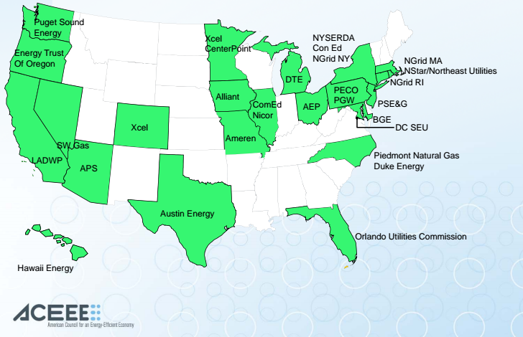
Utilities actively engaging on MF

Slide 17
A National Affordable Multifamily EE Network: sharing recent lessons and success stories across states
MI | Consumers Energy $400k pilot to benchmark energy usage of 1,200 units/79 bldgs.
IL | $4.7MM in new funding for affordable MF (via State Energy Office & IL Pwr Auth.) ComEd offering online landlord portal for aggregate energy usage data
MD | MD HFA (DHCD) administers utility low-income multifamily programs PSC changes cost-effectiveness test, allowing 40% more savings per property
PA | PUC requires Philadelphia Gas Works to design its first ever low-income MF program.
CA | $35MM/year allocation to affordable MF Wx via utility-funded environmental fund Low-income proceedings result in MF-friendly program design changes, including focus on whole-building measures, cost-effectiveness reform, streamlined income verification, coordination with state agencies, & single point of contact for owners
RI | State Energy Office creates working group to advise National Grid’s MF program
NY | Long Island Power Authority proposes $13MM carve-out for affordable multifamily
NJ | PSE&G requests $39MM expansion of affordable multifamily program (incl. on-bill)
CO | PUC approves 10% co-benefits adder and 25% low-income co-benefits adder

Slide 18
For more information
Annika Brink
National Housing Trust
abrink@nhtinc.org
202.333.8931, ext. 141
www.nhtinc.org
  @NatlHsingTrust

Slide 19
Appendix

Slide 20
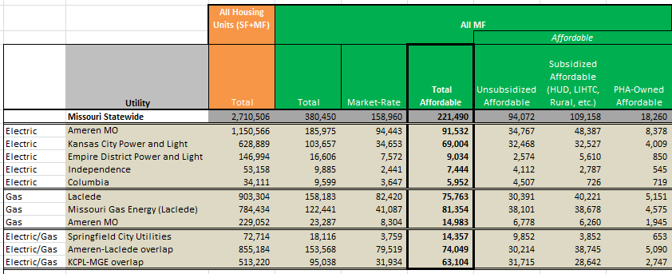
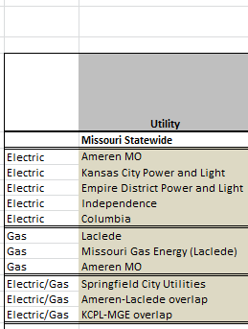
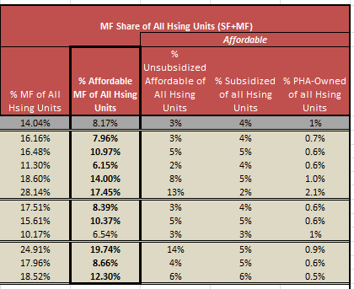

Slide 21
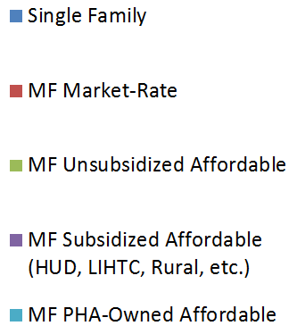
Size of MO opportunity and MO synergistic policy goals, e.g. poverty, housing, jobs
380,000

Slide 22
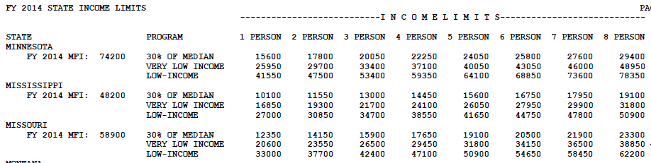
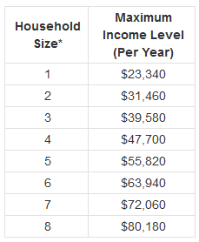
Low-income = 80% of AMI
MO Weatherization eligibility = 200% of poverty
Notes:
AMI: http://www.novoco.com/low_income_housing/facts_figures/income_limits.php
Federal poverty level: http://familiesusa.org/product/federal-poverty-guidelines
MO weatherization: http://www.benefits.gov/benefits/benefit-details/1864

Slide 23
Missouri Public Service Commission Statewide Collaborative
Annika Brink, National Housing Trust
October 21, 2014

Slide 24




Improving Energy Efficiency in Affordable Multifamily Housing

