Slide 1


Vehicle-Grid Integration
Joe Halso
Missouri PSC Workshop
May 25, 2016
Notes:
1
1

Slide 2

Clarification of Terms
Vehicle-Grid Integration: Scheduling, planning, or varying EV charging reduce impact or provide benefits.
  Rate Design: special rates for EV charging (TOU, dynamic, etc.)
  V1G: Using VGI communications to effect unidirectional demand response at peak demand periods.
  V2G: Using VGI communications and bidirectional charging technologies to provide DR and ancillary services.

Slide 3
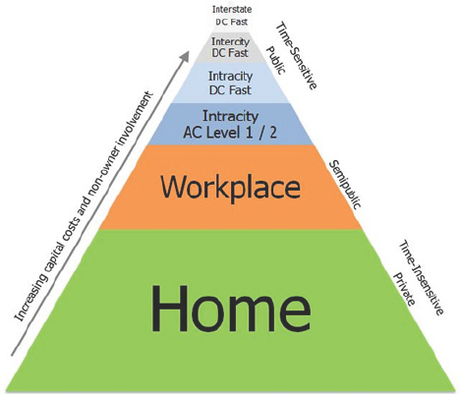
Siting Charging to Optimize Grid Benefits

Slide 4
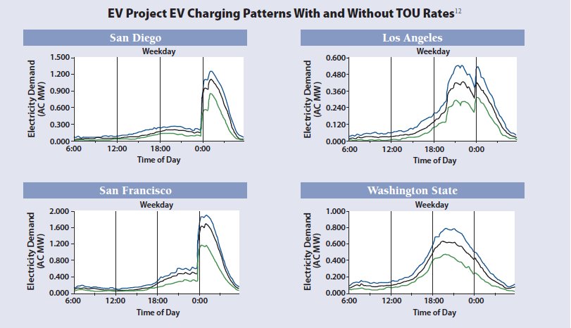
Effects of Rate Design

Slide 5
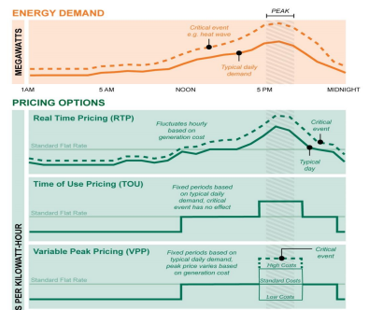
Examples of Time-Variant Rate Design

Slide 6
V1G: Demand Response
DR historically relied on large commercial customers, times are a-changin’
EV owner/operator contracts with utility or third party
EV owner/operator cedes level of control over charging in exchange for $
Utility/3rd party can modulate or curtail charging
SCE & PG&E commitment to EV-specific DR programs

Slide 7
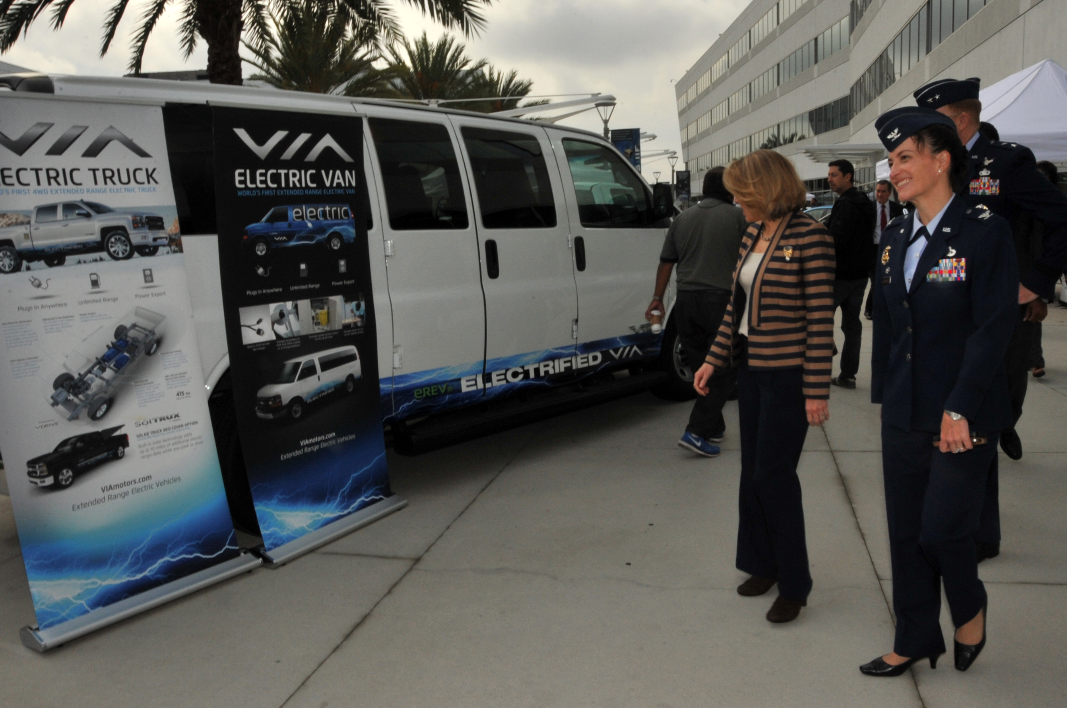
V2G: Vehicle-to-Grid

Slide 8
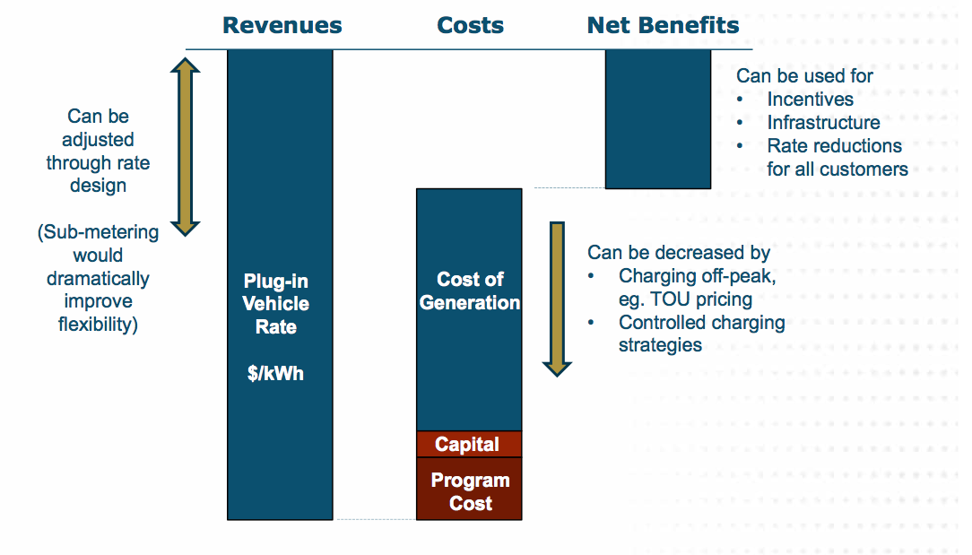
Ratepayer Impacts

Slide 9
Sierra Club position
PSC should proactively support growth of and access to EV charging, including utility cost recovery, so long as utilities can demonstrate benefits to the electricity grid, EV drivers and the body of utility customers

Slide 10
Thank You
Notes:
10
10

