Slide 1
Cyber Security Background Material

Slide 2
Content
Cybersecurity Threats/Attacks
Avenues of Attack
Threat Actors

Slide 3
Types of Cyber Attacks

Slide 4
Summary – Types of Cyber Attacks
There are many different types of cyber attacks, and the threat landscape is continually evolving with new types of threats emerging, and variations of previous attacks creating a continually changing threat landscape, vary by industry
Cyber threats remain the same year over year while threat actors are becoming more sophisticated.
Ransomware continues to be a prevalent form of cyberattack. These attacks often begin due to successful email phishing with the malware itself being available for purchase for $20-$30. Executed at a large volume, even if a small fraction of victims pay the ransom (often $250-$300), it becomes a very profitable business.
KCP&L has a solid mix of security tools that are very efficient in blocking nearly all known forms of malware. We continue to work to improve the program through savvy investments.
We may need to invest in additional human resources to manage those tools more effectively and respond quickly to security incidents.
We need to develop and implement a data loss prevention strategy.

Slide 5
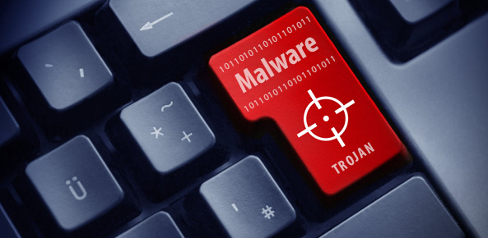
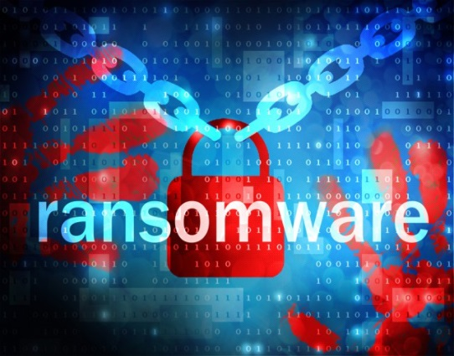
Common Cyber Attacks
Malware
Broad term that encompasses many varieties of attacks of varying levels of sophistication, risk, and harm
described as trojans, viruses, worms
installed on individual workstations, network storage, and removable media (e.g. storage cards, thumb drives)
Dangerous examples:
Keyloggers - capture all user keystrokes to allow an attacker undetected access (used in the Ukraine attack)
Ransomware - locks a workstation and often encrypts the files making them inaccessible, demands a ransom to receive an electronic key to unlock

Slide 6
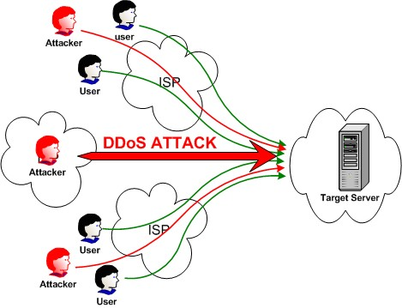
Common Cyber Attacks
Denial of Service (DDoS)
Flooding of internet access point (network) to effectively shutoff inbound/outbound access
Now a very common approach
Readily “available for hire”
We have experienced these “attacks” several times on a limited basis and have successfully defended ourselves
Have tools and services in place to address based on severity
Metrics in place to monitor trending over time

Slide 7
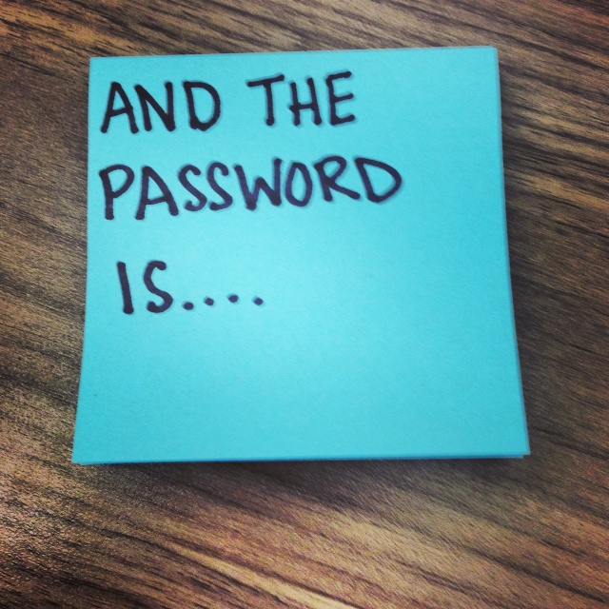
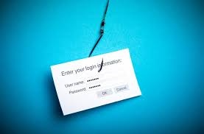
Common Cyber Attacks
Password Attacks
A brute force approach that attempts to “figure out” a user password through an iterative, automated persistence
Best mitigations include account lock-outs upon failed attempts, minimum password complexity, and multiple layers of authentication
Phishing
Still the most common and effective way to deliver malware
Having a good email scanning solution is imperative
goroyals

Slide 8
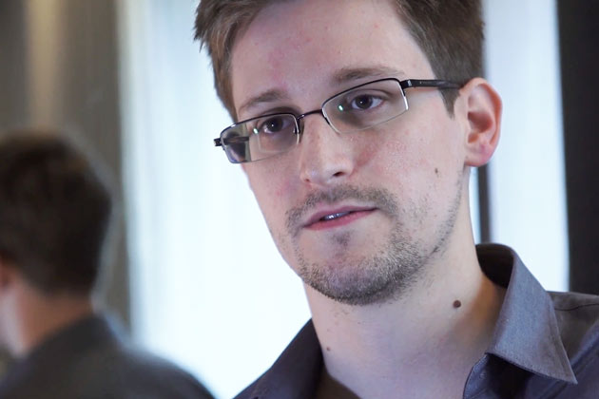
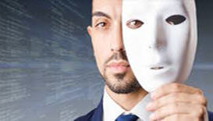
Common Cyber Attacks
Insider Threat/Attack
An attack at the hands of a resource with legitimate access to a corporate system/asset (employee or third party)
Background checks are best example of prevention/mitigation but many insiders have no past record
Multi-factor access and continuous monitoring of access and activities is required

Slide 9
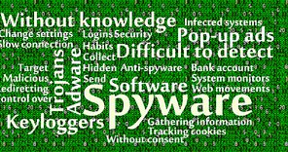
Common Cyber Attacks
Advanced Persistent Threat (APT)
Involves carefully planned planting of seed(s), often forms of malware that will be harvested/exploited at a future point
Typically occurs over a long period of time until attacker is “ready” to initiate attack

Slide 10
EEI Industry Threat Model
EEI staff and member companies developed a list of nine top security threats facing electric utilities in 2012, and added a tenth in early 2013.
Intended to create executive awareness and stimulate further consideration of preparedness, prevention, response and recovery activities.
Below are the top threat scenarios that were chosen in consultation with EEI staff and member companies:
Coordinated Cyber Attack
Advanced Persistent Threat
Disruption of Voice & Data Services
Coordinated Physical & Cyber Attack
Insider Sabotage
Pandemic
Supply Chain Disruption or Compromise
Catastrophic Human Error
Intentional Electromagnetic Interference
Distributed Denial of Service (DDoS)

Slide 11
Avenues of Attack

Slide 12
Summary – Avenues of Attack
The internet serves as the primary means of gaining access to conduct a cyber attack, often preying upon human behavior as the weakest link in cyber defenses.
Most cyber attacks are carried out using the internet as the means of gaining access
Many cyber attacks prey upon human behavior to obtain the access necessary to achieve their goals
Humans are often the “weakest link” in the chain of defense and fall victim to a socially engineered “trap” leading to a personal or corporate cyber attack
Company cyber defenses can be undermined by some external threats posed by third parties, insider threats, and supply chain vulnerabilities

Slide 13
Avenues of Attack – Third Party
Third parties are often granted access to internal systems that they support, maintain or utilize
The Target breach originated from a third party from which access credentials were acquired
Mitigations include background checks, creation of secure access methods, contractual provisions, and multi-layer authentication
SMB providers invest less in security

Slide 14
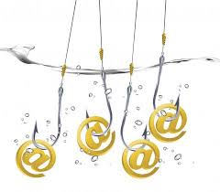
Avenues of Attack - Email
Phishing
Many breaches start from phishing
Compromised credentials
Ukraine started from spear phishing
Spam
90% of email traffic
Many contain malware or links that go to infected sites

Slide 15
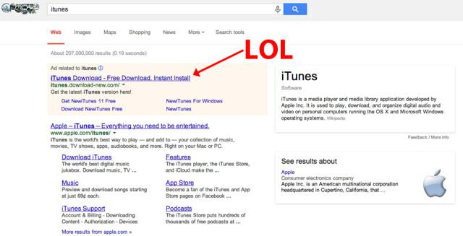
Avenues of Attack – Use of Web
Drive by downloads
Legitimate sites serving malware
Superbowl site in 2012
Watering Hole attacks
Targeted at a specific group
Can capture a large number of victims in a very short time

Slide 16
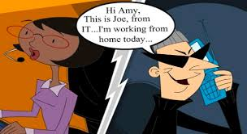
Avenues of Attack – Social Engineering
Social engineering is the art of manipulating people so they give up confidential information. Examples include:
Phone Calls - attempts to obtain personal or confidential information directly or by asking the recipient to take actions leading to data exfiltration
Emails – phishing is also an example of social engineering
Baiting – creating a “trap” that tempts someone into taking action

Slide 17
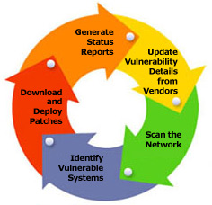
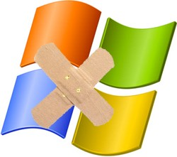
Avenues of Attack - Vulnerabilities
Many software systems are dependent upon third party programming language and tools that contain vulnerabilities
New vulnerabilities are continually being discovered and exploited by cyber attackers
An aggressive patching program is required to remediate known vulnerabilities
Systems without vendor support do not have security patches available and represent a significant risk

Slide 18
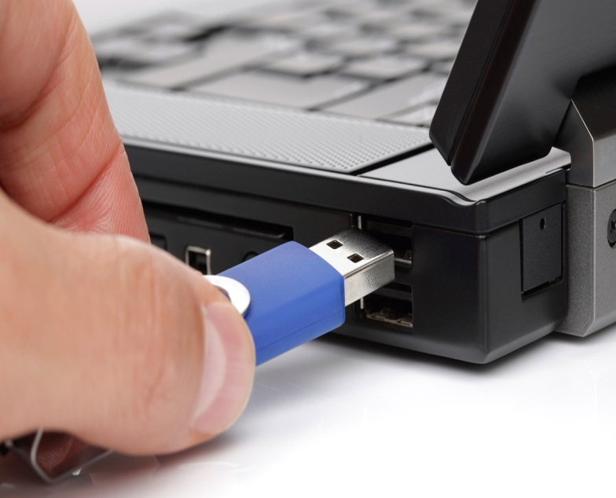
Avenues of Attack - Insiders
An attack at the hands of a resource with legitimate access to a corporate system/asset (employee or third party)
Most breaches involve insiders, wittingly or unwittingly
Falling victim to an email phish renders the individual “an insider” from the perspective of how the attack originated
In some cases, third parties can infiltrate an organization with the intent of levying sabotage

Slide 19
Threat Actors

Slide 20
Summary – Threat Actors
The motivations, levels of threat and sophistication, and threat by industry all vary across the types of cyber attackers known as threat actors.
The motivations of threat actors vary from financial gain (organized crime) to political and personal motives (nation states, hacktivists, insiders
The level of sophistication often varies by threat actor, often proportional to the level of financing supporting the attackers
The threat actors posing the greatest risk to utilities are generally believed to be nation states and insider threats
The primary motivation to attack utilities is not financially driven (as with the retail sector), but to demonstrate the capability to inflict significant operational impact to bulk electric system

Slide 21
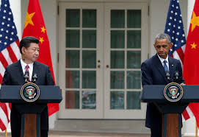
Threat Actors – Nation State
Usually politically motivated
The Ukraine power system was attacked twice, the second attack was much more sophisticated
China, Israel and North Korea are becoming frequent offenders

Slide 22
Threat Actors - Insiders
People with approved access but inappropriately using information
Most breaches involve insiders, wittingly or unwittingly
Falling victim to an email phish renders the individual “an insider” from the perspective of how the attack originated
Insiders can sometimes be “planted” for the purpose of performing sabotage

Slide 23
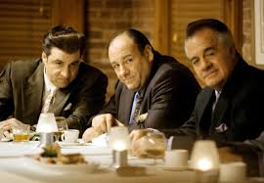
Threat Actors – Organized Crime
Normally seeking financial gain through theft
Best funded IT organizations in the world
Theft of personal data including credit cards, personal identifiable information (identity theft), and intellectual property (espionage) are often the motivations of organized crime
Most significant ransomware attacks are from highly organized syndicates

Slide 24
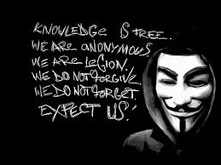
Threat Actors - Hacktivist
Believe what they are doing supports a cause or is justified
Known as cyber-terrorists
Children’s Hospital in Boston was shut down in 2015 by Anonymous via a denial of service attack

Slide 25
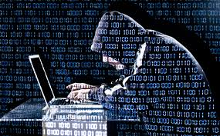
Threat Actors – Rogue Actors
Looking to disrupt service or operations
Typically opportunistic with no specific goals
Typically not elaborate in their attacks
Often seeking personal satisfaction

