Slide 1


Electric Vehicles & Environmental Impacts
Joe Halso
Missouri PSC Workshop
May 25, 2016
Notes:
1
1

Slide 2

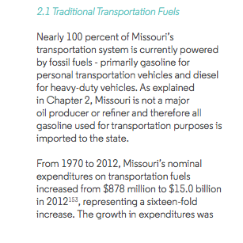
Transportation Scale

Slide 3
Air Pollution Impacts

Slide 4
On the Ground Impacts of Air Pollution
MIT study estimates 1,192 premature deaths occur each year due to PM 2.5 and ozone from tailpipe emissions
In St. Louis, 235 premature deaths each year
In Kansas City, 199 premature deaths each year

Slide 5
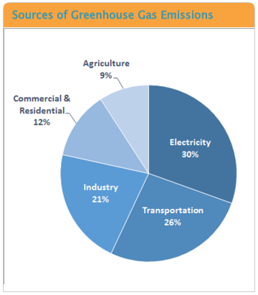
GHG Emissions

Slide 6
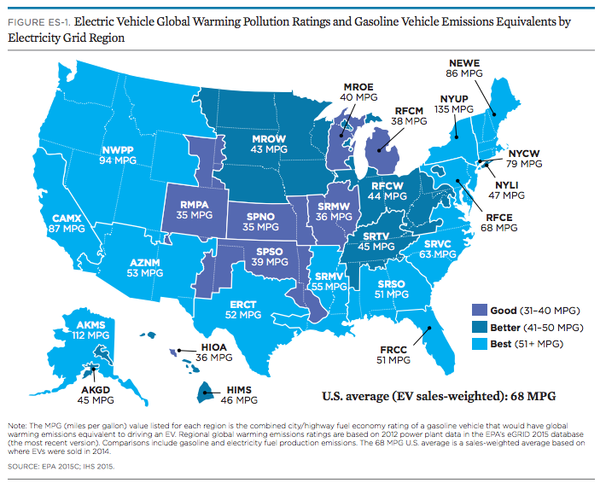
EV MPG Equivalency by Grid Region

Slide 7
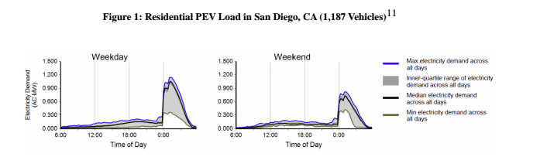
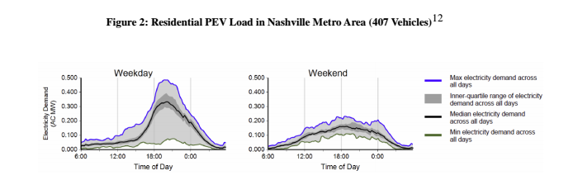
Load Management for Environmental Benefits

Slide 8
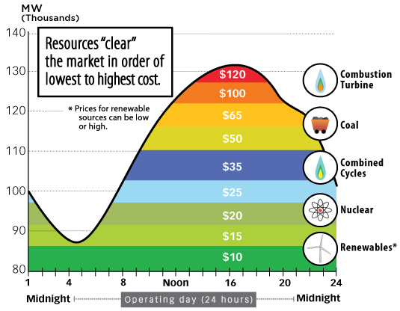
Generation Resource Constitution

Slide 9
Matching EV Load and Renewable Generation

Slide 10
Thank You
Notes:
10
10

Slide 11
Vehicle-Grid Integration
Joe Halso
Missouri PSC Workshop
May 25, 2016
Notes:
11
11

Slide 12
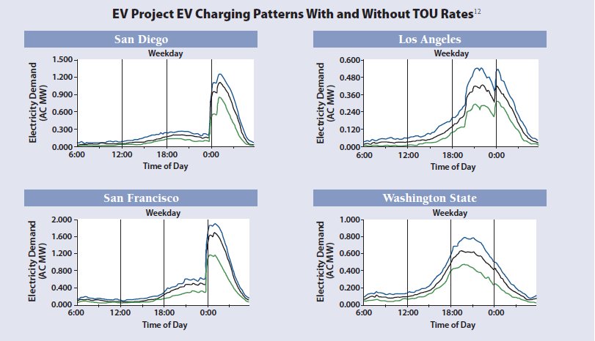
Load Management for Environmental Benefits

