Slide 1
Iatan Generating Station
Mark Howell - Sr. Director, Iatan & Lake Road
Jared Morrison – Director, Environmental Services
August 21, 2023
Restricted - Confidential

Slide 2
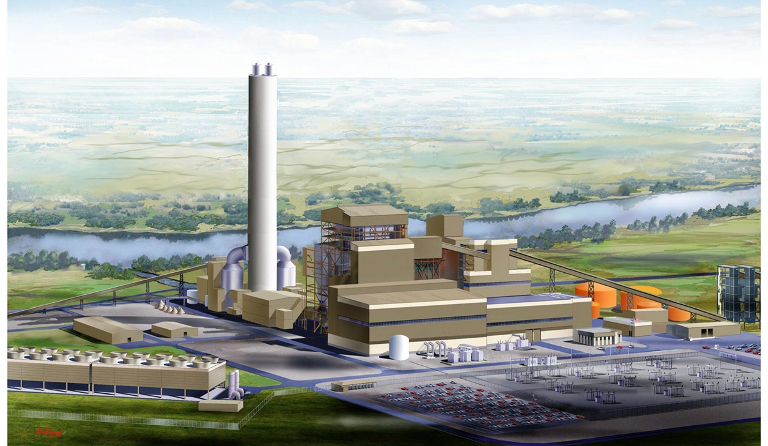
Iatan Generating Station
2
Iatan Generating Station Tour

Slide 3
Safety
Wear Personnel Protective Equipment (PPE): glasses, hard hat, and hearing protection
Do not separate from group
Stay clear of areas with red flashing lights, safety tape and warning signs
Equipment can start without warning
Evacuation procedures
Ammonia is on site
Safety is our Top Priority

Slide 4
Evergy Generation Mix

Slide 5
Evergy Generation Mix

Slide 6
Iatan Background Information

Slide 7
Iatan Background Information
Iatan – Nickname of OTOE tribe Chief who lived from 1780 – 1837
Iatan is situated on a 3,000-acre site adjacent to the Missouri River
The Iatan site has 2 coal-fired electric generating units – Iatan 1 & Iatan 2
Iatan has a coal inventory target of 1.2 M tons. We consume approximately 21,000 tons of coal a day with both units at full load.
135 car trains deliver 16,000 tons of coal per cycle. It takes 5 – 6 hours to unload a train.
Iatan was named after the nickname of an OTOE tribe Chief

Slide 8
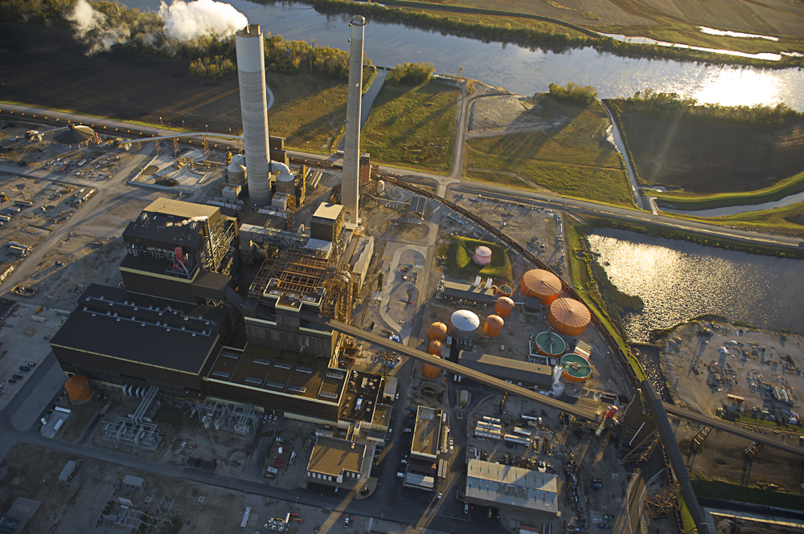
Iatan Site Overview
Unit 2
Unit 1

Slide 9
Iatan Station Ownership Overview
Year Completed | Location | Energy Source | Total MW | Evergy Metro MW | Evergy Missouri West MW | Evergy Total MW | Operator | Other Owners | Other Owners | Other Owners
1980 | Iatan, MO | Coal | 694 | 486 (70%) | 125 (18%) | 611 (88%) | Evergy | Liberty Utilities 83 MW (12%)
2010 | Iatan, MO | Coal | 900 | 465 (51.7%) | 125 (18%) | 611 (72.7%) | Evergy | Liberty Utilities 108 MW (12%) | Missouri Joint Municipal Electric Utility Commission – MJMEUC 106 MW (11.76%) | KEPCO 30 MW (3.53%)

Slide 10
Iatan Background Information
Iatan is one of the cleanest coal stations in the country
Flue Gas Desulfurization (FGD) system removes greater than 95% of the Sulfur Dioxide (SO2) in the flue gas
Selective Catalytic Reduction (SCR) removes 66 % on Iatan 1 and 50% on Iatan 2 of the Nitrous Oxide (NOx)
Mercury (Hg) is removed with Powder Activated Carbon (PAC) and Flue Gas Desulfurization (FGD) to greater than 90%
Particulate is controlled with Fabric Filters with greater than 99% ash removal efficiency
Iatan Air Quality Control System (AQCS) and Unit 2 were designed as Zero Liquid Discharge (ZLD) facilities
Iatan is one of the cleanest coal stations in the country

Slide 11
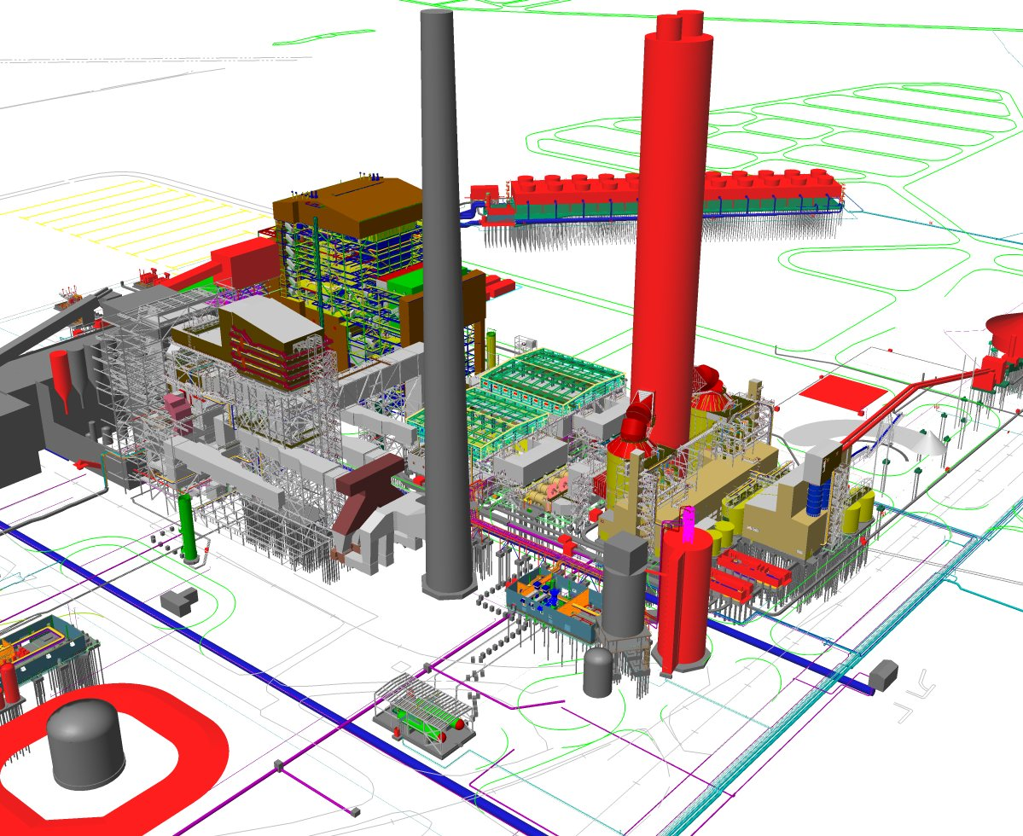
Iatan AQCS Layout
U1
U2
New Chimney
U2 Boiler
U2 Cooling Towers
U2 SCR
U1 Boiler
U1 SCR
Fabric Filters
U1 U2
Reagent Prep Building
Ammonia Tanks

Slide 12
Iatan 1
Commercial operation in 1980. 694 MW net generation
Babcock & Wilcox Subcritical Boiler
General Electric Turbine/Generator
Unit 1 burns approximately 8,500 tons of coal per day
Main Steam Conditions – 4,900,000 pph @ 2,400 psi, 1005 deg. F.
Condenser cooling from the Missouri River – 300,000 gpm
Iatan 1 went into Commercial Operation in 1980

Slide 13
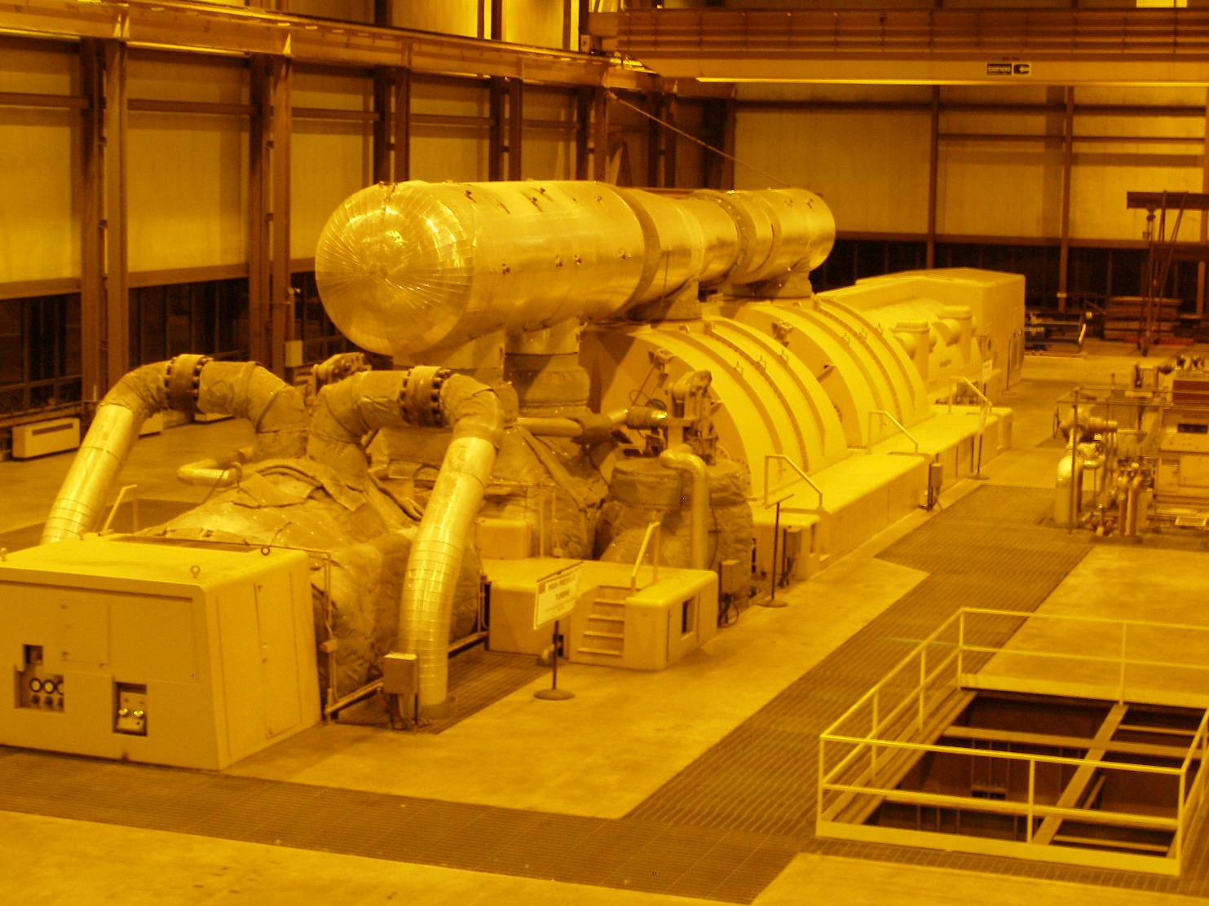
Iatan 1 Turbine-Generator

Slide 14
Iatan 2
Commercial operation in 2010. 900 MW net generation
Alstom Supercritical Boiler
Toshiba Turbine/Generator
Unit 2 burns 12,500 tons of coal per day
Main Steam Conditions – 6,200,000 pph @ 3,600 psi, 1080 deg. F.
Condenser cooling from well water circulated through a cooling tower
Iatan 2 went into Commercial Operation in 2010

Slide 15
Iatan 2 Turbine-Generator

Slide 16
Coal Inventory Update

Slide 17
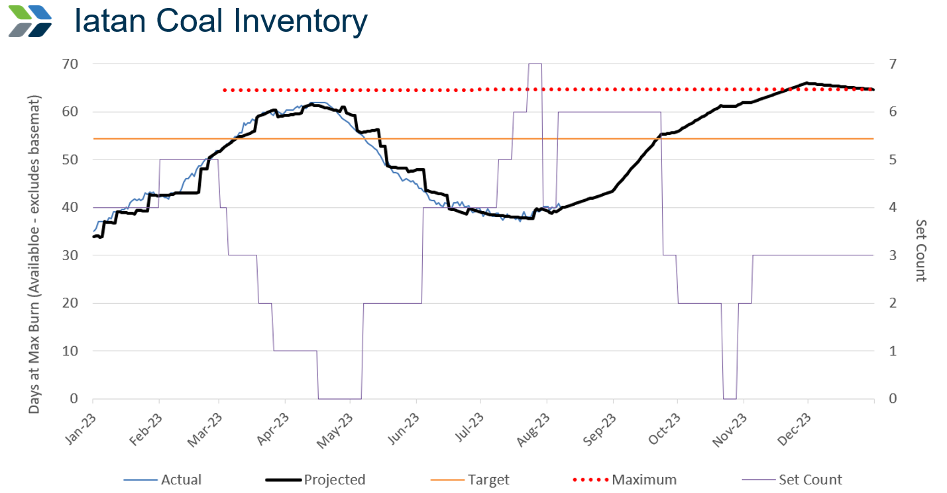
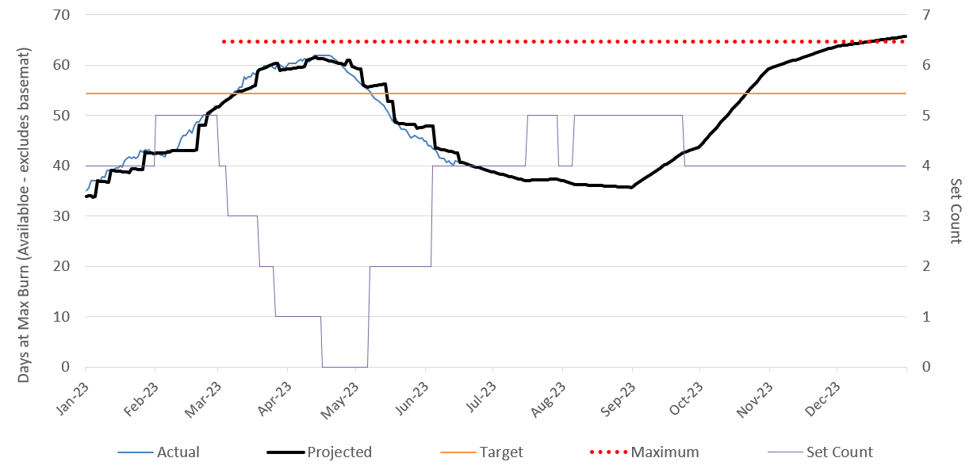
Iatan Coal Inventory
Restricted - Confidential

Slide 18
Seasonal Operations Update

Slide 19
Seasonal Operations
Iatan 1 was place is seasonal operations in the Spring of 2023
From March 1, 2023 to May 9, 2023
Less wear and tear on equipment due to cycling the unit on and off during shoulder month operation

Slide 20
Missouri River Drought Resiliency Update

Slide 21
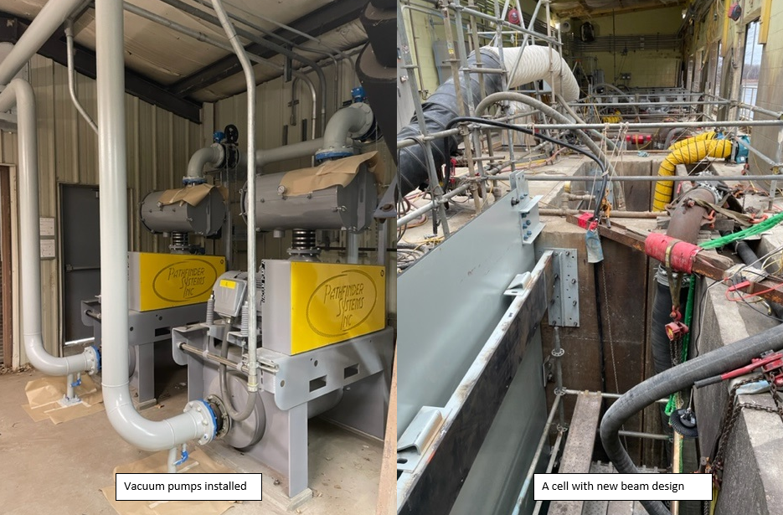
Missouri River Drought Resiliency
Iatan 1 River Intake Vacuum Lift System
(2) 50 HP vacuum pumps added, achieve ~3.5psi vacuum (7ft water column)
Vacuum walls added intake side of screens
Reinforced structure to retain load ratings
Installed during the Fall 2022 Outage and was operational for the winter

Slide 22
Environmental Update

Slide 23
Environmental Update
Proposed Greenhouse Gas Regulation
Good Neighbor State Implementation Plan Stay/Status of Good Neighbor Federal Implementation Plan
Proposed Updates to the Mercury and Air Toxics Standards (MATS) Regulation
Regional Haze Regulations – 2nd Planning Period
Effluent Limitation Guidelines
River Intake Requirements (Clean Water Act 316(a))
Thermal Discharge Requirements (Clean Water Act 316(b))
Coal Combustion Residuals Regulation – Legacy Units
EPA is continuing to modify existing regulations and propose additional regulations for electric generating facilities

Slide 24
Proposed EPA GHG Standard Overview
On May 23, 2023, EPA published proposed greenhouse gas standards and guidelines for fossil fuel-fired power plants
Proposal would set CO₂ limitations for new gas-fired combustion turbines, existing coal, oil and gas-fired steam generating units, and certain existing gas-fired combustion turbines
Represents latest in a series of similar proposals made over the years which included the Clean Power Plan (CPP) and Affordable Clean Energy (ACE) rule
The proposed CO₂ limitations assume technologies such as carbon capture and sequestration/storage (CCS), hydrogen co-firing, and natural gas co-firing will be utilized
Existing coal-fired generation will be impacted
Emission limitations are effective beginning on January 1, 2030
Existing combined cycle generation could be impacted
Future simple and combined cycle generation may be impacted
Comments were due on August 8, 2023
Proposed regulation is extremely aggressive for both CO₂ reductions and implementation timeline

Slide 25
Coal Combustion Residual (CCR) Overview
Regulations first established in 2015 to regulate handling, disposal, and remediation associated with CCR or coal ash
Since 2015, Evergy has ceased operations of all coal ash ponds and either recycles CCR or disposes of it in landfills
In May 2023, EPA proposed the Legacy CCR Unit regulation to expand rule applicability to units closed prior to 2015
This regulation, if finalized, will require Evergy to reevaluate CCR disposal units closed under state regulation prior to 2015
Some units may require re-opening and reconstruction of cap
Regulation expected to be finalized in mid 2024
Proposed regulation would require Evergy to reevaluate CCR units previously closed under state regulation

Slide 26
Tour Route
Please be safe
Please stay close to the group
Open grating
Stay with your Tour Guide

